Slide 1
Substation and Distribution Automation
Module 2: Modeling of distribution level components

Slide 2
Module 2 Overview
Part 1: Overhead Lines
Part 2: Underground lines
Part 3: Three Phase Transformer Models
Part 4: Center –Tapped Transformers and Secondaries

Slide 3
Part 1: Overhead Lines
Series Impedance of Overhead Lines
Transposed Three-phase Lines
Untransposed Distribution Lines
Carson’s Equations
Modified Carson’s Equations
Primitive Impedance Matrix for Overhead Lines
Phase Impedance Matrix for Overhead Lines
Sequence Impedances
Parallel Overhead Distribution Lines
Shunt Admittance of Overhead Parallel Lines
General Voltage Drop Equation

Slide 4
Series Impedance of Overhead Lines
Critical step before the analysis of the distribution feeder can begin.
Resistance component of the conductors is typically taken from a look-up table (can be found in Appendix A of the text book)
The reactance comes from the inductive reactance (self and mutual) of the conductors. The inductive reactance is due to the magnetic field surrounding the conductors.

Slide 5
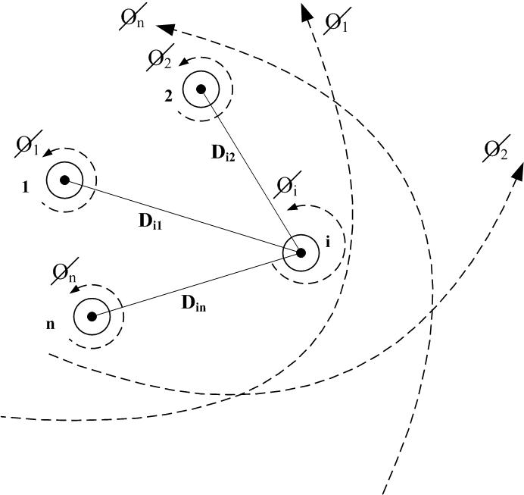
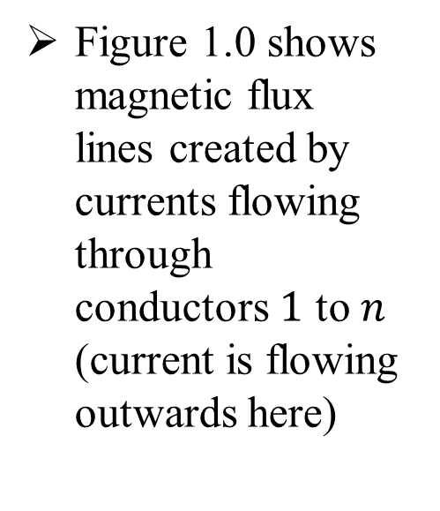
Series Impedance of Overhead Lines
Figure 1.0 shows magnetic flux lines created by currents flowing through conductors $1$ to $n$ (current is flowing outwards here)
Figure 1.0

Slide 6
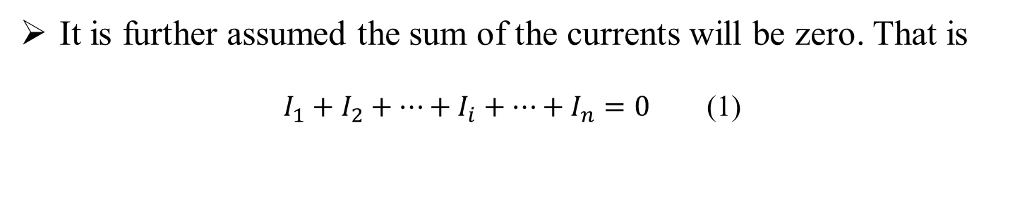
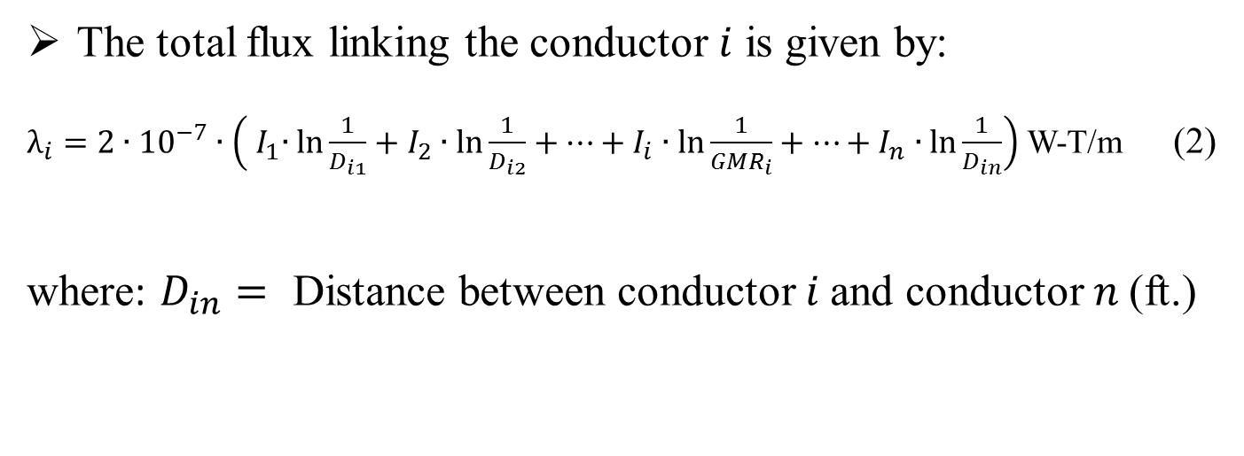
Series Impedance of Overhead Lines
It is further assumed the sum of the currents will be zero. That is
$I_{1}+I_{2}+⋯+I_{i}+⋯+I_{n}=0$ (1)
The total flux linking the conductor $i$ is given by:
$λ_{i}=2∙{10}^{−7}∙\left({ I}_{1}∙\ln{\frac{1}{D_{i1}}}+I_{2}∙\ln{\frac{1}{D_{i2}}}+⋯+I_{i}∙\ln{\frac{1}{GMR_{i}}}+⋯+I_{n}∙\ln{\frac{1}{D_{in}}}\right)$ W-T/m (2)
where: $D_{in}=$ Distance between conductor $i$and conductor $n$(ft.)

Slide 7
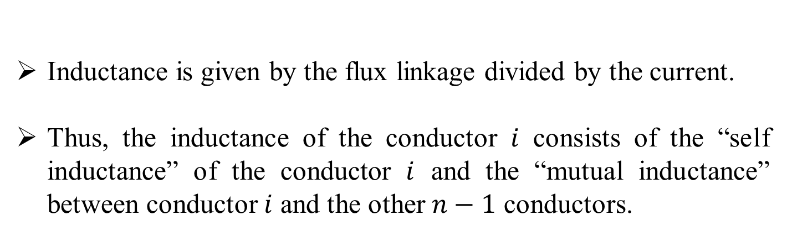
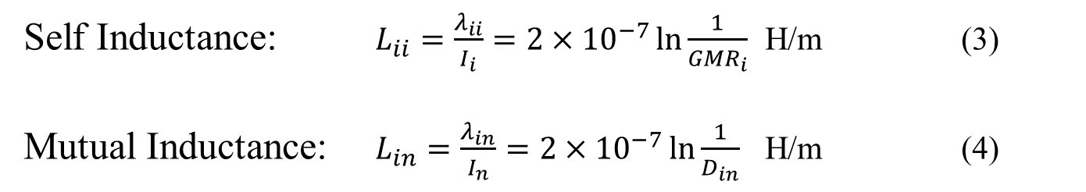
Series Impedance of Overhead Lines
Inductance is given by the flux linkage divided by the current.
Thus, the inductance of the conductor $i$ consists of the “self inductance” of the conductor $i$ and the “mutual inductance” between conductor $i$ and the other $n−1$ conductors.
Self Inductance: $L_{ii}=\frac{λ_{ii}}{I_{i}}=2×{10}^{−7}\ln{\frac{1}{{GMR}_{i}}}$ H/m (3)
Mutual Inductance: $L_{in}=\frac{λ_{in}}{I_{n}}=2×{10}^{−7}\ln{\frac{1}{D_{in}}}$ H/m (4)
$GMR_{i}$ = Geometric Mean Radius of conductor $i$(ft.)

Slide 8
Part 1: Overhead Lines
Series impedance of Overhead Lines
Transposed Three-phase Lines
Untransposed Distribution Lines
Carson’s Equations
Modified Carson’s Equations
Primitive Impedance Matrix for Overhead Lines
Phase Impedance Matrix for Overhead Lines
Sequence Impedances
Parallel Overhead Distribution Lines
Shunt Admittance of Overhead Parallel Lines
General Voltage Drop Equation

Slide 9
Transposed Three-phase Lines
Usual assumptions made for High-Voltage Transmission lines:
Transposed – Each phase occupies the same physical position on the structure for one-third of the length of the line.
Balanced Loading – All phases are equally loaded.
Hence “self” and “mutual” inductance terms can be combined into one “phase” inductance.
The series impedance per phase of a transposed three-phase line consisting of one conductor per phase is given by (assuming 60 Hz):
Series Impedance: $z_{i}=r_{i}+j0.12134∙ \ln{\frac{D_{eq}}{GMR_{i}}}$ Ω/mile (5)

Slide 10
Part 1: Overhead Lines
Series impedance of Overhead Lines
Transposed Three-phase Lines
Non-transposed Distribution Lines
Carson’s Equations
Modified Carson’s Equations
Primitive Impedance Matrix for Overhead Lines
Phase Impedance Matrix for Overhead Lines
Sequence Impedances
Parallel Overhead Distribution Lines
Shunt Admittance of Overhead Parallel Lines
General Voltage Drop Equation

Slide 11
Non-transposed Distribution Lines
Distribution Systems consist of single-phase, two-phase and untransposed three-phase lines serving unbalanced loads.
Hence it is necessary to retain the identity of the self and mutual impedance terms of the conductors in addition to taking into account the ground return path for the unbalanced currents.
The resistance of the conductors is taken directly from the table of conductor data.

Slide 12
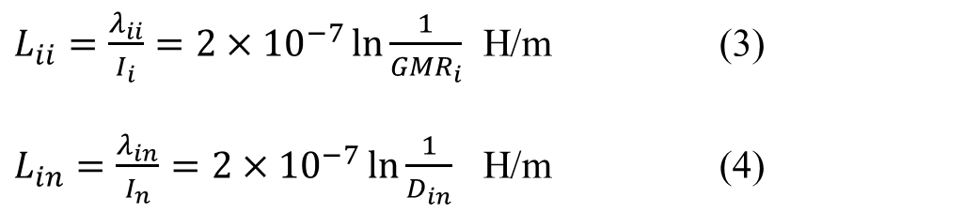
Non-transposed Distribution Lines
Equations (3) and (4) are used to calculate self and mutual inductance of the conductors.
Recall:
$L_{ii}=\frac{λ_{ii}}{I_{i}}=2×{10}^{−7}\ln{\frac{1}{{GMR}_{i}}}$ H/m (3)
$L_{in}=\frac{λ_{in}}{I_{n}}=2×{10}^{−7}\ln{\frac{1}{D_{in}}}$ H/m (4)

Slide 13
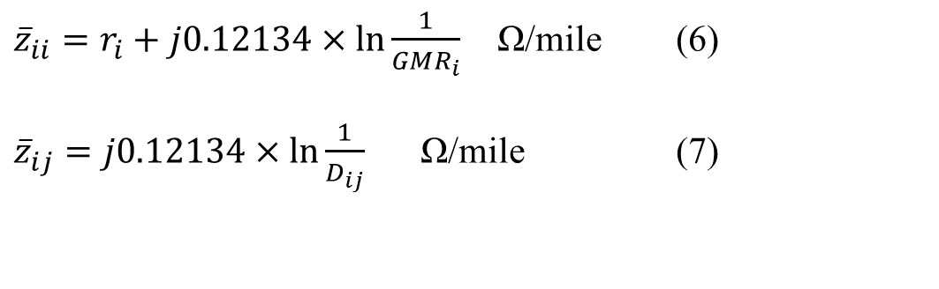
Non-transposed Distribution Lines
Assumption:
Inductance will calculated at a frequency of 60 Hz.
The self and mutual impedances are given by:
${\overline{z}}_{ii}=r_{i}+j0.12134×\ln{\frac{1}{GMR_{i}}}$ Ω/mile (6)
${\overline{z}}_{ij}=j0.12134×\ln{\frac{1}{D_{ij}}}$ Ω/mile (7)

Slide 14
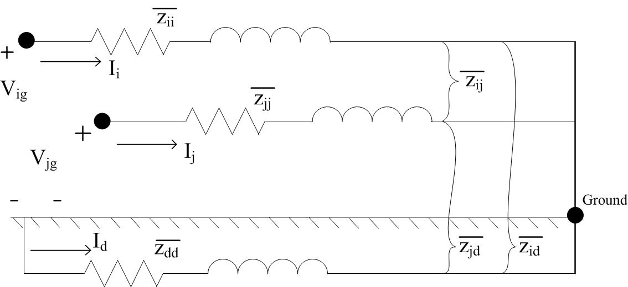
Two Conductors with Earth Return

Slide 15
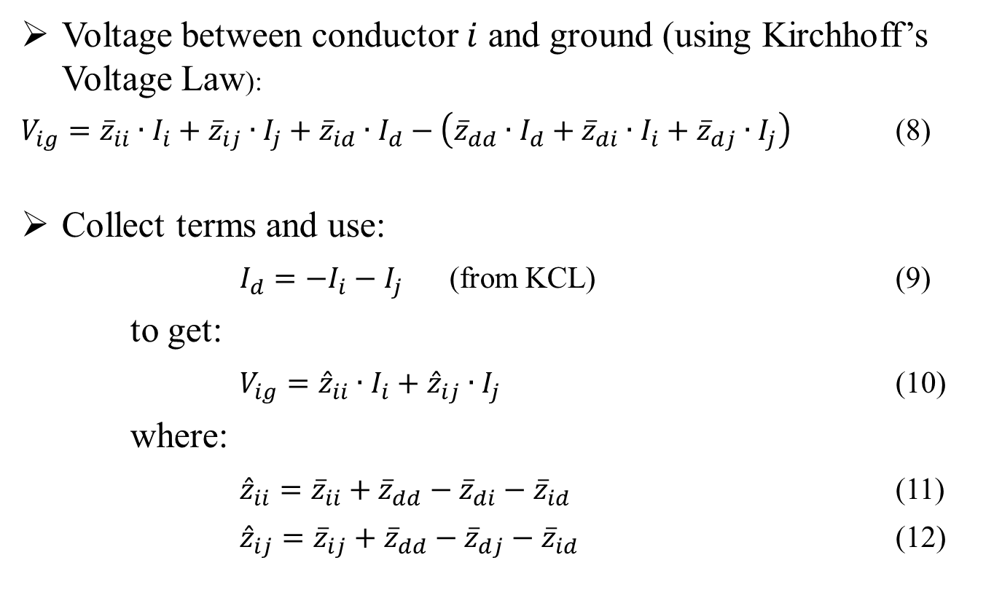
Two Conductors with Earth Return
Voltage between conductor $i$ and ground (using Kirchhoff’s Voltage Law):
$V_{ig}={\overline{z}}_{ii}∙I_{i}+{\overline{z}}_{ij}∙I_{j}+{\overline{z}}_{id}∙I_{d}−\left({\overline{z}}_{dd}∙I_{d}+{\overline{z}}_{di}∙I_{i}+{\overline{z}}_{dj}∙I_{j}\right)$ (8)
Collect terms and use:
$I_{d}=−I_{i}−I_{j}$ (from KCL) (9)
to get:
$V_{ig}={\hat{z}}_{ii}∙I_{i}+{\hat{z}}_{ij}∙I_{j}$ (10)
where:
${\hat{z}}_{ii}={\overline{z}}_{ii}+{\overline{z}}_{dd}−{\overline{z}}_{di}−{\overline{z}}_{id}$ (11)
${\hat{z}}_{ij}={\overline{z}}_{ij}+{\overline{z}}_{dd}−{\overline{z}}_{dj}−{\overline{z}}_{id}$ (12)

Slide 16
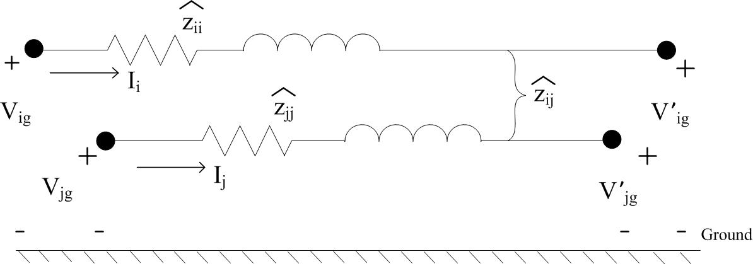
Primitive Circuit Impedances

Slide 17
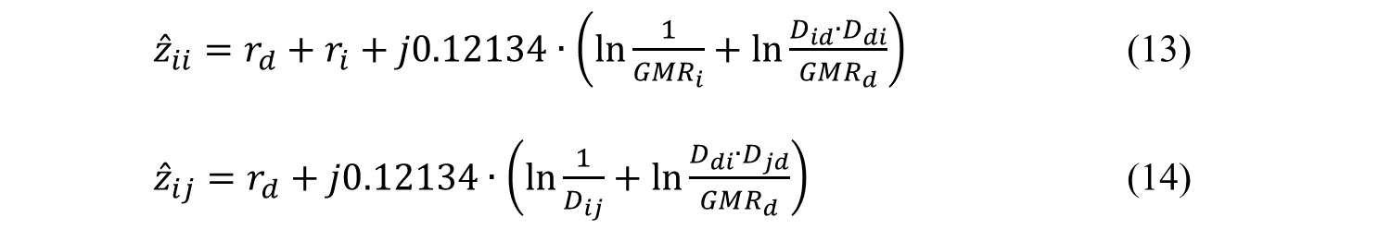
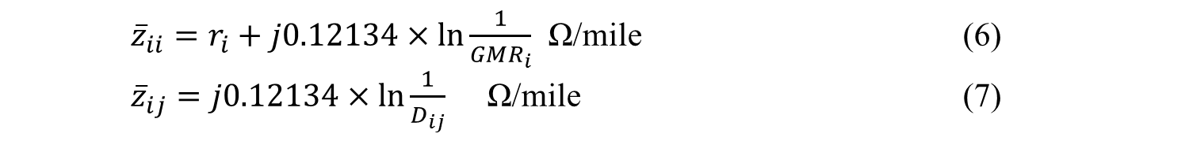
Primitive Circuit Impedances
Substitute the self and mutual impedance equations:
${\overline{z}}_{ii}=r_{i}+j0.12134×\ln{\frac{1}{GMR_{i}}}$ Ω/mile (6)
${\overline{z}}_{ij}=j0.12134×\ln{\frac{1}{D_{ij}}}$ Ω/mile (7)
into our “hat” impedances, (11) and (12), to get the primitive self and mutual impedances:
${\hat{z}}_{ii}=r_{d}+r_{i}+j0.12134∙\left(\ln{\frac{1}{GMR_{i}}}+\ln{\frac{D_{id}∙D_{di}}{GMR_{d}}}\right)$ (13)
${\hat{z}}_{ij}=r_{d}+j0.12134∙\left(\ln{\frac{1}{D_{ij}}}+\ln{\frac{D_{di}∙D_{jd}}{GMR_{d}}}\right)$ (14)

Slide 18
Part 1: Overhead Lines
Series impedance of Overhead Lines
Transposed Three-phase Lines
Non-transposed Distribution Lines
Carson’s Equations
Modified Carson’s Equations
Primitive Impedance Matrix for Overhead Lines
Phase Impedance Matrix for Overhead Lines
Sequence Impedances
Parallel Overhead Distribution Lines
Shunt Admittance of Overhead Parallel Lines
General Voltage Drop Equation

Slide 19
Carson’s Equations
Because distribution is inherently unbalanced, the most accurate analysis should not make any assumptions regarding:
the spacing between conductors
conductor sizes
transposition
Carson assumes the earth is an infinite, uniform solid, with a flat uniform upper surface and a constant resistivity.
Any “end effects” introduced at the neutral grounding points are not large at power frequencies, and therefore, are neglected.

Slide 20
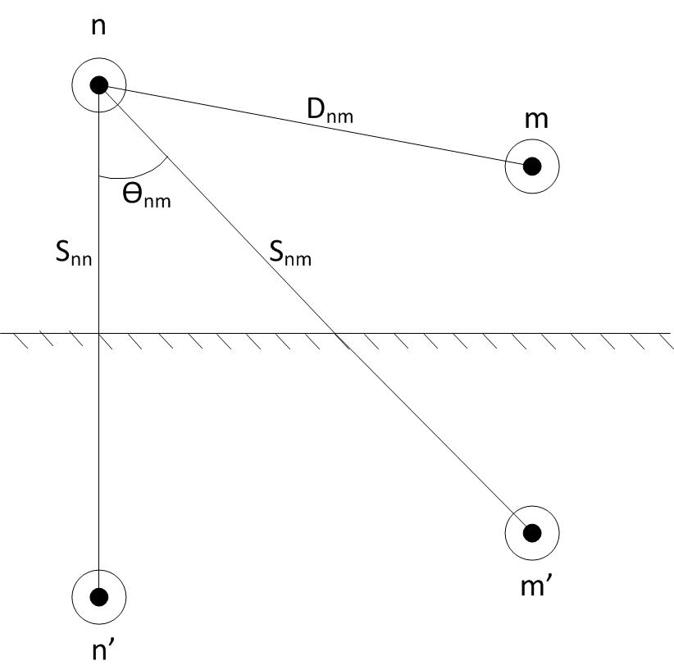
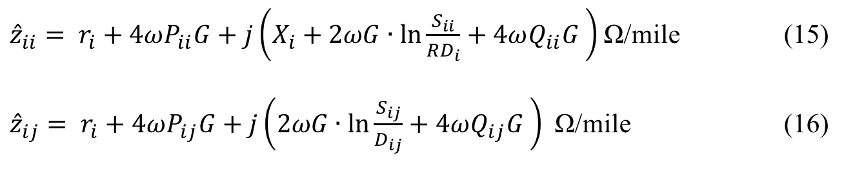
Carson’s Equations Cont.
Carson made use of conductor images; that is, every conductor at a given distance above ground has an image conductor at the same distance below-ground.
Figure 4.0
Self Impedance:
${\hat{z}}_{ii}= r_{i}+4ωP_{ii}G+j\left(X_{i}+2ωG∙\ln{\frac{S_{ii}}{RD_{i}}}+4ωQ_{ii}G \right)$ Ω/mile (15)
${\hat{z}}_{ij}= r_{i}+4ωP_{ij}G+j\left(2ωG∙\ln{\frac{S_{ij}}{D_{ij}}}+4ωQ_{ij}G \right)$ Ω/mile (16)
Mutual Impedance:

Slide 21
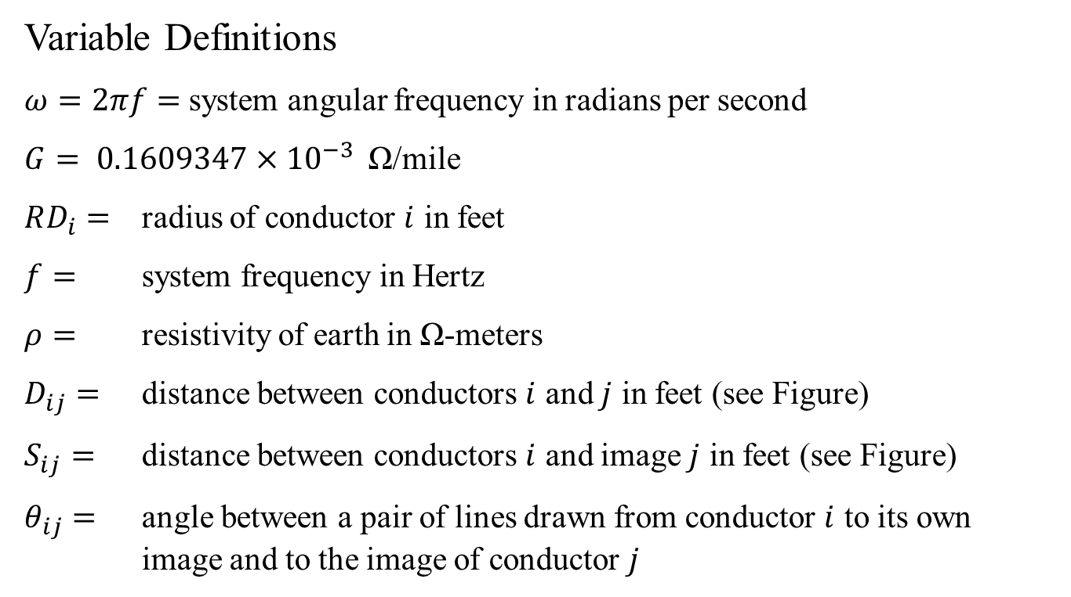
Carson’s Equations Cont.
Variable Definitions
$ω=2πf=$system angular frequency in radians per second
$G= 0.1609347×{10}^{−3 }$ Ω/mile
$RD_{i}=$ radius of conductor $i$ in feet
$f=$ system frequency in Hertz
$ρ=$ resistivity of earth in Ω-meters
$D_{ij}=$ distance between conductors $i$ and $j$ in feet (see Figure)
$S_{ij}=$ distance between conductors $i$ and image $j$ in feet (see Figure)
$θ_{ij}=$ angle between a pair of lines drawn from conductor $i$ to its own image and to the image of conductor $j$

Slide 22
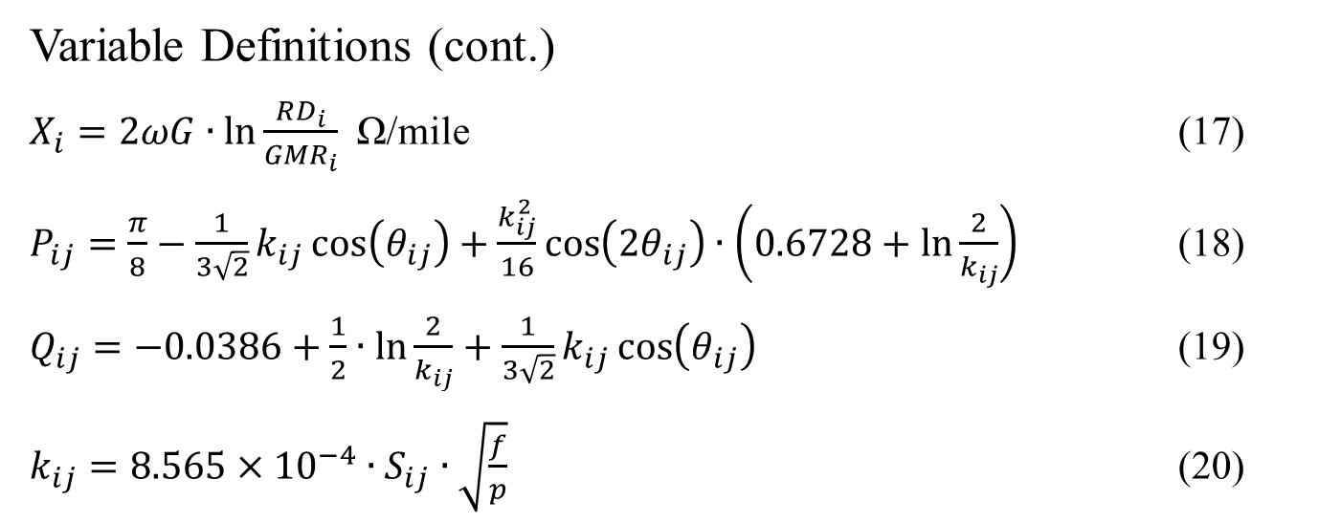
Carson’s Equations Cont.
Variable Definitions (cont.)
$X_{i}=2ωG∙\ln{\frac{RD_{i}}{GMR_{i}}}$ Ω/mile (17)
$P_{ij}=\frac{π}{8}−\frac{1}{3\sqrt{2}}k_{ij}\cos\left(θ_{ij}\right)+\frac{k_{ij}^{2}}{16}\cos\left(2θ_{ij}\right)∙\left(0.6728+\ln{\frac{2}{k_{ij}}}\right)$ (18)
$Q_{ij}=−0.0386+\frac{1}{2}∙\ln{\frac{2}{k_{ij}}}+\frac{1}{3\sqrt{2}}k_{ij}\cos\left(θ_{ij}\right)$ (19)
$k_{ij}=8.565×{10}^{−4}∙S_{ij}∙\sqrt{\frac{f}{p}}$ (20)

Slide 23
Part 1: Overhead Lines
Series impedance of Overhead Lines
Transposed Three-phase Lines
Non-transposed Distribution Lines
Carson’s Equations
Modified Carson’s Equations
Primitive Impedance Matrix for Overhead Lines
Phase Impedance Matrix for Overhead Lines
Sequence Impedances
Parallel Overhead Distribution Lines
Shunt Admittance of Overhead Parallel Lines
General Voltage Drop Equation

Slide 24
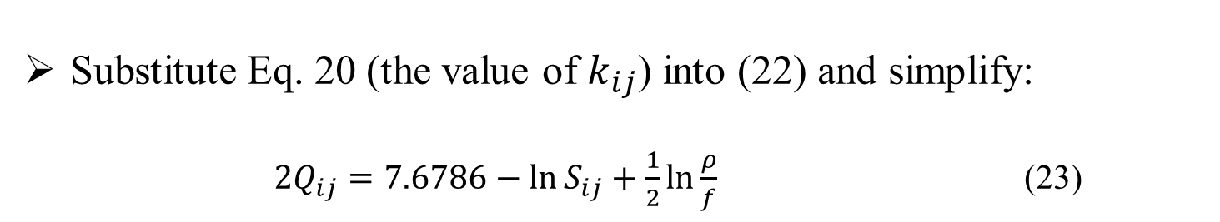
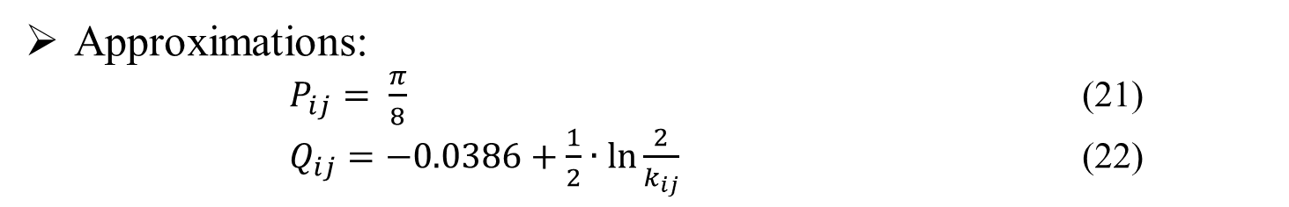
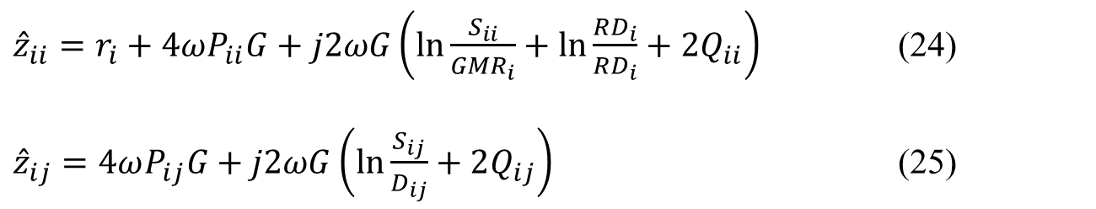
Modified Carson’s Equations
Approximations:
$P_{ij}= \frac{π}{8}$ (21)
$Q_{ij}=−0.0386+\frac{1}{2}∙\ln{\frac{2}{k_{ij}} }$ (22)
Substitute Eq. 20 (the value of $k_{ij}$) into (22) and simplify:
$2Q_{ij}=7.6786−\ln{S_{ij}}+\frac{1}{2}\ln{\frac{ρ}{f}}$ (23)
Now simplify the Carson’s Eq’s (substituting $X_{i}$ in the first):
${\hat{z}}_{ii}=r_{i}+4ωP_{ii}G+j2ωG\left(\ln{\frac{S_{ii}}{GMR_{i}}+\ln{\frac{RD_{i}}{RD_{i}}}}+2Q_{ii}\right)$ (24)
${\hat{z}}_{ij}=4ωP_{ij}G+j2ωG\left(\ln{\frac{S_{ij}}{D_{ij}}}+2Q_{ij}\right)$ (25)

Slide 25
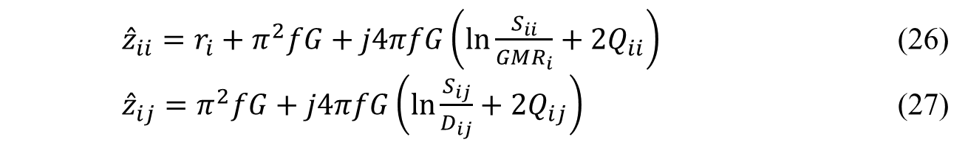
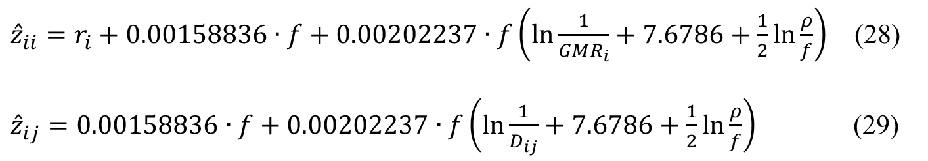
Modified Carson’s Equations Cont.
Substitute expressions for ${ P}_{ij}$ and $ω=2πf:$
${\hat{z}}_{ii}=r_{i}+π^{2}fG+j4πfG\left(\ln{\frac{S_{ii}}{GMR_{i}}}+2Q_{ii}\right)$ (26)
${\hat{z}}_{ij}=π^{2}fG+j4πfG\left(\ln{\frac{S_{ij}}{D_{ij}}}+2Q_{ij}\right)$ (27)
Now substitute our expression for $2Q_{ij}$and values $π$and $G$:
${\hat{z}}_{ii}=r_{i}+0.00158836∙f+0.00202237∙f\left(\ln{\frac{1}{GMR_{i}}}+7.6786+\frac{1}{2}\ln{\frac{ρ}{f}}\right)$ (28)
${\hat{z}}_{ij}=0.00158836∙f+0.00202237∙f\left(\ln{\frac{1}{D_{ij}}}+7.6786+\frac{1}{2}\ln{\frac{ρ}{f}}\right)$ (29)

Slide 26
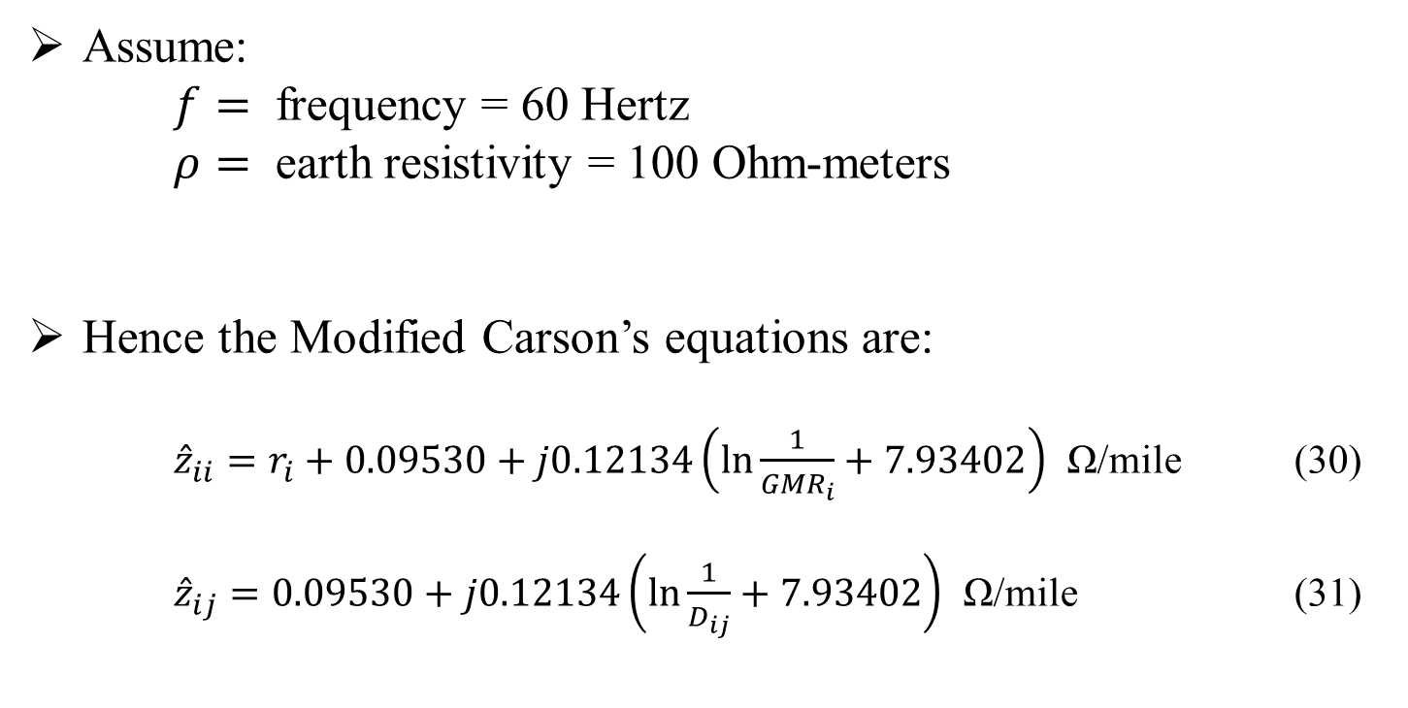
Modified Carson’s Equations Cont.
Assume:
$f=$ frequency = 60 Hertz
$ρ=$ earth resistivity = 100 Ohm-meters
Hence the Modified Carson’s equations are:
${\hat{z}}_{ii}=r_{i}+0.09530+j0.12134\left(\ln{\frac{1}{{GMR}_{i}}+7.93402}\right)$ Ω/mile (30)
${\hat{z}}_{ij}=0.09530+j0.12134\left(\ln{\frac{1}{D_{ij}}}+7.93402\right)$ Ω/mile (31)

Slide 27
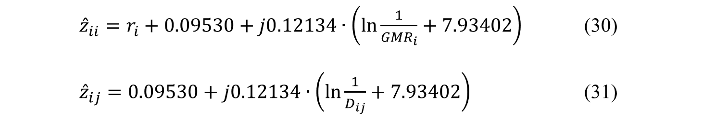
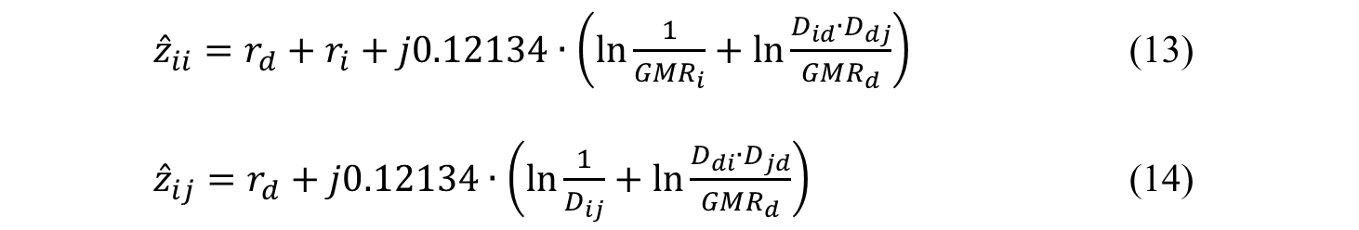
Modified Carson’s Equations Cont.
Primitive Impedance:
${\hat{z}}_{ii}=r_{d}+r_{i}+j0.12134∙\left(\ln{\frac{1}{GMR_{i}}}+\ln{\frac{D_{id}∙D_{dj}}{GMR_{d}}}\right)$ (13)
${\hat{z}}_{ij}=r_{d}+j0.12134∙\left(\ln{\frac{1}{D_{ij}}}+\ln{\frac{D_{di}∙D_{jd}}{GMR_{d}}}\right)$ (14)
Modified Carson’s:
${\hat{z}}_{ii}=r_{i}+0.09530+j0.12134∙\left(\ln{\frac{1}{{GMR}_{i}}}+7.93402\right)$ (30)
${\hat{z}}_{ij}=0.09530+j0.12134∙\left(\ln{\frac{1}{D_{ij}}}+7.93402\right)$ (31)

Slide 28
Part 1: Overhead Lines
Series impedance of Overhead Lines
Transposed Three-phase Lines
Non-transposed Distribution Lines
Carson’s Equations
Modified Carson’s Equations
Primitive Impedance Matrix for Overhead Lines
Phase Impedance Matrix for Overhead Lines
Sequence Impedances
Parallel Overhead Distribution Lines
Shunt Admittance of Overhead Parallel Lines
General Voltage Drop Equation

Slide 29
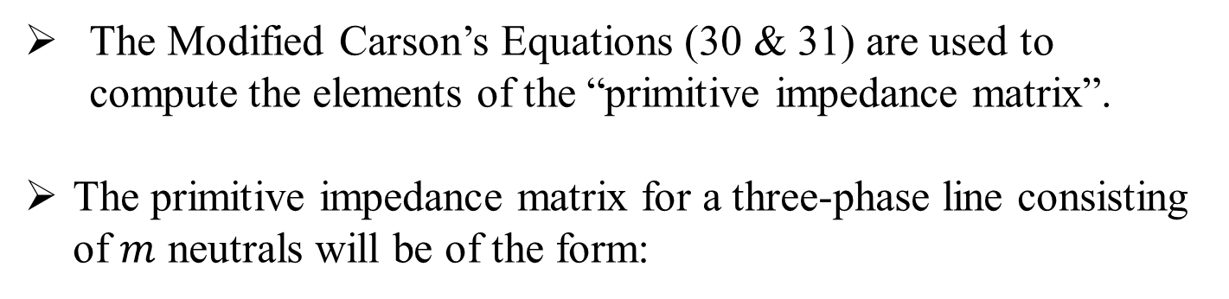
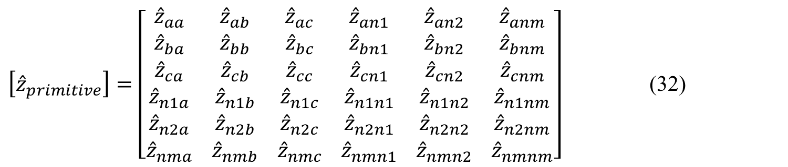
Primitive Impedance Matrix for Overhead Lines
The Modified Carson’s Equations (30 & 31) are used to compute the elements of the “primitive impedance matrix”.
The primitive impedance matrix for a three-phase line consisting of $m$ neutrals will be of the form:
$\left[{\hat{z}}_{primitive}\right]=\left[\begin{matrix}{\hat{z}}_{aa} \\ {\hat{z}}_{ba} \\ \begin{matrix}{\hat{z}}_{ca} \\ {\hat{z}}_{n1a} \\ \begin{matrix}{\hat{z}}_{n2a} \\ {\hat{z}}_{nma}\end{matrix}\end{matrix}\end{matrix} \begin{matrix}{\hat{z}}_{ab} \\ {\hat{z}}_{bb} \\ \begin{matrix}{\hat{z}}_{cb} \\ {\hat{z}}_{n1b} \\ \begin{matrix}{\hat{z}}_{n2b} \\ {\hat{z}}_{nmb}\end{matrix}\end{matrix}\end{matrix} \begin{matrix}{\hat{z}}_{ac} \\ {\hat{z}}_{bc} \\ \begin{matrix}{\hat{z}}_{cc} \\ {\hat{z}}_{n1c} \\ \begin{matrix}{\hat{z}}_{n2c} \\ {\hat{z}}_{nmc}\end{matrix}\end{matrix}\end{matrix} \begin{matrix}{\hat{z}}_{an1} \\ {\hat{z}}_{bn1} \\ \begin{matrix}{\hat{z}}_{cn1} \\ {\hat{z}}_{n1n1} \\ \begin{matrix}{\hat{z}}_{n2n1} \\ {\hat{z}}_{nmn1}\end{matrix}\end{matrix}\end{matrix} \begin{matrix}{\hat{z}}_{an2} \\ {\hat{z}}_{bn2} \\ \begin{matrix}{\hat{z}}_{cn2} \\ {\hat{z}}_{n1n2} \\ \begin{matrix}{\hat{z}}_{n2n2} \\ {\hat{z}}_{nmn2}\end{matrix}\end{matrix}\end{matrix} \begin{matrix}{\hat{z}}_{anm} \\ {\hat{z}}_{bnm} \\ \begin{matrix}{\hat{z}}_{cnm} \\ {\hat{z}}_{n1nm} \\ \begin{matrix}{\hat{z}}_{n2nm} \\ {\hat{z}}_{nmnm}\end{matrix}\end{matrix}\end{matrix}\right]$ (32)

Slide 30
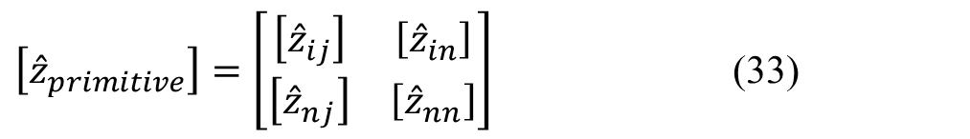
Primitive Impedance Matrix for Overhead Lines Cont.
In partitioned form, Equation (32) becomes:
$\left[{\hat{z}}_{primitive}\right]=\left[\begin{matrix}\left[{\hat{z}}_{ij}\right] & \left[{\hat{z}}_{in}\right] \\ \left[{\hat{z}}_{nj}\right] & \left[{\hat{z}}_{nn}\right]\end{matrix}\right]$ (33)

Slide 31
Part 1: Overhead Lines
Series impedance of Overhead Lines
Transposed Three-phase Lines
Non-transposed Distribution Lines
Carson’s Equations
Modified Carson’s Equations
Primitive Impedance Matrix for Overhead Lines
Phase Impedance Matrix for Overhead Lines
Sequence Impedances
Parallel Overhead Distribution Lines
Shunt Admittance of Overhead Parallel Lines
General Voltage Drop Equation

Slide 32
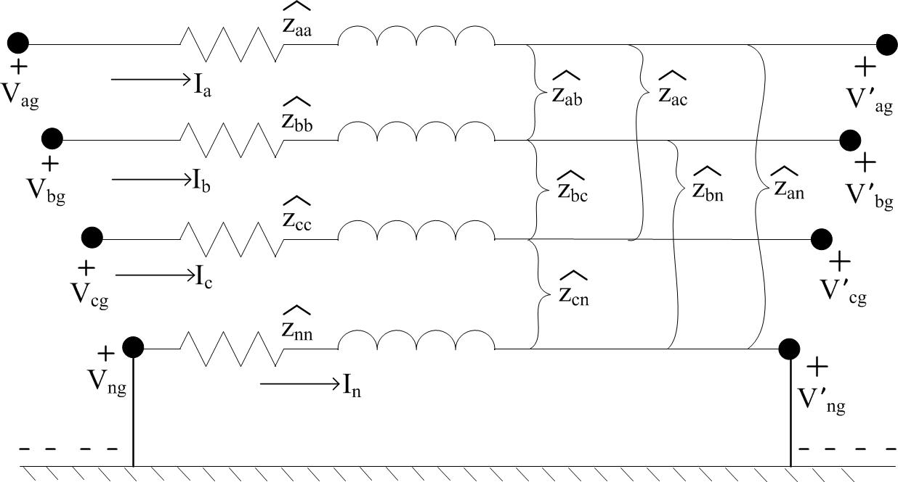
Phase Impedance Matrix for Overhead Lines
For most applications, the primitive impedance matrix needs to be reduced to a 3x3 “phase frame” matrix consisting of the self and mutual equivalent impedances for the three phases. Figure 5.0 shows a four-wire grounded neutral line segment
Figure 5.0

Slide 33
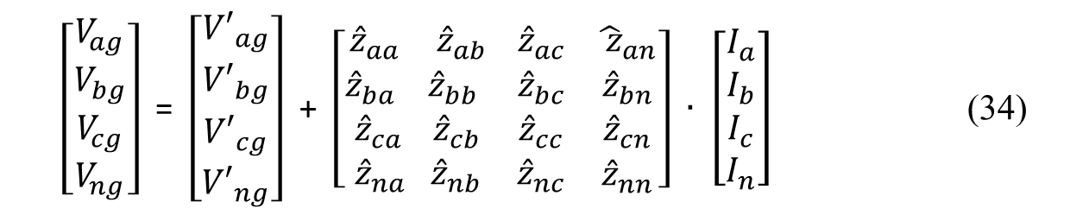
Phase Impedance Matrix for Overhead Lines Cont.
Figure 5.0
$\left[\begin{matrix}V_{ag} \\ \begin{matrix}V_{bg} \\ V_{cg} \\ V_{ng}\end{matrix}\end{matrix}\right]$ = $\left[\begin{matrix}{V′}_{ag} \\ \begin{matrix}{V′}_{bg} \\ {V′}_{cg} \\ {V′}_{ng}\end{matrix}\end{matrix}\right]$ + $\left[\begin{matrix}{\hat{z}}_{aa} \\ {\hat{z}}_{ba} \\ \begin{matrix}{\hat{z}}_{ca} \\ {\hat{z}}_{na }\end{matrix}\end{matrix}\begin{matrix}{\hat{z}}_{ab } \\ {\hat{z}}_{bb} \\ \begin{matrix}{\hat{z}}_{cb} \\ {\hat{z}}_{nb}\end{matrix} \end{matrix}\begin{matrix}{\hat{z}}_{ac} \\ {\hat{z}}_{bc} \\ \begin{matrix}{\hat{z}}_{cc} \\ {\hat{z}}_{nc}\end{matrix}\end{matrix} \begin{matrix}{\hat{ z}}_{an} \\ {\hat{z}}_{bn} \\ \begin{matrix}{\hat{z}}_{cn} \\ {\hat{z}}_{nn}\end{matrix}\end{matrix}\right] ∙$ $\left[\begin{matrix}I_{a} \\ I_{b} \\ \begin{matrix}I_{c} \\ I_{n}\end{matrix}\end{matrix}\right]$ (34)

Slide 34
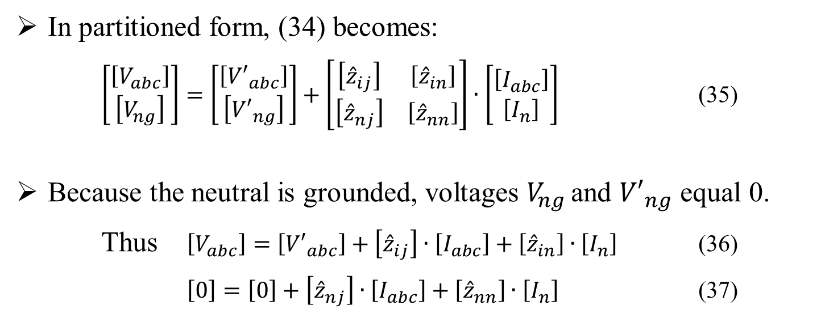
Phase Impedance Matrix for Overhead Lines Cont.
One standard method of reduction is the “Kron” reduction. The Kron reduction method applies KVL to the circuit.
In partitioned form, (34) becomes:
$\left[\begin{matrix}\left[V_{abc}\right] \\ \left[V_{ng}\right]\end{matrix}\right]=\left[\begin{matrix}\left[{V′}_{abc}\right] \\ \left[{V′}_{ng}\right]\end{matrix}\right]+\left[\begin{matrix}\left[{\hat{z}}_{ij}\right] & \left[{\hat{z}}_{in}\right] \\ \left[{\hat{z}}_{nj}\right] & \left[{\hat{z}}_{nn}\right]\end{matrix}\right]∙\left[\begin{matrix}\left[I_{abc}\right] \\ \left[I_{n}\right]\end{matrix}\right]$ (35)
Because the neutral is grounded, voltages $V_{ng }$and ${V′}_{ng}$ equal 0.
Thus $\left[V_{abc}\right]=\left[{V′}_{abc}\right]+\left[{\hat{z}}_{ij}\right]∙\left[I_{abc}\right]+\left[{\hat{z}}_{in}\right]∙\left[I_{n}\right]$ (36)
$\left[0\right]=\left[0\right]+\left[{\hat{z}}_{nj}\right]∙\left[I_{abc}\right]+\left[{\hat{z}}_{nn}\right]∙\left[I_{n}\right]$ (37)

Slide 35
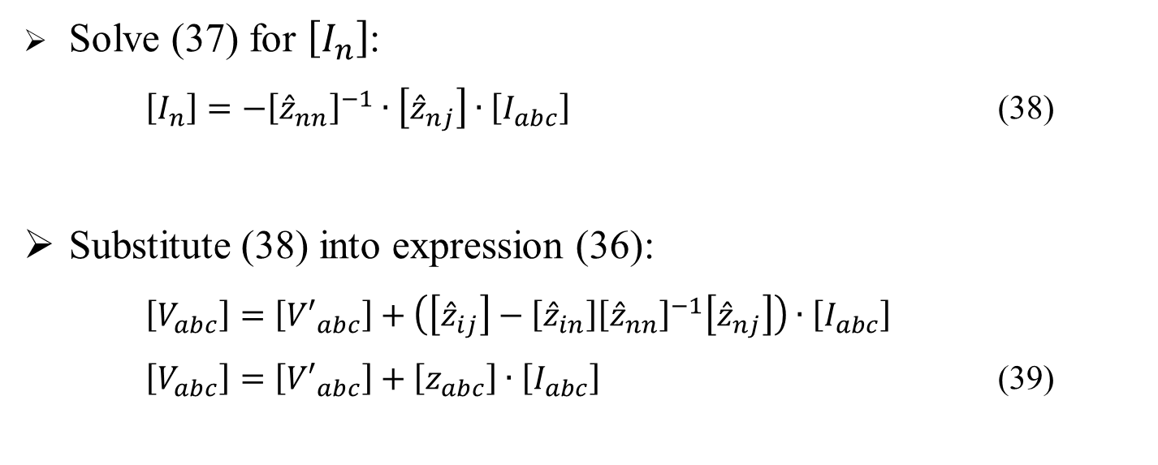
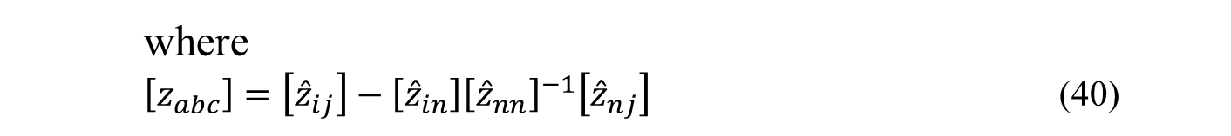
Phase Impedance Matrix for Overhead Lines Cont.
Solve (37) for $\left[I_{n}\right]$:
$\left[I_{n}\right]=−{\left[{\hat{z}}_{nn}\right]}^{−1}∙\left[{\hat{z}}_{nj}\right]∙\left[I_{abc}\right]$ (38)
Substitute (38) into expression (36):
$\left[V_{abc}\right]=\left[{V′}_{abc}\right]+\left(\left[{\hat{z}}_{ij}\right]−\left[{\hat{z}}_{in}\right]{\left[{\hat{z}}_{nn}\right]}^{−1}\left[{\hat{z}}_{nj}\right]\right)∙\left[I_{abc}\right]$
$\left[V_{abc}\right]=\left[{V′}_{abc}\right]+\left[z_{abc}\right]∙\left[I_{abc}\right]$ (39)
where
$\left[z_{abc}\right]=\left[{\hat{z}}_{ij}\right]−\left[{\hat{z}}_{in}\right]{\left[{\hat{z}}_{nn}\right]}^{−1}\left[{\hat{z}}_{nj}\right]$ (40)

Slide 36
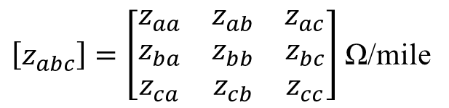
Phase Impedance Matrix for Overhead Lines Cont.
After having applied the Kron reduction technique, the final phase impedance matrix becomes:
$\left[z_{abc}\right]=\left[\begin{matrix}z_{aa} & z_{ab} & z_{ac} \\ z_{ba} & z_{bb} & z_{bc} \\ z_{ca} & z_{cb} & z_{cc}\end{matrix}\right]$ Ω/mile
(41)

Slide 37
Phase Impedance Matrix for Overhead Lines Cont.
The phase impedance matrix for a three-wire delta line is determined by the application of Carson’s equations without the Kron reduction step.
The phase impedance matrix can be used to accurately determine the voltage drops on the feeder line segments once the currents have been determined.
Since no approximations (transpositions for example) have been made regarding the spacing between conductors, the effect of the mutual coupling between the phases is accurately taken into account.

Slide 38
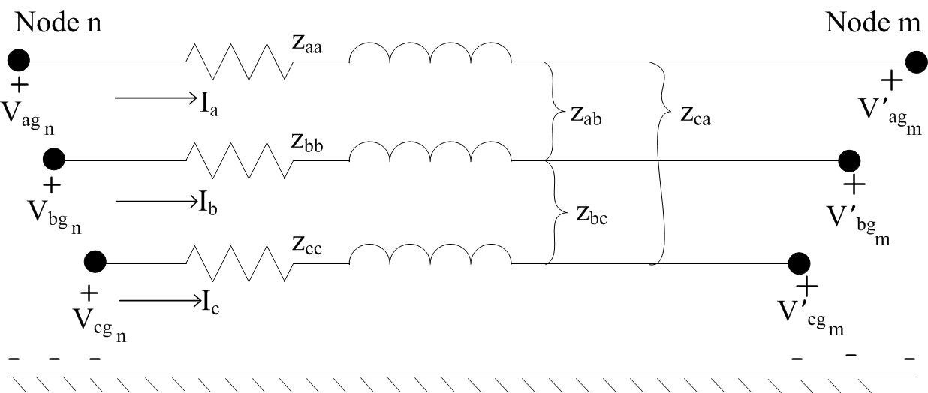
Phase Impedance Matrix for Overhead Lines Cont.
The application of the Modified Carson’s equations and the phase frame matrix lead to the most accurate model of a line segment as shown in Figure 6.0.
Figure 6.0

Slide 39

Phase Impedance Matrix for Overhead Lines Cont.
$${\left[\begin{matrix}V_{ag} \\ V_{bg} \\ V_{cg}\end{matrix}\right]}_{n}= {\left[\begin{matrix}V_{ag} \\ V_{bg} \\ V_{cg}\end{matrix}\right]}_{m}+ \left[\begin{matrix}z_{aa} & z_{ab} & z_{ac} \\ z_{ba} & z_{bb} & z_{bc} \\ z_{ca} & z_{cb} & z_{cc}\end{matrix}\right]∙ \left[\begin{matrix}I_{a} \\ I_{b} \\ I_{c}\end{matrix}\right]$$
$Z_{ij}= z_{ij}∙$length

Slide 40
Part 1: Overhead Lines
Series impedance of Overhead Lines
Transposed Three-phase Lines
Non-transposed Distribution Lines
Carson’s Equations
Modified Carson’s Equations
Primitive Impedance Matrix for Overhead Lines
Phase Impedance Matrix for Overhead Lines
Sequence Impedances
Parallel Overhead Distribution Lines
Shunt Admittance of Overhead Parallel Lines
General Voltage Drop Equation

Slide 41
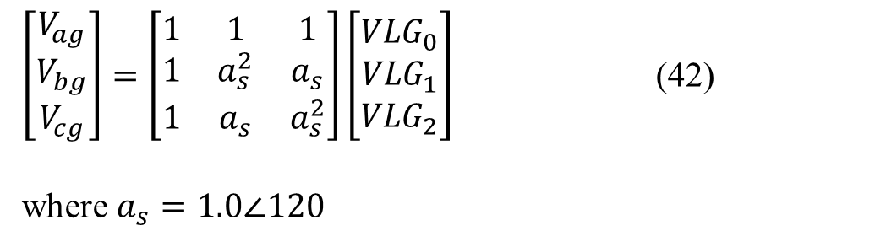
Sequence Impedances
Many times the analysis of a feeder will use only the positive and zero sequence impedances for the line segments. There are two methods for obtaining these impedances.
The first method uses the Modified Carson’s Equations and the Kron reduction to obtain the phase impedance matrix.
The definition of line-to-ground phase voltages as a function of the line-to-ground sequence voltages is given by:
$\left[\begin{matrix}V_{ag} \\ V_{bg} \\ V_{cg}\end{matrix}\right]=\left[\begin{matrix}1 & 1 & 1 \\ 1 & a_{s}^{2} & a_{s} \\ 1 & a_{s} & a_{s}^{2}\end{matrix}\right]\left[\begin{matrix}{VLG}_{0} \\ {VLG}_{1} \\ {VLG}_{2}\end{matrix}\right]$ (42)
where $a_{s}=1.0∠120$

Slide 42
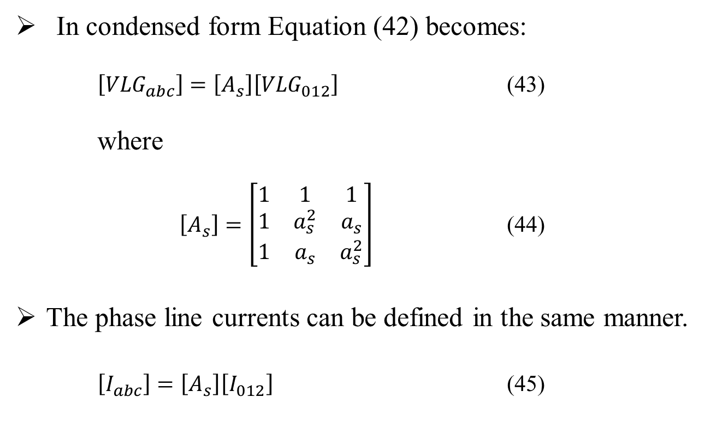
Sequence Impedances Cont.
In condensed form Equation (42) becomes:
$\left[{VLG}_{abc}\right]=\left[A_{s}\right]\left[{VLG}_{012}\right]$ (43)
where
$\left[A_{s}\right]=\left[\begin{matrix}1 & 1 & 1 \\ 1 & a_{s}^{2} & a_{s} \\ 1 & a_{s} & a_{s}^{2}\end{matrix}\right]$ (44)
The phase line currents can be defined in the same manner.
$\left[I_{abc}\right]=\left[A_{s}\right]\left[I_{012}\right]$ (45)

Slide 43
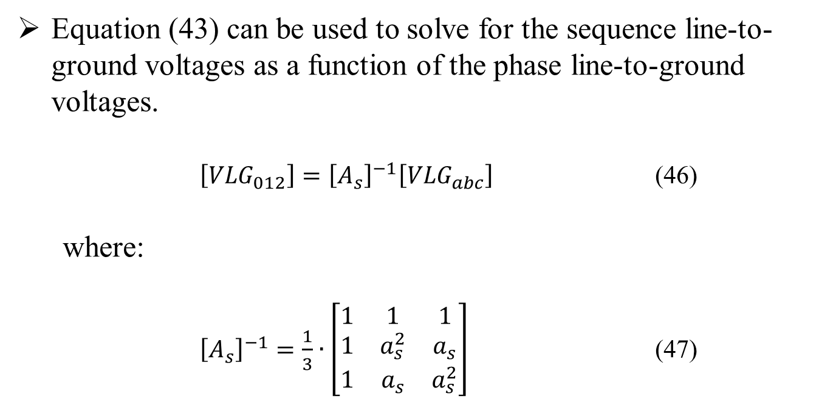
Sequence Impedances Cont.
Equation (43) can be used to solve for the sequence line-to-ground voltages as a function of the phase line-to-ground voltages.
$\left[{VLG}_{012}\right]={\left[A_{s}\right]}^{−1}\left[{VLG}_{abc}\right]$ (46)
where:
${\left[A_{s}\right]}^{−1}=\frac{1}{3}∙\left[\begin{matrix}1 & 1 & 1 \\ 1 & a_{s}^{2} & a_{s} \\ 1 & a_{s} & a_{s}^{2}\end{matrix}\right]$ (47)

Slide 44
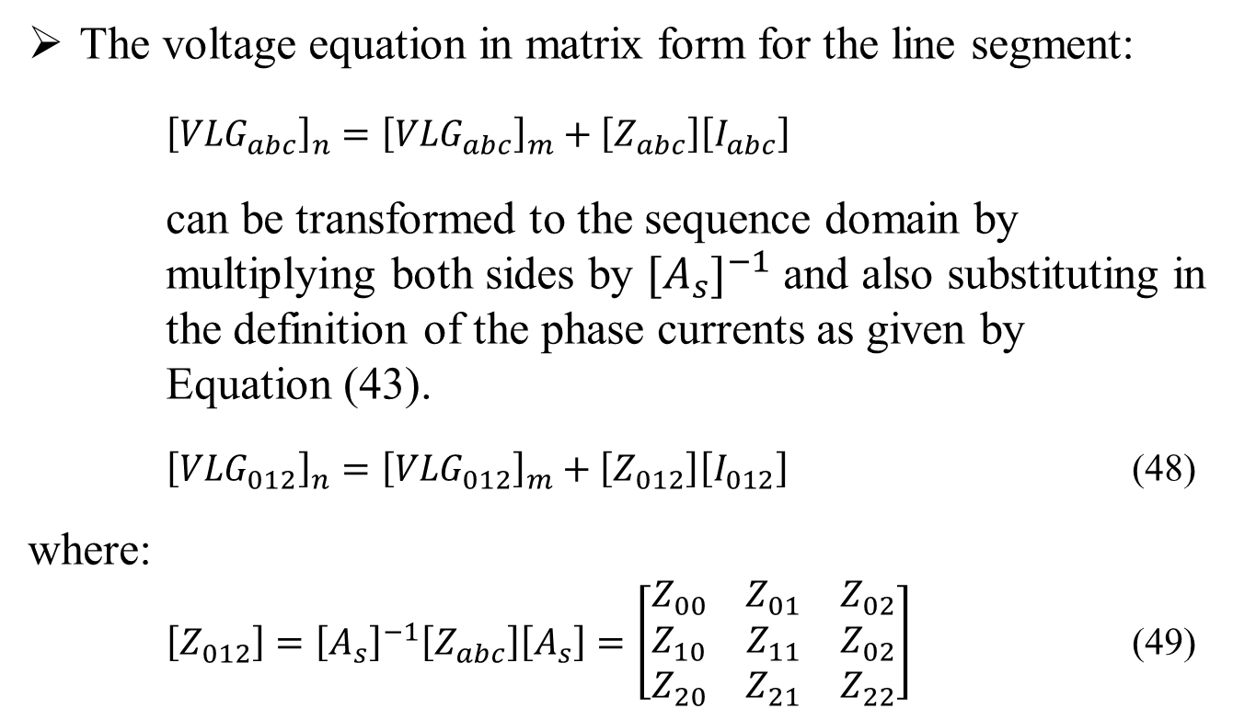
Sequence Impedances Cont.
The voltage equation in matrix form for the line segment:
${\left[{VLG}_{abc}\right]}_{n}={\left[{VLG}_{abc}\right]}_{m}+\left[Z_{abc}\right]\left[I_{abc}\right]$
can be transformed to the sequence domain by multiplying both sides by ${[A_{s}]}^{−1}$ and also substituting in the definition of the phase currents as given by Equation (43).
${\left[{VLG}_{012}\right]}_{n}={\left[{VLG}_{012}\right]}_{m}+\left[Z_{012}\right]\left[I_{012}\right]$ (48)
where:
$\left[Z_{012}\right]={\left[A_{s}\right]}^{−1}\left[Z_{abc}\right]\left[A_{s}\right]=\left[\begin{matrix}Z_{00} & Z_{01} & Z_{02} \\ Z_{10} & Z_{11} & Z_{02} \\ Z_{20} & Z_{21} & Z_{22}\end{matrix}\right]$ (49)

Slide 45
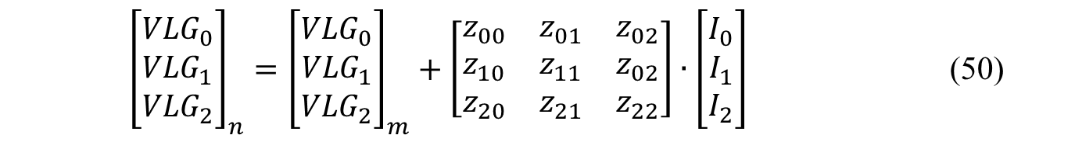
Sequence Impedances Cont.
Equation (48) in expanded form is given by:
${\left[\begin{matrix}{VLG}_{0} \\ {VLG}_{1} \\ {VLG}_{2}\end{matrix}\right]}_{n}={\left[\begin{matrix}{VLG}_{0} \\ {VLG}_{1} \\ {VLG}_{2}\end{matrix}\right]}_{m}+\left[\begin{matrix}z_{00} & z_{01} & z_{02} \\ z_{10} & z_{11} & z_{02} \\ z_{20} & z_{21} & z_{22}\end{matrix}\right]∙\left[\begin{matrix}I_{0} \\ I_{1} \\ I_{2}\end{matrix}\right]$ (50)
Equation (49) is the defining equation for converting phase impedances to sequence impedances. In equation (49), the diagonal terms of the matrix are the sequence impedances of the line such that:

Slide 46
Sequence Impedances Cont.
<Kevin’s example of sequential components not being equal to phase components. In any commercial tool, often diagonal components are ignored>

Slide 47
Sequence Impedances Cont.
The off-diagonal terms of Equation (49) represent the mutual coupling between sequences.
If the lines were transposed, these off-diagonal terms would be zero. This will generally be true for off-diagonal terms.
For transposed lines, the phase impedance matrix is modified so the three diagonal terms are equal, and all of the off-diagonal terms are equal.
Usually, the procedure is to set the three diagonal terms of the phase impedance matrix equal to the average of the diagonal terms of Equation (41) and the off-diagonal terms equal to the average of the off-diagonal terms of Equation (41).

Slide 48
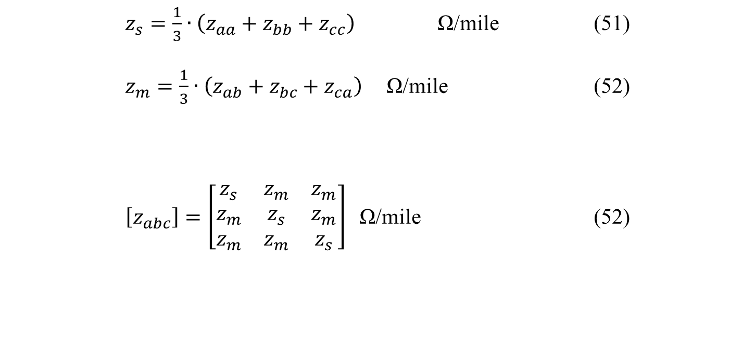
Sequence Impedances for Transposed Lines
Self and Mutual Impedance defined as:
$z_{s}=\frac{1}{3}∙\left(z_{aa}+z_{bb}+z_{cc}\right)$ Ω/mile (51)
$z_{m}=\frac{1}{3}∙\left(z_{ab}+z_{bc}+z_{ca}\right)$ Ω/mile (52)
$\left[z_{abc}\right]=\left[\begin{matrix}z_{s} & z_{m} & z_{m} \\ z_{m} & z_{s} & z_{m} \\ z_{m} & z_{m} & z_{s}\end{matrix}\right]$ Ω/mile (52)
Phase Impedance matrix:

Slide 49
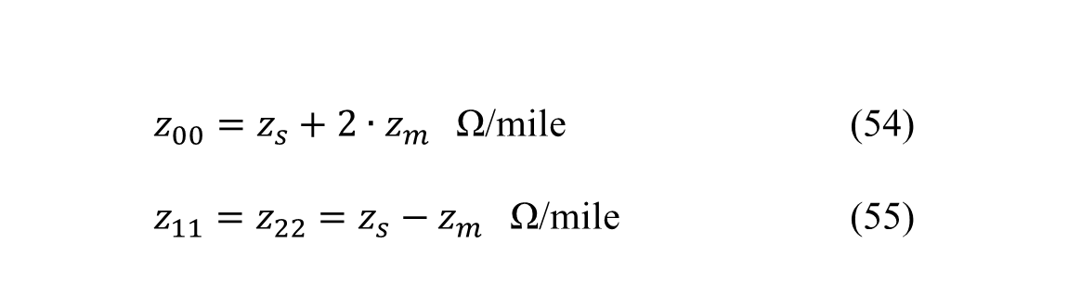
Sequence Impedances for Transposed Lines Cont.
Determine Sequence Impedances:
$z_{00}=z_{s}+2∙z_{m}$ Ω/mile (54)
$z_{11}=z_{22}=z_{s}−z_{m}$ Ω/mile (55)

Slide 50


Sequence Impedances
A second method that is commonly used to determine the sequence impedances directly is to employ the concept of Geometric Mean Distances (GMD).
GMD between phases:
$D_{ij}=GMD_{ij}=\sqrt[3]{D_{ab}∙D_{bc}∙D_{ca}}$ (56)
GMD between phases and neutral:
$D_{in}=GMD_{in}=\sqrt[3]{D_{an}∙D_{bn}∙D_{cn}}$ (57)

Slide 51
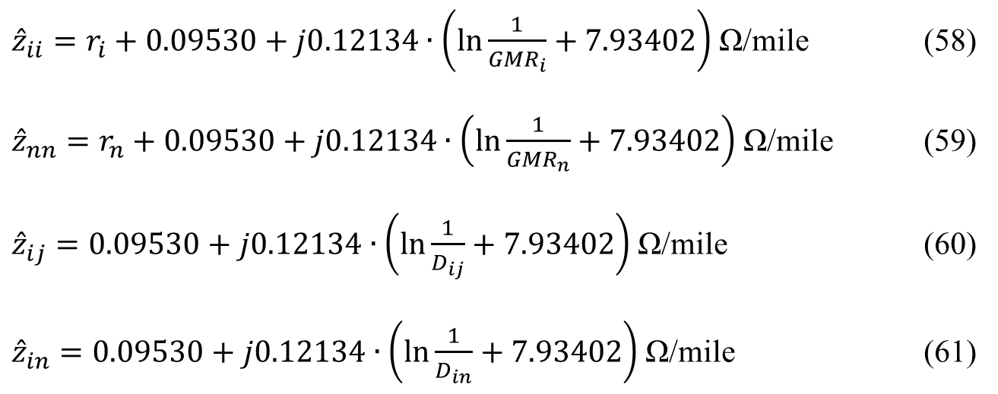
Sequence Impedances Cont.
The above GMD’s are used in the Modified Carson Equations, resulting in:
${\hat{z}}_{ii}=r_{i}+0.09530+j0.12134∙\left(\ln{\frac{1}{{GMR}_{i}}}+7.93402\right)$ Ω/mile (58)
${\hat{z}}_{nn}=r_{n}+0.09530+j0.12134∙\left(\ln{\frac{1}{{GMR}_{n}}}+7.93402\right)$ Ω/mile (59)
${\hat{z}}_{ij}=0.09530+j0.12134∙\left(\ln{\frac{1}{D_{ij}}}+7.93402\right)$Ω/mile (60)
${\hat{z}}_{in}=0.09530+j0.12134∙\left(\ln{\frac{1}{D_{in}}}+7.93402\right)$ Ω/mile (61)

Slide 52
Part 1: Overhead Lines
Series impedance of Overhead Lines
Transposed Three-phase Lines
Non-transposed Distribution Lines
Carson’s Equations
Modified Carson’s Equations
Primitive Impedance Matrix for Overhead Lines
Phase Impedance Matrix for Overhead Lines
Sequence Impedances
Parallel Overhead Distribution Lines
Shunt Admittance of Overhead Parallel Lines
General Voltage Drop Equation

Slide 53
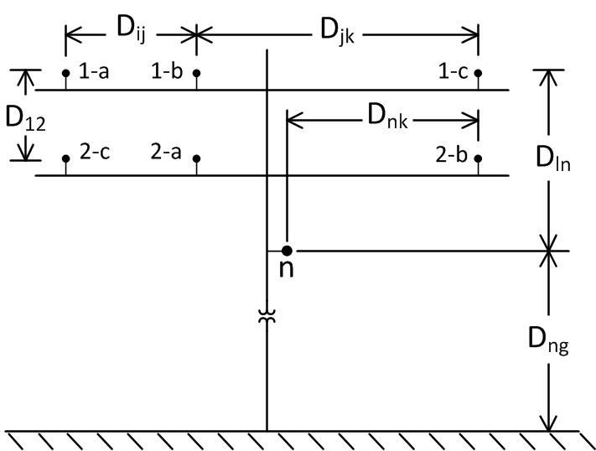
Parallel Overhead Lines
It is fairly common in a distribution system to find instances where two distribution lines are “physically” parallel.
The phase impedance matrix of parallel lines is computed from the application of Carson’s equations and the Kron reduction method.
Line 1
Line 2
Figure 7.0

Slide 54
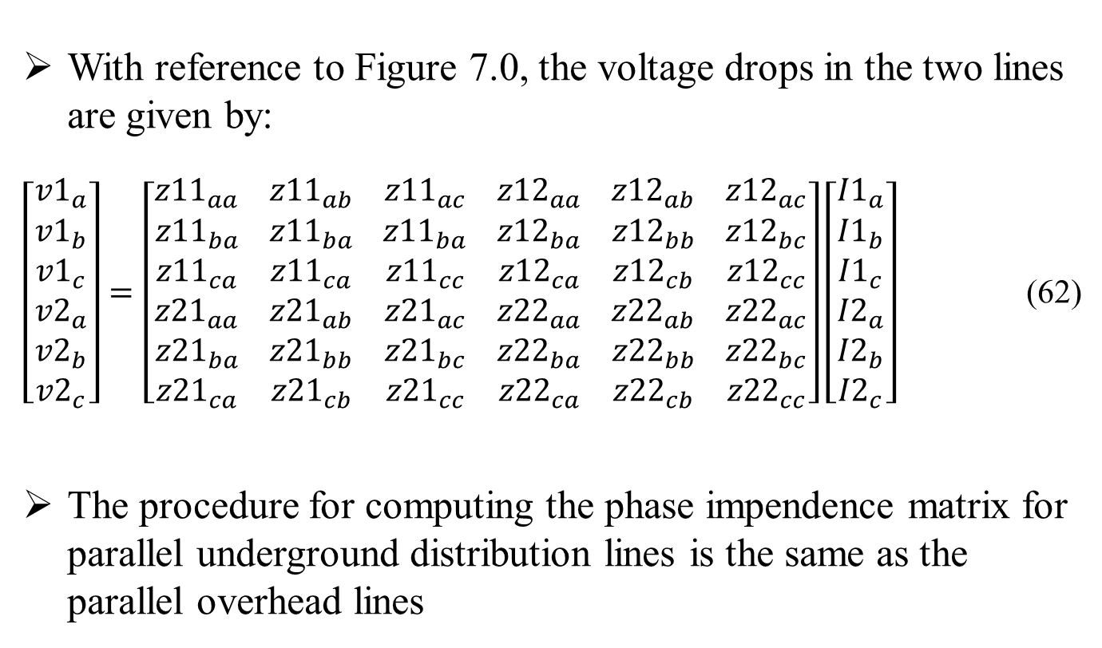
Parallel Overhead Lines Cont.
With reference to Figure 7.0, the voltage drops in the two lines are given by:
$\left[\begin{matrix}{v1}_{a} \\ {v1}_{b} \\ \begin{matrix}{v1}_{c} \\ {v2}_{a} \\ \begin{matrix}{v2}_{b} \\ {v2}_{c}\end{matrix}\end{matrix}\end{matrix}\right]=\left[\begin{matrix}{z11}_{aa} \\ {z11}_{ba} \\ \begin{matrix}{z11}_{ca} \\ {z21}_{aa} \\ \begin{matrix}{z21}_{ba} \\ {z21}_{ca}\end{matrix}\end{matrix}\end{matrix} \begin{matrix}{z11}_{ab} \\ {z11}_{ba} \\ \begin{matrix}{z11}_{ca} \\ {z21}_{ab} \\ \begin{matrix}{z21}_{bb} \\ {z21}_{cb}\end{matrix}\end{matrix}\end{matrix} \begin{matrix}{z11}_{ac} \\ {z11}_{ba} \\ \begin{matrix}{z11}_{cc} \\ {z21}_{ac} \\ \begin{matrix}{z21}_{bc} \\ {z21}_{cc}\end{matrix}\end{matrix}\end{matrix} \begin{matrix}{z12}_{aa} \\ {z12}_{ba} \\ \begin{matrix}{z12}_{ca} \\ {z22}_{aa} \\ \begin{matrix}{z22}_{ba} \\ {z22}_{ca}\end{matrix}\end{matrix}\end{matrix} \begin{matrix}{z12}_{ab} \\ {z12}_{bb} \\ \begin{matrix}{z12}_{cb} \\ {z22}_{ab} \\ \begin{matrix}{z22}_{bb} \\ {z22}_{cb}\end{matrix}\end{matrix}\end{matrix} \begin{matrix}{z12}_{ac} \\ {z12}_{bc} \\ \begin{matrix}{z12}_{cc} \\ {z22}_{ac} \\ \begin{matrix}{z22}_{bc} \\ {z22}_{cc}\end{matrix}\end{matrix}\end{matrix}\right]\left[\begin{matrix}{I1}_{a} \\ {I1}_{b} \\ \begin{matrix}{I1}_{c} \\ {I2}_{a} \\ \begin{matrix}{I2}_{b} \\ {I2}_{c}\end{matrix}\end{matrix}\end{matrix}\right]$ (62)
The procedure for computing the phase impendence matrix for parallel underground distribution lines is the same as the parallel overhead lines

Slide 55
Part 1: Overhead Lines
Series impedance of Overhead Lines
Transposed Three-phase Lines
Non-transposed Distribution Lines
Carson’s Equations
Modified Carson’s Equations
Primitive Impedance Matrix for Overhead Lines
Phase Impedance Matrix for Overhead Lines
Sequence Impedances
Parallel Overhead Distribution Lines
Shunt Admittance of Overhead Parallel Lines
General Voltage Drop Equation

Slide 56
Shunt Admittance of Overhead Parallel Lines
The shunt admittance of a line consists of the conductance and the capacitive susceptance.
The conductance is usually ignored because it is very small compared to the capacitive susceptance.
The capacitance of a line is the result of the potential difference between conductors.

Slide 57
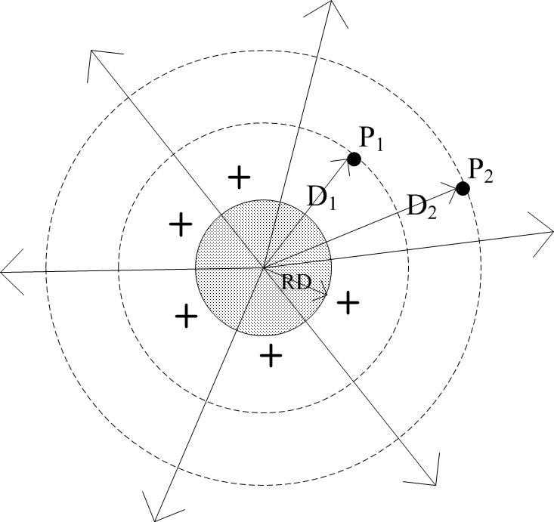
Electric field of a charged round conductor
Figure 8.0

Slide 58
Electric field of a charged round conductor
A charged conductor creates an electric field that emanates outward from the center of the conductor.
Lines of equipotential are created outward from the center of the conductor.
A difference of potential between two points is a result of the electric field of the charged conductor.
When the potential difference between two points is known, then the capacitance between the two points can be computed.

Slide 59
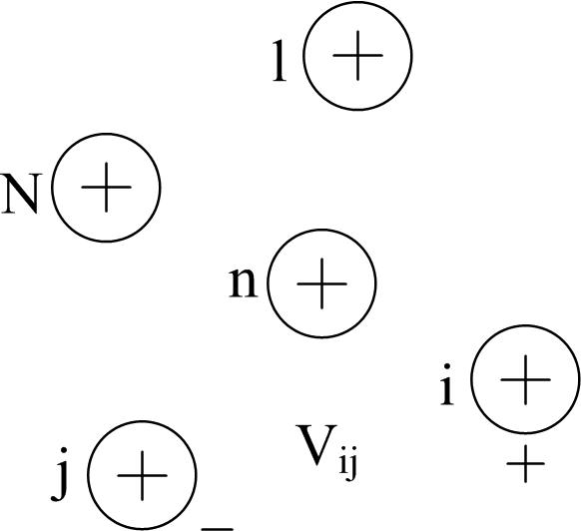
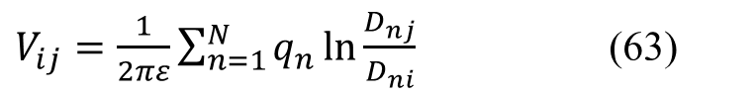
Shunt Admittance of Overhead Parallel Lines
General Voltage Drop Equation
Figure 9.0
$V_{ij}=\frac{1}{2πε}\sum_{n=1}^{N}{q_{n}}\ln{\frac{D_{nj}}{D_{ni}}}$ (63)

Slide 60
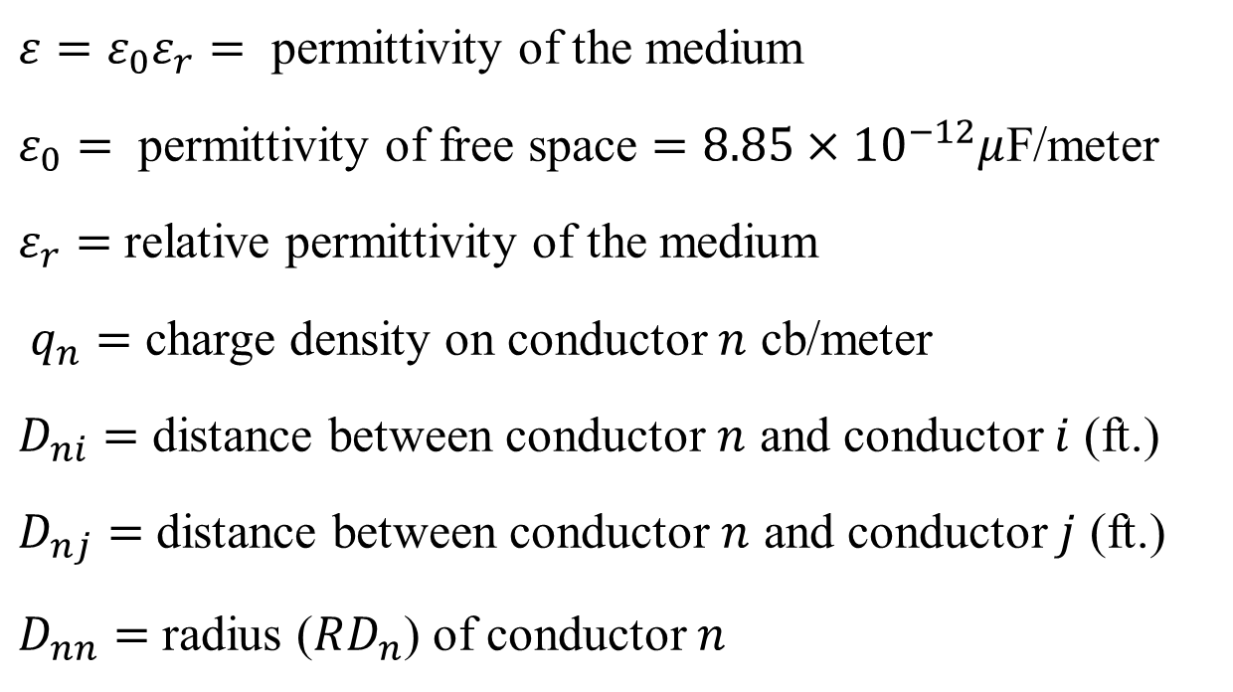
Shunt Admittance of Overhead Parallel Lines
Definition of Terms
$ε=ε_{0}ε_{r}=$ permittivity of the medium
$ε_{0}=$ permittivity of free space $=8.85×{10}^{−12}μ$F/meter
$ε_{r}=$ relative permittivity of the medium
$q_{n}=$ charge density on conductor $n$ cb/meter
$D_{ni}=$ distance between conductor $n$ and conductor $i$ (ft.)
$D_{nj}=$ distance between conductor $n$ and conductor $j$ (ft.)
$D_{nn}=$ radius ($RD_{n}$) of conductor $n$

Slide 61
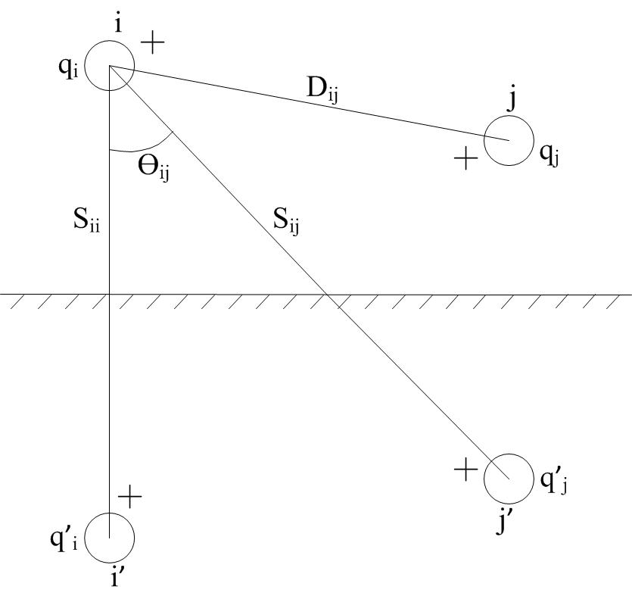
Conductors and Images
Figure 10.0

Slide 62

Shunt Admittance of Overhead Parallel Lines
The method of conductors and their images is employed in the calculation of the shunt capacitance of overhead lines. This is the same concept that was used for calculating series impedances in the general application of Carson’s Equations.
$V_{ii} =\frac{1}{2πε}\left(q_{i}\ln{\frac{S_{ii}}{RD_{i}}+{q′}_{i}\ln{\frac{RD_{i}}{S_{ii}}+q_{j}\ln{\frac{S_{ij}}{D_{ij}}}}}+{q′}_{j}\ln{\frac{D_{ij}}{S_{ij}}}\right)$ (64)
when assuming:
${q′}_{i} =−q_{i}$
${q′}_{j} =−q_{j}$ (66)
$V_{ig}=\frac{1}{2πε}\left(q_{i}\ln{\frac{S_{ii}}{RD_{i}}+q_{j}\ln{\frac{S_{ij}}{D_{ij}}}}\right)$ (65)

Slide 63


Shunt Admittance of Overhead Parallel Lines
where
$S_{ii}=$ distance of the conductor $i$ to its image $i′$ (ft)
$S_{ij}=$ distance of the conductor $i$ to the image of conductor $j$ (ft)
$D_{ij}=$ distance of the conductor $i$ to conductor $j$ (ft)
${RD}_{i}=$ radius of conductor $i$ (ft)
The first step is to create the primitive potential coefficient matrix, where the elements of the primitive potential coefficient matrix are given by
${\hat{P}}_{ii}=11.17689\ln{\frac{S_{ii}}{{RD}_{i}}}$ mile/$μ$F (67)
${\hat{P}}_{ij}=11.17689\ln{\frac{S_{ij}}{D_{ij}}}$ mile/$μ$F (68)

Slide 64

Shunt Admittance of Overhead Parallel Lines
After reducing the primitive potential matrix through Kron reduction, we obtain the potential matrix $\left[P\right]$.
The shunt capacitance matrix is the inverse of the potential matrix.
$\left[C\right]={\left[P\right]}^{−1}$ (69)
The shunt admittance matrix is given by
$\left[y\right]=jω∙\left[C\right]∙{10}^{−6}=\left[\begin{matrix}\left[y11\right] & \left[y12\right] \\ \left[y21\right] & \left[y22\right]\end{matrix}\right]S$ (70)
where $ω=2π∙frequency$.

Slide 65
Part 2: Underground Lines
Underground lines
Series impedance of Underground Lines
Concentric Neutral Cable
Tape Shielded Cables
Shunt Admittance of Underground Lines
Concentric Neutral Cable
Tape Shielded Cables
Sequence Admittance
Parallel Underground Distribution Lines
Series Impedance
Shunt Admittance

Slide 66
Part 2: Underground Lines
Underground lines
Series impedance of Underground Lines
Concentric Neutral Cable
Tape Shielded Cables
Shunt Admittance of Underground Lines
Concentric Neutral Cable
Tape Shielded Cables
Sequence Admittance
Parallel Underground Distribution Lines
Series Impedance
Shunt Admittance

Slide 67

Series Impedance of Underground Lines
Concentric Neutral Cable
Figure shows the detail of a concentric neutral cable
Figure 11.0

Slide 68

Series Impedance of Underground Lines
Concentric Neutral Cable
In order to apply the Carson’s equations, the following data needs to be extracted from a table of underground cables. (Appendices A and B in the book)
$d_{c}=$ diameter of phase conductor (inches)
$d_{od}=$ nominal diameter over the concentric neutrals of the cable (inches)
$d_{s}=$ diameter of a concentric neutral strand (inches)
$GMR_{c}=$ geometric mean radius of the phase conductor (feet)
${GMR}_{s}=$ geometric mean radius of a neutral strand (feet)
$r_{c}=$ resistance of the phase conductor (Ω/mile)
$r_{s}=$ resistance of a solid neutral strand (Ω/mile)
$k=$ number of concentric neutral strands

Slide 69

Series Impedance of Underground Lines
Concentric Neutral Cable
The GMR of the phase conductor and a neutral strand are obtained from the standard table of the conductor data (Appendix A).
The equivalent GMR of the concentric neutral is computed using the equation
${GMR}_{cn}=\sqrt[k]{{GMR}_{s}∙k∙R^{k−1}}$ ft (71)
where $R$is the radius of a circle passing through the center of the concentric neutral strands given by:
$R=\frac{d_{od}−d_{s}}{24}$ ft (72)

Slide 70


Series Impedance of Underground Lines
Concentric Neutral Distances
The equivalent resistance of the concentric neutral is:
$r_{cn}=\frac{r_{s}}{k}$ Ω/mile (73)
CN to its own phase conductor:
$D_{ij}=R$
CN to adjacent CN:
${ D}_{ij} =$Center-to-Center of phase conductors
CN to adjacent phase conductor:
$D_{ij}=\sqrt[k]{D_{nm}^{k}−R^{k}}$ (74)

Slide 71
Part 2: Underground Lines
Underground lines
Series impedance of Underground Lines
Concentric Neutral Cable
Tape Shielded Cables
Shunt Admittance of Underground Lines
Concentric Neutral Cable
Tape Shielded Cables
Sequence Admittance
Parallel Underground Distribution Lines
Series Impedance
Shunt Admittance

Slide 72
Series Impedance of Underground Lines
Tape Shielded Cables
The tape shielded cable consists of a central conductor covered by a thin layer of non-metallic semi conducting screen to which is bonded the insulating material.
The insulation is covered by a semiconducting insulation screen. The shield is bare copper tape.
An insulating jacket encircles the tape shield.

Slide 73

Series Impedance of Underground Lines
Tape Shielded Cables
Figure 12.0

Slide 74

Series Impedance of Underground Lines
Tape Shielded Cables
Parameters of the tape shielded cable are:
$d_{c}=$ diameter of phase conductor (inches)
$d_{s}=$ outside diameter of the tape shield (inches)
$d_{od}=$ outside diameter over jacket (inches)
$T=$ thickness of copper tape shield (millimeters)
Modified Carson’s Equations will be applied to calculate:
self impedances of the phase conductor and the tape shield
mutual impedance between the phase conductor and the tape shield.
The resistance and GMR of the phase conductor are found in a standard table of conductor data. (Appendix A in this book)

Slide 75

Series Impedance of Underground Lines
Tape Shielded Cables
The resistance of the tape shield is given by:
$r_{shield}=7.9385×{10}^{8}∙\frac{ρ}{d_{s}∙T}$ Ω/mile (75)
Assumptions:
Temperature is 50 degrees C
Resistivity is 100 Ω-meter
Frequency is 60 Hz
The GMR of the tape shield is the radius of a circle passing through the middle of the shield and is given by:
${GMR}_{shield}=\frac{\frac{d_{s}}{2}−\frac{T}{2000}}{12}$ ft (76)

Slide 76


Series Impedance of Underground Lines
Tape Shielded Cables
The various spacings between a tape shield and the conductors and other tape shields are as follows:
Tape shield to its own phase:
$D_{ij}={GMR}_{shield}=$ radius to midpoint of the shield (ft)
Tape shield to an adjacent tape shield:
$D_{ij}=$ center-to-center distance of the phase conductors (ft)
Tape shield to an adjacent phase or neutral conductor:
$D_{ij}=D_{nm}$ ft
where $D_{nm}=$ center-to-center distance between phase conductors

Slide 77
Part 2: Underground Lines
Underground lines
Series impedance of Underground Lines
Concentric Neutral Cable
Tape Shielded Cables
Shunt Admittance of Underground Lines
Concentric Neutral Cable
Tape Shielded Cables
Sequence Admittance
Parallel Underground Distribution Lines
Series Impedance
Shunt Admittance

Slide 78

Shunt Admittance of Underground Lines
Concentric Neutral Cable
Figure shows a basic concentric neutral cable with center conductor being the phase conductor and the concentric neutral strands equally displaced around a circle of radius of R_{b}
Figure 13.0

Slide 79

Shunt Admittance of Underground Lines
Concentric Neutral Cable
where
$Rb$ = Radius of a circle passing through the centers of the neutral strands
$dc$ = Diameter of the phase conductor
$ds$ = Diameter of a neutral strand
$k$ = Total number of neutral strands

Slide 80

Shunt Admittance of Underground Lines
Concentric Neutral Cable
The concentric neutral strands are grounded so that they are all at the same potential.
Since they are all at the same potential, it is only necessary to determine the potential difference between the phase conductor $p$ and strand $1$.
$V_{p1}=\frac{1}{2πε}\left(q_{p}\ln{\frac{R_{b}}{{RD}_{c}}}+q_{1}\ln{\frac{{RD}_{s}}{R_{b}}}+q_{2}\ln{\frac{D_{12}}{R_{b}}}+⋯+q_{k}\ln{\frac{D_{1k}}{R_{b}}}\right)$ (77)
where ${RD}_{c}=\frac{{dia}_{c}}{2}$
${RD}_{s}=\frac{{dia}_{c}}{2}$

Slide 81

Shunt Admittance of Underground Lines
Concentric Neutral Cable
The voltage drop from the phase conductor to neutral strand $1$ is then given by
$V_{p1}=\frac{q_{p}}{2πε}\left(\ln{\frac{R_{b}}{{RD}_{c}}}−\frac{1}{k}\left(\ln{\frac{k∙{RD}_{s}}{R_{b}}}\right)\right)$ (78)
The electric field of a cable is confined to the insulation material. Cross-Linked Polyethlyene is a very popular insulation material.
If the minimum value of relative permittivity is assumed, the equation for shunt admittance of the concentric neutral cable is given by
$y_{ag}=0+j\frac{77.3619}{\left(\ln{\frac{R_{b}}{{RD}_{c}}}−\frac{1}{k}\left(\ln{\frac{k∙{RD}_{s}}{R_{b}}}\right)\right)}$ $μ$S/mile (79)

Slide 82
Typical Values of Relative Permittivity
Material | Relative Permittivity
Polyvinyl Chloride (PVC) | 3.4-8.0
Ethylene-Propylene Rubber (EPR) | 2.5-3.5
Polyethylene (PE) | 2.5-2.6
Cross-Linked Polyethylene (XLPE) | 2.3-6.0

Slide 83
Part 2: Underground Lines
Underground lines
Series impedance of Underground Lines
Concentric Neutral Cable
Tape Shielded Cables
Shunt Admittance of Underground Lines
Concentric Neutral Cable
Tape Shielded Cables
Sequence Admittance
Parallel Underground Distribution Lines
Series Impedance
Shunt Admittance

Slide 84


Shunt Admittance of Underground Lines
Tape Shielded Cables
The tape-shielded cable is shown in Figure 14.0. $R_{b}$ is the radius of the circle passing through the center of the tape-shield.
Figure 14.0

Slide 85

Shunt Admittance of Underground Lines
Tape Shielded Cables
As with the concentric neutral cable, the electric field is confined to the insulation so that the relative permittivity of Table 1.0 will apply.
The tape-shielded conductor can be visualized as a concentric neutral cable where the number of strands $k$has become infinite.
Therefore, the equation for the shunt admittance of a tape-shielded conductor becomes:
$y_{ag}=0+j\frac{77.3619}{\ln{\frac{R_{b}}{{RD}_{c}}}}$ $μ$S/mile (80)

Slide 86
Part 2: Underground Lines
Underground lines
Series impedance of Underground Lines
Concentric Neutral Cable
Tape Shielded Cables
Shunt Admittance of Underground Lines
Concentric Neutral Cable
Tape Shielded Cables
Sequence Admittance
Parallel Underground Distribution Lines
Series Impedance
Shunt Admittance

Slide 87

Sequence Admittance
Sequence Admittance of a Three Phase Line
The sequence admittances of a three-phase line can be determined in much the same manner as the sequence impedances.
Assume that the 3 x 3 admittance matrix is given in S/mile. Then the three phase capacitance currents as a function of the line-to ground voltages is given by:
$\left[\begin{matrix}{Icap}_{a} \\ {Icap}_{b} \\ {Icap}_{c}\end{matrix}\right]=\left[\begin{matrix}y_{aa} & y_{ab} & y_{ac} \\ y_{ba} & y_{bb} & y_{bc} \\ y_{ca} & y_{cb} & y_{cc}\end{matrix}\right]∙\left[\begin{matrix}V_{ag} \\ V_{bg} \\ V_{cg}\end{matrix}\right]$ (81)
$\left[{Icap}_{abc}\right]=\left[y_{abc}\right]∙\left[{VLG}_{abc}\right]$ (82)

Slide 88

Sequence Admittance
Sequence Admittance of a Three Phase Line
Applying symmetric component transformations:
$\left[{Icap}_{012}\right]={\left[A_{s}\right]}^{−1}∙\left[{Icap}_{abc}\right]={\left[A_{s}\right]}^{−1}∙\left[y_{abc}\right]∙\left[A_{s}\right]∙\left[{VLG}_{012}\right]$ (83)
Sequence admittance matrix given by:
$\left[y_{012}\right]={\left[A_{s}\right]}^{−1}∙\left[y_{abc}\right]∙\left[A_{s}\right]=\left[\begin{matrix}y_{00} & y_{01} & y_{02} \\ y_{10} & y_{11} & y_{12} \\ y_{10} & y_{12} & y_{22}\end{matrix}\right]$ (84)

Slide 89
Sequence Admittance
Sequence Admittance of a Three Phase Line
For a three-phase overhead line with unsymmetrical spacing, the sequence admittance matrix will be full (non-zero off diagonal terms).
However, a three-phase underground line with three identical cables will only have the diagonal terms since there is no “mutual capacitance” between phases.
In fact, the sequence admittances will be exactly the same as phase admittances.

Slide 90
Part 2: Underground Lines
Underground lines
Series impedance of Underground Lines
Concentric Neutral Cable
Tape Shielded Cables
Shunt Admittance of Underground Lines
Concentric Neutral Cable
Tape Shielded Cables
Sequence Admittance
Parallel Underground Distribution Lines
Series Impedance
Shunt Admittance

Slide 91
Parallel Underground Distribution Lines
Series Impedance
The procedure for computing the phase impedence matrix for parallel underground distribution lines is the same as the parallel overhead lines.
Carson’s equations are applied to find the primitive impedance matrix.
The Kron reduction is applied to find the final impedance matrix.

Slide 92
Part 2: Underground Lines
Underground lines
Series impedance of Underground Lines
Concentric Neutral Cable
Tape Shielded Cables
Shunt Admittance of Underground Lines
Concentric Neutral Cable
Tape Shielded Cables
Sequence Admittance
Parallel Underground Distribution Lines
Series impedance
Shunt Admittance

Slide 93
Parallel Underground Distribution Lines
Shunt Admittance
Computation of shunt admittance of underground lines is quite simple.
The electric field created by the charged phase conductor does not link to the adjacent conductors because of the presence of concentric neutrals or the tape shield.
As a result, the shunt admittance matrix for parallel underground lines will consist of diagonal terms only.

Slide 94

Parallel Underground Distribution Lines
Shunt Admittance
The diagonal terms for concentric neutral cables are given by:
$y_{ii}=0+j\frac{77.3619}{\ln{\frac{R_{b}}{{RD}_{i}}}−\frac{1}{k}\ln{\frac{{kRD}_{s}}{R_{b}}}}{10}^{−6}$ S/mile (85)
where
$R_{b}=$ radius of circle through center of neutral strands (feet)
${RD}_{i}=$ radius of the center phase conductor (feet)
${RD}_{s}=$ radius of neutral strands (feet)
$k=$ number of neutral strands

Slide 95


Parallel Underground Distribution Lines
Shunt Admittance
The diagonal terms for tape-shielded cables are given by:
$y_{ii}=0+j\frac{77.3619}{\ln{\frac{R_{b}}{{RD}_{i}}}}{10}^{−6}$ S/mile (86)
where
$R_{b}=$ radius of circle through center of neutral strands (feet)
${RD}_{i}=$ radius of center of phase conductor (feet)

Slide 96
Substation and Distribution Automation Module 2
Three Phase Transformer Models
Center –Tapped Transformers and Secondaries
IEEE Test Systems

Slide 97
Module 1 Overview
Part 1: Overhead Lines
Part 2: Underground lines
Part 3: Three Phase Transformer Models
Part 4: Center –Tapped Transformers and Secondaries
Part 5: IEEE Test Systems

Slide 98
Part 3: Three Phase Transformer Models
Three Phase Transformer Models
General Three Phase Transformer Banks
Generalized Matrices
Symmetrical Components
The Delta-Grounded Wye Step Down Connection
The Ungrounded Wye-Delta Step Down Connection
The Grounded Wye-Grounded Wye Connection
The Delta-Delta Connection
Open Wye-Open Delta
Thevenin Equivalent Circuit

Slide 99
Three Phase Transformer Models
Three-phase transformer banks in the distribution substation transform the transmission or sub-transmission level voltages to the distribution feeder level voltage.
Different substations transformer connections exist, like the Delta-grounded wye, the delta-delta transformer,… etc.
The connection used depends on the configuration of the distribution feeder.

Slide 100
Three Phase Transformer Models
Three-phase transformer banks on the feeder will provide the final voltage transformation to the customer’s load.
Again, different transformer connections can be applied depending on the load characteristics (whether a pure 3 phase load or a combination of single phase and three phase loads).

Slide 101
Quick Review of Wye and Delta Connection
Figure 1.0: Wye and delta source connections
Figure 2.0: The line-neutral voltages in terms of the line-line voltages

Slide 102

Quick Review of Wye and Delta Connection
If all the voltages are considered to be positive sequence components (to be discussed later), $V_{ab}$ can be related to $V_{an}$ as:
$V_{ab}=\sqrt{3}V_{an}∠30°$ (1)
The reverse relationship also works.
$V_{an}=\frac{1}{\sqrt{3}}(V_{ab}∠−30°)$ (2)

Slide 103

Quick Review of Wye and Delta Connection
If the voltages considered are negative sequence components (to be discussed later), $V_{ab}$ and $V_{an}$ can be related as:
$V_{ab}=\sqrt{3}(V∠−30°)V_{an}$ (3)
and
$V_{an}=\frac{1}{\sqrt{3}}(V∠30°)V_{ab}$ (4)
The relationship can also be understood by the following.
(Let $V_{an}=V∠0°$)
${\overline{V}}_{ab}={\overline{V}}_{an}−{\overline{V}}_{bn}=\left(V∠0°\right)−\left(V∠−120°\right)=\sqrt{3}V∠30°$ (5)
${\overline{V}}_{bc}={\overline{V}}_{bn}−{\overline{V}}_{cn}=\left(V∠−120°\right)−\left(V∠120°\right)=\sqrt{3}V∠−90°$ (6)
${\overline{V}}_{ca}={\overline{V}}_{cn}−{\overline{V}}_{an}=\left(V∠120°\right)−\left(V∠0°\right)=\sqrt{3}V∠150°$ (7)

Slide 104
Part 3: Three Phase Transformer Models
Three Phase Transformer Models
General Three Phase Transformer Banks
Generalized Matrices
Symmetrical Components
The Delta-Grounded Wye Step Down Connection
The Ungrounded Wye-Delta Step Down Connection
The Grounded Wye-Grounded Wye Connection
The Delta-Delta Connection
Open Wye-Open Delta
Thevenin Equivalent Circuit

Slide 105

Three Phase Transformer Models
General Three Phase Transformer Banks
Figure 3.0 defines the various voltages and currents of all transformer banks with source side ‘$n$’ and load side ‘$m$’.
The notation is such that upper-case letters refer to the source side and lower-case letters refer to the load side of the bank
Figure 3.0
Step-Down Connection: $V_{AB}$ leads $V_{ab}$ by 30°, and $I_{A}$ leads $I_{a}$ by 30°
Step-Up Connection: $V_{ab}$ leads $V_{AB}$ by 30°, and $I_{a}$ leads $I_{A}$ by 30°

Slide 106

Three Phase Transformer Models
General Three Phase Transformer Banks
The matrix equations for computing the voltages and currents at node $n$ as a function of the voltages and currents at node $m$ are given by:
$\left[{VLN}_{ABC}\right]=\left[a_{t}\right]\left[{VLN}_{abc}\right]+\left[b_{t}\right]\left[I_{abc}\right]$ (8)
$\left[I_{ABC}\right]=\left[c_{t}\right]\left[{VLN}_{abc}\right]+\left[d_{t}\right]\left[I_{abc}\right]$ (9)
The voltages at node $m$ as a function of the voltages at node $n$and the currents at node $m$ are given by:
$\left[{VLN}_{abc}\right]=\left[A_{t}\right]\left[{VLN}_{ABC}\right]−\left[B_{t}\right]\left[I_{abc}\right]$ (10)

Slide 107
Part 3: Three Phase Transformer Models
Three Phase Transformer Models
General Three Phase Transformer Banks
Generalized Matrices
Symmetrical Components
The Delta-Grounded Wye Step Down Connection
The Ungrounded Wye-Delta Step Down Connection
The Grounded Wye-Grounded Wye Connection
The Delta-Delta Connection
Open Wye-Open Delta
Thevenin Equivalent Circuit

Slide 108

Three Phase Transformer Models
Generalized Matrices
Equation (10) will be used in the forward back sweep method to be described later.
The matrices $\left[{VLN}_{ABC}\right]$ and $\left[{VLN}_{abc}\right]$ represent the line-to-neutral voltages for an ungrounded wye connection or the line-to-ground voltages for a grounded wye connection.
For a delta connection, the voltage matrices represent “equivalent” line-to-neutral voltages.
The current matrices represent the line currents regardless of the transformer winding connection.

Slide 109
Part 3: Three Phase Transformer Models
Three Phase Transformer Models
General Three Phase Transformer Banks
Generalized Matrices
Symmetrical Components
The Delta-Grounded Wye Step Down Connection
The Ungrounded Wye-Delta Step Down Connection
The Grounded Wye-Grounded Wye Connection
The Delta-Delta Connection
Open Wye-Open Delta
Thevenin Equivalent Circuit

Slide 110

Quick Review
Symmetrical Components
Unbalanced systems cannot be studied in terms of balanced three phase voltages and currents
Hence the method of symmetrical components is used for unbalanced systems
If the original phasors are voltages, they may be designated $V_{a}$, $V_{b}$, and $V_{c}$. The three sets of symmetrical components are designated by the additional subscript 1 for the positive-sequence components, 2 for the negative-sequence components, and 0 for the zero-sequence components

Slide 111

Quick Review
Symmetrical Components
The positive-sequence components of $Va, Vb,$ and $Vc$ are $Va1, Vb1,$and $Vc1$, respectively. Similarly, the negative-sequence components are $Va2, Vb2$, and $Vc2$, and the zero-sequence components are $Va0, Vb0,$and $Vc0,$ respectively
V_{c1}
V_{b2}
V_{a0} = V_{b0} = V_{c0}
V_{a1}
V_{b1}
V_{c2}
V_{a2}
Positive-sequence
components
Negative-sequence
components
Zero-sequence
components
Fig: Three sets of balanced phasors which are the symmetrical components of three unbalanced phasors

Slide 112
Quick Review
Symmetrical Components
Since each of the original unbalanced phasors is the sum of its
components, the original phasors expressed in terms of their components are
The number of unknown quantities can be reduced by expressing
each component of V_{b} and V_{c} as the product of V_{a} and some function of the operator

Slide 113
Quick Review
Symmetrical Components
Symmetrical component equations for voltages:
matrix form
where

Slide 114

Quick Review
Symmetrical Components
Which shows us how to solve three unsymmetrical phasors into their symmetrical components
Similar results apply to line-to-line voltages by replacing $Vab$, $Vbc$, and $Vca$ in the above equations

Slide 115
Three Phase Transformer Models
Transformers that will be modeled in the coming slides……
1. The Delta-Grounded Wye Step Down Connection
Typically used in a distribution substation serving a four-wire wye feeder system.
Another application is to provide service to a load that is primarily single-phase, since three single-phase circuits are available.
2. The Ungrounded Wye Delta Connection
Typically used to provide service to a combination of single-phase “lighting” load and three-phase “power” load such as an induction motor.

Slide 116
Three Phase Transformer Models
3. The Grounded Wye-Grounded Wye Connection
Primarily used to supply single-phase and three-phase loads on four-wire multigrounded systems.
4. The Delta-Delta Connection
Primarily used on three-wire delta systems to provide service to a three-phase load or a combination of three-phase and single-phase loads.
5. Open Wye-Open Delta
Another connection used to supply a combination of single-phase and three-phase loads. Commonly used when the three-phase load is small compared to the single-phase load.

Slide 117
Part 3: Three Phase Transformer Models
Three Phase Transformer Models
General Three Phase Transformer Banks
Generalized Matrices
Symmetrical Components
The Delta-Grounded Wye Step Down Connection
The Ungrounded Wye-Delta Step Down Connection
The Grounded Wye-Grounded Wye Connection
The Delta-Delta Connection
Open Wye-Open Delta
Thevenin Equivalent Circuit

Slide 118
Three Phase Transformer Models
The Delta-Grounded Wye Step Down Connection
Typically used in a distribution substation serving a four-wire wye feeder system.
Another application is to provide service to a load that is primarily single-phase.
Because of the wye connection, three single-phase circuits are available, making it possible to balance the single phase loading on the transformer bank.

Slide 119
Three Phase Transformer Models
The Delta-Grounded Wye Step Down Connection
Figure 4.0

Slide 120

Three Phase Transformer Models
The Delta-Grounded Wye Step Down Connection
With reference to Figure 4.0, the line-to-line voltages on the primary side of the transformer connection as a function of the ideal secondary side voltages is:
$\left[\begin{matrix}V_{AB} \\ V_{BC} \\ V_{CA}\end{matrix}\right]=\left[\begin{matrix}0 & {−n}_{t} & 0 \\ 0 & 0 & {−n}_{t} \\ {−n}_{t} & 0 & 0\end{matrix}\right]\left[\begin{matrix}{Vt}_{a} \\ {Vt}_{b} \\ {Vt}_{c}\end{matrix}\right]$ (13)
where $n_{t}$ is the turns ratio defined as $n_{t}=\frac{{VLL}_{Rated_High_Side}}{{VLN}_{Rated_Low_Side}}$ (12)

Slide 121

Three Phase Transformer Models
The Delta-Grounded Wye Step Down Connection
In condensed form, (13) is
$\left[{VLL}_{ABC}\right]=\left[AV\right]\left[{Vt}_{abc}\right]$ (14)
where
$\left[AV\right]=\left[\begin{matrix}0 & {−n}_{t} & 0 \\ 0 & 0 & {−n}_{t} \\ {−n}_{t} & 0 & 0\end{matrix}\right]$ (15)
To get the line-to-neutral voltages from the line-to-line voltages, we apply the theory of symmetrical components.

Slide 122

Three Phase Transformer Models
The Delta-Grounded Wye Step Down Connection
The known line-to-line voltages are transformed to their sequence voltages by:
$\left[{VLL}_{012}\right]={\left[A_{s}\right]}^{−1}∙\left[{VLL}_{ABC}\right]$ (16)
$\left[A_{s}\right]=\left[\begin{matrix}1 & 1 & 1 \\ 1 & a_{s}^{2} & a_{s} \\ 1 & a_{s} & a_{s}^{2}\end{matrix}\right]$
$a_{s}=1.0∠ 120$
where
(17)

Slide 123

Three Phase Transformer Models
The Delta-Grounded Wye Step Down Connection
By definition the zero sequence line-to-line voltage is always zero.
The relationship between the positive sequence and negative sequence line-to-neutral and line-to-line voltages in matrix form is
$\left[\begin{matrix}{VLN}_{0} \\ {VLN}_{1} \\ {VLN}_{2}\end{matrix}\right]=\left[\begin{matrix}1 & 0 & 0 \\ 0 & t_{s}^{∗} & 0 \\ 0 & 0 & t_{s}\end{matrix}\right]\left[\begin{matrix}{VLL}_{0} \\ {VLL}_{1} \\ {VLL}_{2}\end{matrix}\right]$ (18)
$\left[{VLN}_{012}\right]=\left[T\right]\left[{VLL}_{012}\right]$ (19)
where $t_{s}=\frac{1}{\sqrt{3}}∠30$ (20)

Slide 124

Three Phase Transformer Models
The Delta-Grounded Wye Step Down Connection
Since the zero sequence line-to-line voltages is zero, the (1,1) term of $\left[T\right]$ can be taken as 1.0.
Knowing the sequence line-to-neutral voltages, the equivalent line-to-neutral voltages can be determined.
The equivalent line-to-neutral voltages, as a function of the sequence line-to-neutral voltages, are
$\left[{VLN}_{ABC}\right]=\left[A_{s}\right]\left[{VLN}_{012}\right]$ (21)
Substitute equation (19) into equation (21):
$\left[{VLN}_{ABC}\right]=\left[A_{s}\right]\left[T\right]\left[{VLL}_{012}\right]$ (22)

Slide 125

Three Phase Transformer Models
The Delta-Grounded Wye Step Down Connection
Substitute equation (16) into equation (22):
$\left[{VLN}_{ABC}\right]=\left[W\right]\left[{VLL}_{ABC}\right]$ (23)
where $\left[W\right]=\left[A_{s}\right]\left[T\right]{\left[A_{s}\right]}^{−1}=\frac{1}{3}∙\left[\begin{matrix}2 & 1 & 0 \\ 0 & 2 & 1 \\ 1 & 0 & 2\end{matrix}\right]$ (24)
Equation (24) provides a method for computing the equivalent line-to-neutral voltages from knowledge of line-to-line voltages.

Slide 126

Three Phase Transformer Models
The Delta-Grounded Wye Step Down Connection
Equation (14) can now be substituted into equation (24).
$\left[{VLN}_{ABC}\right]=\left[W\right]\left[AV\right]\left[{Vt}_{abc}\right]=\left[a_{t}\right]\left[{Vt}_{abc}\right]$ (25)
where $\left[a_{t}\right]=\left[W\right]\left[AV\right]=\frac{{−n}_{t}}{3}∙\left[\begin{matrix}0 & 2 & 1 \\ 1 & 0 & 2 \\ 2 & 1 & 0\end{matrix}\right]$ (26)
Equation (26) defines the generalized $[a]$ matrix for the delta-grounded wye step-down connection.

Slide 127

Three Phase Transformer Models
The Delta-Grounded Wye Step Down Connection
The ideal secondary voltages as a function of the secondary line-to-ground voltages and the secondary line currents are:
$\left[{Vt}_{abc}\right]=\left[{VLG}_{abc}\right]+\left[{Zt}_{abc}\right]\left[I_{abc}\right]$ (27)
where $\left[{Zt}_{abc}\right]=\left[\begin{matrix}{Zt}_{a} & 0 & 0 \\ 0 & {Zt}_{b} & 0 \\ 0 & 0 & {Zt}_{c}\end{matrix}\right]$ (28)

Slide 128

Three Phase Transformer Models
The Delta-Grounded Wye Step Down Connection
Substitute equation (27) into equation (25).
$\left[{VLN}_{ABC}\right]=\left[a_{t}\right]\left(\left[{VLG}_{abc}\right]+\left[{Zt}_{abc}\right]\left[I_{abc}\right]\right)$
$\left[{VLN}_{ABC}\right]=\left[a_{t}\right]\left[{VLG}_{abc}\right]+\left[b_{t}\right]\left[I_{abc}\right]$ (29)
where
$\left[b_{t}\right]=\left[a_{t}\right]\left[{Zt}_{abc}\right]=\frac{{−n}_{t}}{3}∙\left[\begin{matrix}0 & 2∙{Zt}_{b} & {Zt}_{c} \\ {Zt}_{a} & 0 & 2∙{Zt}_{c} \\ 2∙{Zt}_{a} & {Zt}_{b} & 0\end{matrix}\right]$ (30)

Slide 129

Three Phase Transformer Models
The Delta-Grounded Wye Step Down Connection
For the generalized $[A]$ and $[B]$ matrices, we solve equation (14) for the ideal secondary voltages.
$\left[{Vt}_{abc}\right]={\left[AV\right]}^{−1}\left[{VLL}_{ABC}\right]$ (31)
The line-to-line voltages as a function of the equivalent line-to-neutral voltages are:
$\left[{VLL}_{ABC}\right]=\left[D\right]\left[{VLN}_{ABC}\right]$ (32)
where $\left[D\right]=\left[\begin{matrix}1 & −1 & 0 \\ 0 & 1 & −1 \\ −1 & 0 & 1\end{matrix}\right]$ (33)

Slide 130

Three Phase Transformer Models
The Delta-Grounded Wye Step Down Connection
Substituting equation (32) into equation (31) we get:
$\left[{Vt}_{abc}\right]={\left[AV\right]}^{−1}\left[D\right]\left[{VLN}_{ABC}\right]=\left[A_{t}\right]\left[{VLN}_{ABC}\right]$ (34)
where $\left[A_{t}\right]={\left[AV\right]}^{−1}\left[D\right]=\frac{1}{n_{t}}∙\left[\begin{matrix}1 & 0 & −1 \\ −1 & 1 & 0 \\ −1 & 0 & 1\end{matrix}\right]$ (35)
Substitute equations (27) into equation (34)
$\left[{VLG}_{abc}\right]+\left[{Zt}_{abc}\right]\left[I_{abc}\right]=\left[A_{t}\right]\left[{VLN}_{ABC}\right]$ (36)

Slide 131

Three Phase Transformer Models
The Delta-Grounded Wye Step Down Connection
Rearrange equation (36).
$\left[{VLG}_{abc}\right]=\left[A_{t}\right]\left[{VLN}_{ABC}\right]−\left[B_{t}\right]\left[I_{abc}\right]$ (37)
where $\left[B_{t}\right]=\left[{Zt}_{abc}\right]=\left[\begin{matrix}{Zt}_{a} & 0 & 0 \\ 0 & {Zt}_{b} & 0 \\ 0 & 0 & {Zt}_{c}\end{matrix}\right]$ (38)
Equations (29) and (37) are the generalized voltage equations for the step-down delta-grounded wye transformer.

Slide 132
Three Phase Transformer Models
The Delta-Grounded Wye Step Down Connection
For currents, the thirty degree connection specifies that the positive sequence current entering H1 terminal will lead the positive sequence currents leaving the X1 terminal by 30 degrees.
Figure 5.0 shows the currents of the delta-grounded wye step down connection
Figure 5.0

Slide 133

Three Phase Transformer Models
The Delta-Grounded Wye Step Down Connection
Applying Kirchhoff’s Current Law (KCL):
$\left[\begin{matrix}I_{A} \\ I_{B} \\ I_{C}\end{matrix}\right]=\left[\begin{matrix}1 & −1 & 0 \\ 0 & 1 & −1 \\ −1 & 0 & 1\end{matrix}\right]\left[\begin{matrix}I_{AC} \\ I_{BA} \\ I_{CB}\end{matrix}\right]$ (38)
$\left[I_{ABC}\right]=\left[DI\right]\left[{ID}_{ABC}\right]$ (39)
The matrix equation relating the delta primary currents to the secondary line currents is given by:
$\left[\begin{matrix}I_{AC} \\ I_{BA} \\ I_{CB}\end{matrix}\right]=\frac{1}{n_{t}}\left[\begin{matrix}1 & 0 & 0 \\ 0 & 1 & 0 \\ 0 & 0 & 1\end{matrix}\right]\left[\begin{matrix}I_{a} \\ I_{b} \\ I_{c}\end{matrix}\right]$ (40)
$\left[{ID}_{ABC}\right]=\left[AI\right]\left[I_{abc}\right]$ (41)

Slide 134

Three Phase Transformer Models
The Delta-Grounded Wye Step Down Connection
Substitute equation (41) into equation (40).
$\left[I_{ABC}\right]=\left[D\right]\left[AI\right]\left[I_{abc}\right]=\left[c_{t}\right]\left[{VLG}_{abc}\right]+\left[d_{t}\right]\left[I_{abc}\right]$ (42)
where $\left[d_{t}\right]=\left[D\right]\left[AI\right]=\frac{1}{n_{t}}∙\left[\begin{matrix}1 & −1 & 0 \\ 0 & 1 & −1 \\ −1 & 0 & 1\end{matrix}\right]$ (43)
$\left[c_{t}\right]=\left[\begin{matrix}0 & 0 & 0 \\ 0 & 0 & 0 \\ 0 & 0 & 0\end{matrix}\right]$ (44)
Equation (42) provides a direct method of computing the phase line currents at node $n$ knowing the phase line currents at node $m$.

Slide 135
Three Phase Transformer Models
The Delta-Grounded Wye Step Down Connection
The equations derived here were for the step down connection.
The procedure for the step up connection will be the same, except the connection between the transformer windings will be different, as will be the definition of the generalized matrices.

Slide 136
Part 3: Three Phase Transformer Models
Three Phase Transformer Models
General Three Phase Transformer Banks
Generalized Matrices
Symmetrical Components
The Delta-Grounded Wye Step Down Connection
The Ungrounded Wye-Delta Step Down Connection
The Grounded Wye-Grounded Wye Connection
The Delta-Delta Connection
Open Wye-Open Delta
Thevenin Equivalent Circuit

Slide 137
Three Phase Transformer Models
The Ungrounded Wye-Delta Step Down Connection
Three single-phase transformers can be connected in a wye-delta connection and the neutral of the wye can be grounded or ungrounded.
The grounded wye is rarely used because:
The grounded wye provides a path for the zero sequence currents for line-to-ground faults upstream from the transformer bank and can cause the transformers to be susceptible to burnouts.
If one phase of the primary circuit is opened, the transformer bank will continue to provide a three phase service, however the remaining two transformers may be subject to overload.
Thus, the ungrounded wye-delta connection is used to provide service to a combination of single-phase “lighting” load and a three-phase “power” load such as an induction motor.

Slide 138
Three Phase Transformer Models
The Ungrounded Wye-Delta Step Down Connection
Figure 6.0

Slide 139

Three Phase Transformer Models
The Ungrounded Wye-Delta Step Down Connection
The basic ideal transformer voltage and current equations as a function of the turns ratio are:
Figure 7.0
$\left[\begin{matrix}V_{AN} \\ V_{BN} \\ V_{CN}\end{matrix}\right]=\left[\begin{matrix}n_{t} & 0 & 0 \\ 0 & n_{t} & 0 \\ 0 & 0 & n_{t}\end{matrix}\right]\left[\begin{matrix}{Vt}_{ab} \\ {Vt}_{bc} \\ {Vt}_{ca}\end{matrix}\right]$
where $n_{t}=\frac{{VLN}_{Rated_High_Side}}{{VLL}_{Rated_Low_Side}}$ (45)

Slide 140

Three Phase Transformer Models
The Ungrounded Wye-Delta Step Down Connection
$\left[{VLN}_{ABC}\right]=\left[AV\right]\left[{Vt}_{abc}\right]$ (46)
$\left[\begin{matrix}I_{ba} \\ I_{cb} \\ I_{ac}\end{matrix}\right]=\left[\begin{matrix}n_{t} & 0 & 0 \\ 0 & n_{t} & 0 \\ 0 & 0 & n_{t}\end{matrix}\right]\left[\begin{matrix}I_{A} \\ I_{B} \\ I_{C}\end{matrix}\right]$ (47)
$\left[{ID}_{abc}\right]=\left[AI\right]\left[I_{ABC}\right]$ (48)
The basic ideal transformer voltage and current equations as a function of the turns ratio (continued):

Slide 141


Three Phase Transformer Models
The Ungrounded Wye-Delta Step Down Connection
Solve equation (46) for the ideal delta transformer voltages.
$\left[{Vt}_{abc}\right]={\left[AV\right]}^{−1}\left[{VLN}_{ABC}\right]$ (49)
The line-to-line voltages at node $m$ as a function of the ideal transformer voltages and the delta currents are given by:
$\left[\begin{matrix}V_{ab} \\ V_{bc} \\ V_{ca}\end{matrix}\right]=\left[\begin{matrix}{Vt}_{ab} \\ {Vt}_{bc} \\ {Vt}_{ca}\end{matrix}\right]−\left[\begin{matrix}{Zt}_{ab} & 0 & 0 \\ 0 & {Zt}_{ac} & 0 \\ 0 & 0 & {Zt}_{ca}\end{matrix}\right]\left[\begin{matrix}{ID}_{ba} \\ {ID}_{cb} \\ {ID}_{ac}\end{matrix}\right]$ (50)
$\left[{VLL}_{abc}\right]=\left[{Vt}_{abc}\right]−\left[{Zt}_{abc}\right]\left[{ID}_{abc}\right]$ (51)

Slide 142

Three Phase Transformer Models
The Ungrounded Wye-Delta Step Down Connection
Substitute equation (48) and equation (49) into equation (51).
$\left[{VLL}_{abc}\right]={\left[AV\right]}^{−1}\left[{VLN}_{ABC}\right]−\left[{ZNt}_{abc}\right]\left[I_{ABC}\right]$ (52)
where
$\left[{ZNt}_{abc}\right]=\left[{Zt}_{abc}\right]\left[AI\right]=\left[\begin{matrix}n_{t}∙{Zt}_{ab} & 0 & 0 \\ 0 & n_{t}∙{Zt}_{bc} & 0 \\ 0 & 0 & n_{t}∙{Zt}_{ca}\end{matrix}\right]$ (53)

Slide 143

Three Phase Transformer Models
The Ungrounded Wye-Delta Step Down Connection
The line currents on the delta side of the transformer bank as a function of the wye transformer currents are given by:
$\left[I_{abc}\right]=\left[DI\right]\left[{ID}_{abc}\right]$ (54)
where $\left[DI\right]=\left[\begin{matrix}1 & 0 & −1 \\ −1 & 1 & 0 \\ 0 & −1 & 1\end{matrix}\right]$ (55)

Slide 144

Three Phase Transformer Models
The Ungrounded Wye-Delta Step Down Connection
Substitute equation (48) into equation (54).
$\left[I_{abc}\right]=\left[DI\right]\left[AI\right]\left[I_{ABC}\right]=\left[DY\right]\left[I_{ABC}\right]$ (56)
where $\left[DY\right]=\left[DI\right]\left[AI\right]=\left[\begin{matrix}n_{t} & 0 & {−n}_{t} \\ {−n}_{t} & n_{t} & 0 \\ 0 & {−n}_{t} & n_{t}\end{matrix}\right]$ (57)

Slide 145

Three Phase Transformer Models
The Ungrounded Wye-Delta Step Down Connection
Because the matrix $[DY]$is singular, it is not possible to use equation (56) to develop an equation relating the wye side line currents at node $n$ to the delta side line currents at node $m$.
Hence three independent equations must be written.
Two equations are based on the KCL at the 2 vertices of the delta connection.
The third is from the sum of the three delta currents (which will equal zero as the wye connection is ungrounded, and hence all currents on the wye side will equal zero).

Slide 146

Three Phase Transformer Models
The Ungrounded Wye-Delta Step Down Connection
Hence, the three independent equations in matrix form are given by:
$\left[\begin{matrix}I_{a} \\ I_{b} \\ 0\end{matrix}\right]=\left[\begin{matrix}1 & 0 & −1 \\ −1 & 1 & 0 \\ 1 & 1 & 1\end{matrix}\right]\left[\begin{matrix}I_{ba} \\ I_{cb} \\ I_{ac}\end{matrix}\right]$ (58)
Solve equation (58) for the delta currents.
$\left[\begin{matrix}I_{ba} \\ I_{cb} \\ I_{ac}\end{matrix}\right]={\left[\begin{matrix}1 & 0 & −1 \\ −1 & 1 & 0 \\ 1 & 1 & 1\end{matrix}\right]}^{−1}\left[\begin{matrix}I_{a} \\ I_{b} \\ 0\end{matrix}\right]=\frac{1}{3}∙\left[\begin{matrix}1 & −1 & 1 \\ 1 & 2 & 1 \\ −2 & −1 & 1\end{matrix}\right]\left[\begin{matrix}I_{a} \\ I_{b} \\ 0\end{matrix}\right]$ (59)
$\left[{ID}_{abc}\right]=\left[L0\right]\left[I_{ab0}\right]$ (60)

Slide 147

Three Phase Transformer Models
The Ungrounded Wye-Delta Step Down Connection
Equation (60) can be modified to include the phase current $c$ by setting the third column of the $[L0]$matrix to zero:
$\left[\begin{matrix}I_{ba} \\ I_{cb} \\ I_{ac}\end{matrix}\right]=\frac{1}{3}∙\left[\begin{matrix}1 & −1 & 0 \\ 1 & 2 & 0 \\ −2 & −1 & 0\end{matrix}\right]\left[\begin{matrix}I_{a} \\ I_{b} \\ I_{c}\end{matrix}\right]$ (61)
$\left[{ID}_{abc}\right]=\left[L\right]\left[I_{abc}\right]$ (62)

Slide 148

Three Phase Transformer Models
The Ungrounded Wye-Delta Step Down Connection
Solve equation (48) for $\left[I_{ABC}\right]$ and substitute into equation (62).
$\left[I_{ABC}\right]={\left[AI\right]}^{−1}\left[L\right]\left[I_{abc}\right]=\left[d_{t}\right]\left[I_{abc}\right]$ (63)
where $\left[d_{t}\right]={\left[AI\right]}^{−1}\left[L\right]=\frac{1}{3∙n_{T}}∙\left[\begin{matrix}1 & −1 & 0 \\ 1 & 2 & 0 \\ −2 & −1 & 0\end{matrix}\right]$ (64)
Equation (64) defines the generalized constant matrix $\left[d_{t}\right]$ for the ungrounded wye-delta transformer connection.

Slide 149

Three Phase Transformer Models
The Ungrounded Wye-Delta Step Down Connection
The generalized matrices $\left[a_{t}\right]$ and $\left[b_{t}\right]$ can now be developed.
Solving equation (52) for $\left[{VLN}_{ABC}\right]$:
$\left[{VLN}_{ABC}\right]=\left[AV\right]\left[{VLL}_{abc}\right]+\left[AV\right]\left[{ZNt}_{abc}\right]\left[I_{ABC}\right]$ (65)
Substitute equation (63) into equation (65):
$\left[{VLN}_{ABC}\right]=\left[AV\right]\left[{VLL}_{abc}\right]+\left[AV\right]\left[{ZNt}_{abc}\right]\left(\left[d_{t}\right]\left[I_{abc}\right]\right)$ (66)

Slide 150

Three Phase Transformer Models
The Ungrounded Wye-Delta Step Down Connection
But,
$\left[{VLN}_{ABC}\right]=\left[a_{t}\right]\left[{VLN}_{abc}\right]+\left[b_{t}\right]\left[I_{abc}\right]$ (67)
where $\left[a_{t}\right]=\left[AV\right]\left[D\right]=n_{t}∙\left[\begin{matrix}1 & −1 & 0 \\ 0 & 1 & −1 \\ −1 & 0 & 1\end{matrix}\right]$ (68)
$\left[b_{t}\right]=\left[AV\right]\left[{ZNt}_{abc}\right]\left[d_{t}\right]=\frac{n_{t}}{3}∙\left[\begin{matrix}{Zt}_{ab} & −{Zt}_{ab} & 0 \\ {Zt}_{bc} & 2∙{Zt}_{bc} & 0 \\ −2∙{Zt}_{ca} & −{Zt}_{ca} & 0\end{matrix}\right]$ (69)

Slide 151
Three Phase Transformer Models
The Ungrounded Wye-Delta Step Down Connection
The generalized constant matrices have been developed for computing the voltages from the load to the source.
The reverse generalized matrices can be developed by substituting equation (52) into equation (23):
$\left[{VLN}_{abc}\right]=\left[A_{t}\right]\left[{VLN}_{ABC}\right]−\left[B_{t}\right]\left[I_{abc}\right]$ (70)

Slide 152


Three Phase Transformer Models
The Ungrounded Wye-Delta Step Down Connection
where $\left[A_{t}\right]=\left[W\right]{\left[AV\right]}^{−1}=\frac{1}{3∙n_{t}}∙\left[\begin{matrix}2 & 1 & 0 \\ 0 & 2 & 1 \\ 1 & 0 & 2\end{matrix}\right]$ (71)
$$\left[B_{t}\right]=\left[W\right]\left[{ZNt}_{abc}\right]\left[d_{t}\right]$$
$=\frac{1}{9}∙\left[\begin{matrix}{2∙Zt}_{ab}+{Zt}_{bc} & 2∙{Zt}_{bc}−{2∙Zt}_{ab} & 0 \\ {2∙Zt}_{bc}−2∙{Zt}_{ca} & 4∙{Zt}_{bc}−{Zt}_{ca} & 0 \\ {Zt}_{ab}−4∙{Zt}_{ca} & −{Zt}_{ab}−{2∙Zt}_{ca} & 0\end{matrix}\right]$ (72)

Slide 153
Part 3: Three Phase Transformer Models
Three Phase Transformer Models
General Three Phase Transformer Banks
Generalized Matrices
Symmetrical Components
The Delta-Grounded Wye Step Down Connection
The Ungrounded Wye-Delta Step Down Connection
The Grounded Wye-Grounded Wye Connection
The Delta-Delta Connection
Open Wye-Open Delta
Thevenin Equivalent Circuit

Slide 154
Three Phase Transformer Models
The Grounded Wye-Grounded Wye Connection
The grounded wye-grounded wye connection is primarily used to supply single-phase and three-phase loads on four-wire multi-grounded systems.
Unlike the delta-wye and wye-delta connections, there is no phase shift between the voltages and currents on the two sides of the bank.

Slide 155
Three Phase Transformer Models
The Grounded Wye-Grounded Wye Connection
Figure 8.0

Slide 156

Three Phase Transformer Models
The Grounded Wye-Grounded Wye Connection
With reference to Figure 8.0, the ideal transformer voltages on the secondary windings can be computed by:
$\left[\begin{matrix}{Vt}_{a} \\ {Vt}_{b} \\ {Vt}_{c}\end{matrix}\right]=\left[\begin{matrix}V_{ag} \\ V_{bg} \\ V_{cg}\end{matrix}\right]+\left[\begin{matrix}{Zt}_{a} & 0 & 0 \\ 0 & {Zt}_{b} & 0 \\ 0 & 0 & {Zt}_{c}\end{matrix}\right]\left[\begin{matrix}I_{a} \\ I_{b} \\ I_{c}\end{matrix}\right]$ (73)
$\left[{Vt}_{abc}\right]=\left[{VLG}_{abc}\right]+\left[{Zt}_{abc}\right]\left[I_{abc}\right]$ (74)

Slide 157

Three Phase Transformer Models
The Grounded Wye-Grounded Wye Connection
The line-to-ground voltages on the primary side are related to the ideal transformer voltages by the turns ratio:
$\left[\begin{matrix}V_{AG} \\ V_{BG} \\ V_{CG}\end{matrix}\right]=\left[\begin{matrix}n_{t} & 0 & 0 \\ 0 & n_{t} & 0 \\ 0 & 0 & n_{t}\end{matrix}\right]\left[\begin{matrix}{Vt}_{a} \\ {Vt}_{b} \\ {Vt}_{c}\end{matrix}\right]$ (75)
$\left[{VLG}_{ABC}\right]=\left[AV\right]\left[{Vt}_{abc}\right]$ (76)
Substitute equation (74) into equation (76):
$\left[{VLG}_{ABC}\right]=\left[AV\right]\left(\left[{VLG}_{abc}\right]+\left[{Zt}_{abc}\right]\left[I_{abc}\right]\right)$ (77)

Slide 158

Three Phase Transformer Models
The Grounded Wye-Grounded Wye Connection
Equation (77) is in the generalized form with the $[a]$ and $[b]$ matrices defined by:
$\left[a_{t}\right]=\left[AV\right]=\left[\begin{matrix}n_{t} & 0 & 0 \\ 0 & n_{t} & 0 \\ 0 & 0 & n_{t}\end{matrix}\right]$ (78)
$\left[b_{t}\right]=\left[AV\right]\left[{Zt}_{abc}\right]=\left[\begin{matrix}{n_{t}∙Zt}_{a} & 0 & 0 \\ 0 & {n_{t}∙t}_{b} & 0 \\ 0 & 0 & {n_{t}∙Zt}_{c}\end{matrix}\right]$ (79)

Slide 159


Three Phase Transformer Models
The Grounded Wye-Grounded Wye Connection
The primary line currents as a function of the secondary line currents is given by:
$\left[I_{ABC}\right]=\left[d_{t}\right]\left[I_{abc}\right]$ (80)
where $\left[d_{t}\right]=\left[\begin{matrix}\frac{1}{n_{t}} & 0 & 0 \\ 0 & \frac{1}{n_{t}} & 0 \\ 0 & 0 & \frac{1}{n_{t}}\end{matrix}\right]$ (81)
The reverse equation is determined by solving equation (77) for the secondary line-to-ground voltages:
$\left[{VLG}_{abc}\right]={\left[AV\right]}^{−1}\left[{VLG}_{ABC}\right]−\left[{Zt}_{abc}\right]\left[I_{abc}\right]$ (82)

Slide 160

Three Phase Transformer Models
The Grounded Wye-Grounded Wye Connection
Constant matrices for the reverse equation are given by:
$\left[A_{t}\right]={\left[AV\right]}^{−1}=\left[\begin{matrix}\frac{1}{n_{t}} & 0 & 0 \\ 0 & \frac{1}{n_{t}} & 0 \\ 0 & 0 & \frac{1}{n_{t}}\end{matrix}\right]$ (83)
$\left[B_{t}\right]=\left[\begin{matrix}{Zt}_{a} & 0 & 0 \\ 0 & {Zt}_{b} & 0 \\ 0 & 0 & {Zt}_{c}\end{matrix}\right]$ (84)

Slide 161
Part 3: Three Phase Transformer Models
Three Phase Transformer Models
General Three Phase Transformer Banks
Generalized Matrices
Symmetrical Components
The Delta-Grounded Wye Step Down Connection
The Ungrounded Wye-Delta Step Down Connection
The Grounded Wye-Grounded Wye Connection
The Delta-Delta Connection
Open Wye-Open Delta
Thevenin Equivalent Circuit

Slide 162
Three Phase Transformer Models
The Delta-Delta Connection
The delta-delta connection is primarily used on three wire systems to provide service to a three-phase load or a combination of three-phase and single-phase loads.
Figure 9.0

Slide 163

Three Phase Transformer Models
The Delta-Delta Connection
The basic ideal transformer voltage and current equations as a function of the turns ratio are:
$\left[\begin{matrix}{VLL}_{AB} \\ {VLL}_{BC} \\ {VLL}_{CA}\end{matrix}\right]=\left[\begin{matrix}n_{t} & 0 & 0 \\ 0 & n_{t} & 0 \\ 0 & 0 & n_{t}\end{matrix}\right]\left[\begin{matrix}{Vt}_{ab} \\ {Vt}_{bc} \\ {Vt}_{ca}\end{matrix}\right]$ (85)
$\left[{VLL}_{ABC}\right]=\left[AV\right]\left[{Vt}_{abc}\right]$ (86)
$\left[\begin{matrix}I_{ba} \\ I_{cb} \\ I_{ca}\end{matrix}\right]=\left[\begin{matrix}n_{t} & 0 & 0 \\ 0 & n_{t} & 0 \\ 0 & 0 & n_{t}\end{matrix}\right]\left[\begin{matrix}I_{AB} \\ I_{BC} \\ I_{CA}\end{matrix}\right]$ (87)

Slide 164


Three Phase Transformer Models
The Delta-Delta Connection
The basic ideal transformer voltage and current equations as a function of the turns ratio (continued):
$\left[{ID}_{abc}\right]=\left[AI\right]\left[{ID}_{ABC}\right]$ (88)
where $n_{t}=\frac{{VLL}_{Rated_High_Side}}{{VLL}_{Rated_Low_Side}}$ (89)
Solve equation (88) for the source side delta currents.
$\left[{ID}_{ABC}\right]={\left[AI\right]}^{−1}\left[{ID}_{abc}\right]$ (90)

Slide 165

Three Phase Transformer Models
The Delta-Delta Connection
The line currents as a function of the delta currents on the source side are given by:
$\left[\begin{matrix}I_{A} \\ I_{B} \\ I_{C}\end{matrix}\right]=\left[\begin{matrix}1 & 0 & −1 \\ −1 & 1 & 0 \\ 0 & −1 & 1\end{matrix}\right]\left[\begin{matrix}I_{AB} \\ I_{BC} \\ I_{CA}\end{matrix}\right]$ (91)
$\left[I_{ABC}\right]=\left[DI\right]\left[{ID}_{ABC}\right]$ (92)
Substitute equation (90) into equation (92).
$\left[I_{ABC}\right]=\left[DI\right]{\left[AI\right]}^{−1}\left[{ID}_{abc}\right]$ (93)

Slide 166


Three Phase Transformer Models
The Delta-Delta Connection
Since $[AI]$is a diagonal matrix, Equation (93) can be rewritten as:
$\left[I_{ABC}\right]={\left[AI\right]}^{−1}\left[DI\right]\left[{ID}_{abc}\right]$ (94)
The load side line currents as a function of the load side delta currents is given by:
$\left[\begin{matrix}I_{a} \\ I_{b} \\ I_{c}\end{matrix}\right]=\left[\begin{matrix}1 & 0 & −1 \\ −1 & 1 & 0 \\ 0 & −1 & 1\end{matrix}\right]\left[\begin{matrix}I_{ba} \\ I_{cb} \\ I_{ac}\end{matrix}\right]$ (95)
$\left[I_{abc}\right]=\left[DI\right]\left[{ID}_{abc}\right]$ (96)

Slide 167

Three Phase Transformer Models
The Delta-Delta Connection
Applying equation (96), equation (94) becomes:
$\left[I_{ABC}\right]={\left[AI\right]}^{−1}\left[I_{abc}\right]$ (97)
From the above equation, the load side line currents as a function of the source side line currents are given by:
$\left[I_{abc}\right]=\left[AI\right]\left[I_{ABC}\right]$ (98)
Equation (97) and equation (98) demonstrate that the line currents on the two sides of the transformer are in phase and differ only by the turns ratio of the transformer windings.

Slide 168

Three Phase Transformer Models
The Delta-Delta Connection
The ideal delta voltages on the load side as a function of the line-to-line voltages, the delta currents, and the transformer impedances are given by:
$\left[{Vt}_{abc}\right]=\left[{VLL}_{abc}\right]+\left[{Zt}_{abc}\right]\left[{ID}_{abc}\right]$ (99)
where $\left[{Zt}_{abc}\right]=\left[\begin{matrix}{Zt}_{ab} & 0 & 0 \\ 0 & {Zt}_{bc} & 0 \\ 0 & 0 & {Zt}_{ca}\end{matrix}\right]$ (100)

Slide 169

Three Phase Transformer Models
The Delta-Delta Connection
Substitute equation (99) into equation (86).
$\left[{VLL}_{ABC}\right]=\left[AV\right]\left[{VLL}_{abc}\right]+\left[AV\right]\left[{Zt}_{abc}\right]\left[{ID}_{abc}\right]$ (101)
Solve equation (101) for the load side line-to-line voltages.
$\left[{VLL}_{abc}\right]={\left[AV\right]}^{−1}\left[{VLL}_{ABC}\right]−\left[{Zt}_{abc}\right]\left[{ID}_{abc}\right]$ (102)
The delta currents $\left[{ID}_{abc}\right]$ in equation (101) and equation (102) are replaced by the load side line currents $\left[I_{abc}\right]$.

Slide 170

Three Phase Transformer Models
The Delta-Delta Connection
Three independent equations are needed.
Two come from applying KCL at the two vertices of the delta connected secondary.
$I_{a}=I_{ba}−I_{ac}$ (103)
$I_{b}=I_{cb}−I_{ba}$ (104)
The third equation comes because the sum of the primary line-to-line voltages and, therefore, the secondary ideal transformer voltages must sum to zero. KVL around the delta windings gives:
${Vt}_{ab}−{Zt}_{ab}∙I_{ba}+{Vt}_{bc}−{Zt}_{bc}∙I_{cb}+{Vt}_{ca}−{Zt}_{ca}∙I_{ac}=0$
(105)

Slide 171

Three Phase Transformer Models
The Delta-Delta Connection
Replace the ideal delta voltages with the source side line-to-line voltages.
$\frac{V_{AB}}{n_{t}}+\frac{V_{BC}}{n_{t}}+\frac{V_{CA}}{n_{t}}={Zt}_{ab}∙I_{ba}+{Zt}_{bc}∙I_{cb}+{Zt}_{ca}∙I_{ac}$ (106)
As the sum of the line-to-line voltages must equal zero (KVL), and the turns ratio of the three transformers are equal, equation (106) is simplified to:
$0={Zt}_{a}∙I_{ba}+{Zt}_{b}∙I_{cb}+{Zt}_{c}∙I_{ac}$ (107)

Slide 172

Three Phase Transformer Models
The Delta-Delta Connection
Equation (103), equation (104), and equation (107) can be put into the matrix form:
$\left[\begin{matrix}I_{a} \\ I_{b} \\ 0\end{matrix}\right]=\left[\begin{matrix}1 & 0 & −1 \\ −1 & 1 & 0 \\ {Zt}_{ab} & {Zt}_{bc} & {Zt}_{ca}\end{matrix}\right]\left[\begin{matrix}I_{ba} \\ I_{cb} \\ I_{ac}\end{matrix}\right]$ (108)
$\left[{I0}_{abc}\right]=\left[F\right]\left[{ID}_{abc}\right]$ (109)
where $\left[{I0}_{abc}\right]=\left[\begin{matrix}I_{a} \\ I_{b} \\ 0\end{matrix}\right]$ (110)
$\left[F\right]=\left[\begin{matrix}1 & 0 & −1 \\ −1 & 1 & 0 \\ {Zt}_{ab} & {Zt}_{bc} & {Zt}_{ca}\end{matrix}\right]$ (111)

Slide 173

Three Phase Transformer Models
The Delta-Delta Connection
Solve (109) for the load side delta currents.
$\left[{ID}_{abc}\right]={\left[F\right]}^{−1}\left[{I0}_{abc}\right]=\left[G\right]\left[{I0}_{abc}\right]$ (112)
where
$\left[G\right]={\left[F\right]}^{−1}=\frac{1}{{Zt}_{ab}+{Zt}_{bc}+{Zt}_{ca}}∙\left[\begin{matrix}{Zt}_{ca} & {−Zt}_{bc} & 1 \\ {Zt}_{ca} & {Zt}_{ab}+{Zt}_{ca} & 1 \\ {−Zt}_{ab}−{Zt}_{bc} & {−Zt}_{bc} & 1\end{matrix}\right]$ (113)

Slide 174


Three Phase Transformer Models
The Delta-Delta Connection
Writing equation (112) in the matrix form gives:
$\left[\begin{matrix}I_{ba} \\ I_{cb} \\ I_{ac}\end{matrix}\right]=\left[\begin{matrix}G_{11} & G_{12} & G_{13} \\ G_{21} & G_{22} & G_{23} \\ G_{31} & G_{32} & G_{33}\end{matrix}\right]\left[\begin{matrix}I_{a} \\ I_{b} \\ 0\end{matrix}\right]$ (114)
From equation (113) and equation (114), it can be seen that the delta currents are a function of the transformer impedances and the line currents in phases $a$ and $b$.

Slide 175

Three Phase Transformer Models
The Delta-Delta Connection
Equation (114) can be modified to include the line current in phase $c$ by setting the last column of the $[G]$ matrix to zeros.
$\left[\begin{matrix}I_{ba} \\ I_{cb} \\ I_{ac}\end{matrix}\right]=\left[\begin{matrix}G_{11} & G_{12} & 0 \\ G_{21} & G_{22} & 0 \\ G_{31} & G_{32} & 0\end{matrix}\right]\left[\begin{matrix}I_{a} \\ I_{b} \\ I_{c}\end{matrix}\right]$ (115)
The final form of equation (115) can be written as:
$\left[{ID}_{abc}\right]=\left[G1\right]\left[I_{abc}\right]$ (116)
where $\left[G1\right]=\frac{1}{{Zt}_{ab}+{Zt}_{bc}+{Zt}_{ca}}∙\left[\begin{matrix}{Zt}_{ca} & {−Zt}_{bc} & 0 \\ {Zt}_{ca} & {Zt}_{ab}+{Zt}_{ca} & 0 \\ {−Zt}_{ab}−{Zt}_{bc} & {−Zt}_{bc} & 0\end{matrix}\right]$ (117)

Slide 176

Three Phase Transformer Models
The Delta-Delta Connection
The general form of the equation (117) will be used to define the generalized constant matrices for the delta-delta connection.
Substitute equation (117) into equation (111).
$\left[{VLL}_{ABC}\right]=\left[AV\right]\left[{VLL}_{abc}\right]+\left[AV\right]\left[{Zt}_{abc}\right]\left[G1\right]\left[I_{abc}\right]$ (118)
The generalized matrices are defined in terms of the line-to-neutral voltages on the two sides of the transformer bank.
Equation (118) is modified to be in terms of equivalent line-to-neutral voltages
$$\left[{VLN}_{ABC}\right]=\left[W\right]\left[{VLL}_{ABC}\right]$$
$\left[{VLN}_{ABC}\right]=\left[W\right]\left[AV\right]\left[D\right]\left[{VLN}_{abc}\right]+\left[W\right]\left[{Zt}_{abc}\right]\left[G1\right]\left[I_{abc}\right]$ (119)

Slide 177

Three Phase Transformer Models
The Delta-Delta Connection
Equation (119) is in the general form:
$\left[{VLN}_{ABC}\right]=\left[a_{t}\right]\left[{VLN}_{abc}\right]+\left[b_{t}\right]\left[I_{abc}\right]$ (120)
where $\left[a_{t}\right]=\left[W\right]\left[AV\right]\left[D\right]=\frac{n_{t}}{3}∙\left[\begin{matrix}2 & −1 & −1 \\ −1 & 2 & −1 \\ −1 & −1 & 2\end{matrix}\right]$ (121)
$\left[b_{t}\right]=\left[AV\right]\left[W\right]\left[{Zt}_{abc}\right]\left[G1\right]$ (122)

Slide 178

Three Phase Transformer Models
The Delta-Delta Connection
Equation (97) gives the generalized equation for currents.
$\left[I_{ABC}\right]={\left[AI\right]}^{−1}\left[I_{abc}\right]=\left[d_{t}\right]\left[I_{abc}\right]$ (123)
where $\left[d_{t}\right]=\left[\begin{matrix}\frac{1}{n_{t}} & 0 & 0 \\ 0 & \frac{1}{n_{t}} & 0 \\ 0 & 0 & \frac{1}{n_{t}}\end{matrix}\right]$ (124)

Slide 179

Three Phase Transformer Models
The Delta-Delta Connection
The reverse generalized equation can be derived by modifying Equation (102) in terms of equivalent line-to-neutral voltages.
$$\left[{VLN}_{abc}\right]=\left[W\right]\left[{VLL}_{abc}\right]$$
$\left[{VLN}_{abc}\right]=\left[W\right]{\left[AV\right]}^{−1}\left[D\right]\left[{VLN}_{ABC}\right]−\left[W\right]\left[{Zt}_{abc}\right]\left[G1\right]\left[I_{abc}\right]$ (125)
$\left[{VLN}_{abc}\right]=\left[A_{t}\right]\left[{VLN}_{ABC}\right]−\left[B_{t}\right]\left[I_{abc}\right]$ (126)
where $\left[A_{t}\right]=\left[W\right]{\left[AV\right]}^{−1}\left[D\right]=\frac{1}{3∙n_{t}}∙\left[\begin{matrix}2 & −1 & −1 \\ −1 & 2 & −1 \\ −1 & 2 & −1\end{matrix}\right]$ (127)
$\left[B_{t}\right]=\left[W\right]\left[{Zt}_{abc}\right]\left[G1\right]$ (128)

Slide 180
Part 3: Three Phase Transformer Models
Three Phase Transformer Models
General Three Phase Transformer Banks
Generalized Matrices
Symmetrical Components
The Delta-Grounded Wye Step Down Connection
The Ungrounded Wye-Delta Step Down Connection
The Grounded Wye-Grounded Wye Connection
The Delta-Delta Connection
Open Wye-Open Delta
Thevenin Equivalent Circuit

Slide 181
Three Phase Transformer Models
Open Wye-Open Delta
A distribution feeder commonly serves a combination of both single phase and three phase loads.
This combination can be served with an ungrounded wye-delta connection as previously described.
When the three phase load is small compared to the single phase load, the “open wye-open delta” combination is commonly used.
The advantage of the open wye-open delta connection is that it requires only two transformers, but can provide three-phase line-to-line voltages to the combination load.

Slide 182
Three Phase Transformer Models
Open Wye-Open Delta
Figure 10.0 shows the open wye-open delta connection and the primary and secondary positive sequence voltage phasors.
Figure 10.0

Slide 183

Three Phase Transformer Models
Open Wye-Open Delta
With reference to Figure 10.0, the basic ideal transformer voltages as a function of the “turns ratio” are:
$\left[\begin{matrix}V_{AN} \\ V_{BN} \\ V_{CN}\end{matrix}\right]=\left[\begin{matrix}n_{t} & 0 & 0 \\ 0 & n_{t} & 0 \\ 0 & 0 & 0\end{matrix}\right]\left[\begin{matrix}{Vt}_{ab} \\ {Vt}_{bc} \\ {Vt}_{ca}\end{matrix}\right]$ (129)
$\left[{VLN}_{ABC}\right]=\left[AV\right]\left[{Vt}_{abc}\right]$ (130)

Slide 184


Three Phase Transformer Models
Open Wye-Open Delta
The currents as a function of the turns ratio are given by:
$I_{ba}=n_{T}∙I_{A}=I_{a}$
$I_{cb}=n_{T}∙I_{B}={−I}_{c}$
$I_{b}=−(I_{a}+I_{c})$
(131)
Equation (131) can be expressed in matrix form by:
$\left[\begin{matrix}I_{a} \\ I_{b} \\ I_{c}\end{matrix}\right]=\left[\begin{matrix}n_{t} & 0 & 0 \\ −n_{t} & n_{t} & 0 \\ 0 & −n_{t} & 0\end{matrix}\right]\left[\begin{matrix}I_{A} \\ I_{B} \\ I_{C}\end{matrix}\right]$ (132)
$\left[I_{abc}\right]=\left[AI\right]\left[I_{ABC}\right]$ (133)

Slide 185

Three Phase Transformer Models
Open Wye-Open Delta
The ideal voltages on the delta windings can be determined by:
$${Vt}_{ab}=V_{ab}+{Zt}_{ab}∙I_{a}$$
$${Vt}_{bc}=V_{bc}−{Zt}_{bc}∙I_{c}$$
Apply equation (129) to equation (134).
$$V_{AG}=n_{t}∙{Vt}_{ab}=n_{t}∙V_{ab}+n_{t}∙{Zt}_{ab}∙I_{a}$$
$$V_{BG}=n_{t}∙{Vt}_{bc}=n_{t}∙V_{bc}−n_{t}∙{Zt}_{bc}∙I_{c}$$
(134)
(135)

Slide 186

Three Phase Transformer Models
Open Wye-Open Delta
Equation (135) can be put into three-phase matrix form as:
$\left[\begin{matrix}V_{AG} \\ V_{BG} \\ V_{CG}\end{matrix}\right]=\left[\begin{matrix}n_{t} & 0 & 0 \\ 0 & n_{t} & 0 \\ 0 & 0 & 0\end{matrix}\right]\left[\begin{matrix}V_{ab} \\ V_{bc} \\ V_{ca}\end{matrix}\right]+\left[\begin{matrix}n_{t}∙{Zt}_{ab} & 0 & 0 \\ 0 & 0 & {−n}_{t}∙{Zt}_{bc} \\ 0 & 0 & 0\end{matrix}\right]\left[\begin{matrix}I_{a} \\ I_{b} \\ I_{c}\end{matrix}\right]$ (136)
$\left[{VLG}_{ABC}\right]=\left[AV\right]\left[{VLL}_{abc}\right]+\left[b_{t}\right]\left[I_{abc}\right]$ (137)
The secondary line-to-line voltages in equation (137) can be replaced by the equivalent line-to-neutral secondary voltages.
$\left[{VLG}_{ABC}\right]=\left[AV\right]\left[D\right]\left[{VLN}_{abc}\right]+\left[b_{t}\right]\left[I_{abc}\right]$ (138)

Slide 187

Three Phase Transformer Models
Open Wye-Open Delta
The generalized matrix equation becomes:
$\left[{VLG}_{ABC}\right]=\left[a_{t}\right]\left[{VLN}_{abc}\right]+\left[b_{t}\right]\left[I_{abc}\right]$ (139)
where $\left[a_{t}\right]=\left[\begin{matrix}n_{t} & −n_{t} & 0 \\ 0 & n_{t} & −n_{t} \\ 0 & 0 & 0\end{matrix}\right]$ (140)
$\left[b_{t}\right]=\left[\begin{matrix}n_{t}∙{Zt}_{ab} & 0 & 0 \\ 0 & 0 & {−n}_{t}∙{Zt}_{bc} \\ 0 & 0 & 0\end{matrix}\right]$ (142)

Slide 188

Three Phase Transformer Models
Open Wye-Open Delta
The source side line currents as a function of the load side line currents are given by:
$\left[\begin{matrix}I_{A} \\ I_{B} \\ I_{C}\end{matrix}\right]=\left[\begin{matrix}\frac{1}{n_{t}} & 0 & 0 \\ 0 & 0 & −\frac{1}{n_{t}} \\ 0 & 0 & 0\end{matrix}\right]\left[\begin{matrix}I_{a} \\ I_{b} \\ I_{c}\end{matrix}\right]$ (143)
$\left[I_{ABC}\right]=\left[d_{t}\right]\left[I_{abc}\right]$ (144)
where $\left[d_{t}\right]=\left[\begin{matrix}\frac{1}{n_{t}} & 0 & 0 \\ 0 & 0 & −\frac{1}{n_{t}} \\ 0 & 0 & 0\end{matrix}\right]$ (145)

Slide 189

Three Phase Transformer Models
Open Wye-Open Delta
For deriving the reverse equation, relating the secondary equivalent line-to-neutral voltages as a function of the source side line-to-ground voltages and line currents, we first obtain the two line-to-line secondary voltages.
$$V_{ab}=\frac{1}{n_{t}}∙V_{AG}−{Zt}_{ab}∙I_{a}$$
$$V_{bc}=\frac{1}{n_{t}}∙V_{BG}−{Zt}_{bc}∙I_{c}$$
(146)

Slide 190

Three Phase Transformer Models
Open Wye-Open Delta
The third line-to-line voltage ($Vca$) must be equal to the negative sum of the other two line-to-line voltages(KVL). In the matrix form, the desired equation is:
$\left[\begin{matrix}V_{ab} \\ V_{bc} \\ V_{ca}\end{matrix}\right]=\left[\begin{matrix}\frac{1}{n_{t}} & 0 & 0 \\ 0 & \frac{1}{n_{t}} & 0 \\ −\frac{1}{n_{t}} & −\frac{1}{n_{t}} & 0\end{matrix}\right]\left[\begin{matrix}V_{AG} \\ V_{BG} \\ V_{CG}\end{matrix}\right]−\left[\begin{matrix}{Zt}_{ab} & 0 & 0 \\ 0 & 0 & −{Zt}_{bc} \\ {−Zt}_{ab} & 0 & {Zt}_{bc}\end{matrix}\right]\left[\begin{matrix}I_{a} \\ I_{b} \\ I_{c}\end{matrix}\right]$ (147)
$\left[{VLL}_{abc}\right]=\left[BV\right]\left[{VLG}_{ABC}\right]−\left[{Zt}_{abc}\right]\left[I_{abc}\right]$ (148)

Slide 191


Three Phase Transformer Models
Open Wye-Open Delta
The equivalent secondary line-to-neutral voltages are given by:
$\left[{VLN}_{abc}\right]=\left[W\right]\left[{VLL}_{ABC}\right]=\left[W\right]\left[BV\right]\left[{VLG}_{ABC}\right]−\left[W\right]\left[{Zt}_{abc}\right]\left[I_{abc}\right]$ (149)
The generalized reverse equation is given by:
$\left[{VLN}_{abc}\right]=\left[A_{t}\right]\left[{VLG}_{ABC}\right]−\left[B_{t}\right]\left[I_{abc}\right]$ (150)

Slide 192

Three Phase Transformer Models
Open Wye-Open Delta
where
$\left[A_{t}\right]=\left[W\right]\left[BV\right]=\frac{1}{3∙n_{t}}∙\left[\begin{matrix}2 & 1 & 0 \\ −1 & 1 & 0 \\ −1 & −2 & 0\end{matrix}\right]$ (151)
$\left[B_{t}\right]=\left[W\right]\left[{Zt}_{abc}\right]=\frac{1}{3}∙\left[\begin{matrix}2∙{Zt}_{ab} & 0 & −{Zt}_{bc} \\ −{Zt}_{ab} & 0 & −{Zt}_{bc} \\ −{Zt}_{ab} & 0 & 2∙{Zt}_{bc}\end{matrix}\right]$ (152)

Slide 193
Three Phase Transformer Models
Open Wye-Open Delta
The equations derived on the previous slide are for an open-wye-open delta connection on phases A and B on the primary.
The same methodology can be adopted to derive the equations when the transformers are on phases B and C or A and C on the primary.
The terms “leading” and “lagging” connection are also associated with the open wye-open delta connection.

Slide 194
Three Phase Transformer Models
Open Wye-Open Delta
When the “lighting” transformer is connected across the leading of the two phases, it is known as “leading” connection.
For example when connected from phase A to ground, the connection would be known as a leading connection.
When the “lighting” transformer is connected across the lagging of the two phases, it is known as a “lagging” connection.
For example, when the connection is from the ground to phase A, it is known as a lagging connection

Slide 195
Part 3: Three Phase Transformer Models
Three Phase Transformer Models
General Three Phase Transformer Banks
Generalized Matrices
Symmetrical Components
The Delta-Grounded Wye Step Down Connection
The Ungrounded Wye-Delta Step Down Connection
The Grounded Wye-Grounded Wye Connection
The Delta-Delta Connection
Open Wye-Open Delta
Thevenin Equivalent Circuit

Slide 196
Three Phase Transformer Models
Thevenin Equivalent Circuit
The Thevenin equivalent circuit referenced to the secondary terminals of the transformer must take into account the equivalent impedance between the primary terminals of the transformer and the feeder source.
Figure 11.0 is a general circuit showing the feeder source down to the secondary bus.
Figure 11.0

Slide 197
Three Phase Transformer Models
Thevenin Equivalent Circuit
The Thevenin equivalent is obtained by “referring” the source voltage and the source impedance to the secondary side of the transformer.
The desired Thevenin equivalent circuit at the transformer secondary node is shown in Figure 12.0.
Figure 12.0

Slide 198

Three Phase Transformer Models
Thevenin Equivalent Circuit
In Figure 11.0, the primary transformer equivalent line-to-neutral voltages as a function of the source voltage and the equivalent high side impedance is given by:
$\left[{VLN}_{ABC}\right]=\left[{ELN}_{ABC}\right]−\left[{Zsys}_{ABC}\right]\left[I_{ABC}\right]$ (153)
But $\left[I_{ABC}\right]=\left[d_{t}\right]\left[I_{abc}\right]$
Therefore,
$\left[{VLN}_{ABC}\right]=\left[{ELN}_{ABC}\right]−\left[{Zsys}_{ABC}\right]\left[d_{t}\right]\left[I_{abc}\right]$ (154)

Slide 199

Three Phase Transformer Models
Thevenin Equivalent Circuit
The general reverse equation gives the secondary line-to-neutral voltages as a function of the primary line-to-neutral voltages:
$\left[{VLN}_{abc}\right]=\left[A_{t}\right]\left[{VLN}_{ABC}\right]−\left[B_{t}\right]\left[I_{abc}\right]$ (155)
Substitute equation (154) into equation (155).
$\left[{VLN}_{abc}\right]=\left[A_{t}\right]\left\{\left[{ELN}_{ABC}\right]−\left[{Zsys}_{ABC}\right]\left[d_{t}\right]\left[I_{abc}\right]\right\}−\left[B_{t}\right]\left[I_{abc}\right]$ (156)

Slide 200

Three Phase Transformer Models
Thevenin Equivalent Circuit
With reference to equation (156), the Thevenin equivalent voltages and impedances can be defined as:
$\left[{Eth}_{abc}\right]=\left[A_{t}\right]\left[{ELN}_{ABC}\right]$ (157)
$\left[{Zth}_{abc}\right]=\left[A_{t}\right]\left[{Zsys}_{ABC}\right]\left[d_{t}\right]+\left[B_{t}\right]$ (158)
The definition of the Thevenin equivalent voltages and impedances as given in equation (157) and equation (158) are general and can be used for all transformer connections.

Slide 201
Part 4: Center –Tapped Transformers and Secondaries
Center –Tapped Transformers and Secondaries
Center-Tapped Single-Phase Transformer
Matrix Equations
Center-Tapped Transformer Serving Loads through a Triplex Secondary
Underground Wye-Delta Transformer Bank with a Center Tapped Transformer
Leading Open Wye-Open Delta Transformer Connection
Lagging Open Wye-Open Delta Connection
Four Wire Secondary

Slide 202
Center-Tapped Single-Phase Transformer
The standard method of providing three-wire service is from a center-tapped single-phase transformer.
In this type of connection there are two 120 volt circuits and one 240-volt circuit.
There are two types of center tapped transformers.

Slide 203
Center-Tapped Single-Phase Transformer
The first is as shown in Figure 13.0.
Figure 13.0
Here the secondary consists of one winding that is center tapped. The secondary voltage of this transformer will be specified as 240/120 volts.
The 240/120 volts secondary rating specifies that the full winding voltage is 240 volts with the center tap providing two 120 volt circuits.

Slide 204
Center-Tapped Single-Phase Transformer
A second type is as shown in Figure 14.0.
Figure 14.0
Here the transformer consists of a three winding transformer with the two secondary windings connected in series.
The secondary of this transformer is specified in 120/240 volts.

Slide 205
Center-Tapped Single-Phase Transformer
The model of the center-tapped transformer of Figure 13.0 and 14.0 is shown in Figure 15.0.
Figure 15.0
It can either represent the model of the center tapped transformer of Figure 13.0 or the two secondary windings connected in series of Figure 14.0.

Slide 206

Center-Tapped Single-Phase Transformer
The first step to developing the model is to determine the impedances $Z_{0}$, $Z_{1}$, $Z_{2}$.
The values of $R_{A}$ and $X_{A}$ in per-unit based upon transformer ratings are given in Turan Gonen’s Electric Power Distribution System Engineering.
Empirical equations are commonly used to convert the transformer impedance to the winding impendences.

Slide 207

Center-Tapped Single-Phase Transformer
For an interlaced designed, these equations are given by:
$Z_{0}=0.5∙R_{A}+j0.8∙X_{A}$
$Z_{1}=R_{A}+j0.4∙X_{A}$ (159)
$Z_{2}=R_{A}+j0.4∙X_{A}$
For a non-interlaced designed, these equations are given by:
$Z_{0}=0.25∙R_{A}−j0.6∙X_{A}$
$Z_{1}=1.5∙R_{A}+j3.3∙X_{A}$ (160)
$Z_{2}={1.5∙R}_{A}+j3.1∙X_{A}$

Slide 208
Part 4: Center –Tapped Transformers and Secondaries
Center –Tapped Transformers and Secondaries
Center-Tapped Single-Phase Transformer
Matrix Equations
Center-Tapped Transformer Serving Loads through a Triplex Secondary
Underground Wye-Delta Transformer Bank with a Center Tapped Transformer
Leading Open Wye-Open Delta Transformer Connection
Lagging Open Wye-Open Delta Connection
Four Wire Secondary

Slide 209

Center-Tapped Single-Phase Transformer
Matrix Equations
Referring to Figure 13.0, the ideal secondary voltages of the transformer are:
$\left[\begin{matrix}{Vt}_{1} \\ {Vt}_{2}\end{matrix}\right]=\left[\begin{matrix}V_{1} \\ V_{2}\end{matrix}\right]+\left[\begin{matrix}Z_{1} & 0 \\ 0 & {−Z}_{2}\end{matrix}\right]\left[\begin{matrix}I_{1} \\ I_{2}\end{matrix}\right]$
$\left[{Vt}_{12}\right]=\left[V_{12}\right]+\left[Z_{12}\right]\left[I_{12}\right]$
(161)
(162)

Slide 210

Center-Tapped Single-Phase Transformer
Matrix Equations
The ideal primary voltage as a function of the secondary ideal voltages is:
$\left[\begin{matrix}E_{0} \\ E_{0}\end{matrix}\right]=n_{t}∙\left[\begin{matrix}1 & 0 \\ 0 & 1\end{matrix}\right]\left[\begin{matrix}{Vt}_{1} \\ {Vt}_{2}\end{matrix}\right]$
$\left[E_{00}\right]=\left[av\right]\left[{Vt}_{12}\right]$
where $n_{t}=\frac{\text{High} \text{Side} \text{Rated} \text{Voltage}}{\text{Low} \text{Side} \text{Half} \text{Winding} \text{Rated} \text{Voltage}}$ (163)
(162)

Slide 211

Center-Tapped Single-Phase Transformer
Matrix Equations
The primary transformer current as a function of the secondary winding currents is given in equation (164).
The negative sign is due to the selected direction of the current $I_{2}$
$I_{0}=\frac{1}{n_{t}}∙\left(I_{1}−I_{2}\right)$
$\left[\begin{matrix}I_{0} \\ I_{0}\end{matrix}\right]=\frac{1}{n_{t}}∙\left[\begin{matrix}1 & −1 \\ 1 & −1\end{matrix}\right]\left[\begin{matrix}I_{1} \\ I_{2}\end{matrix}\right]$
$\left[I_{00}\right]=\left[ai\right]\left[I_{12}\right]$
(164)

Slide 212


Center-Tapped Single-Phase Transformer
Matrix Equations
Substitute equations (161) into equations (162).
$\left[E_{00}\right]=\left[av\right]\left(\left[V_{12}\right]+\left[Z_{12}\right]\left[I_{12}\right]\right)$
$\left[E_{00}\right]=\left[av\right]\left[V_{12}\right]+\left[av\right]\left[Z_{12}\right]\left[I_{12}\right]$
(165)
The source voltage as a function of the ideal primary voltage is:
$\left[\begin{matrix}V_{s} \\ V_{s}\end{matrix}\right]=\left[\begin{matrix}E_{0} \\ E_{0}\end{matrix}\right]+\left[\begin{matrix}Z_{0} & 0 \\ 0 & Z_{0}\end{matrix}\right]\left[\begin{matrix}I_{0} \\ I_{0}\end{matrix}\right]$
$\left[V_{ss}\right]=\left[E_{00}\right]+\left[Z_{00}\right]\left[I_{00}\right]$
(166)

Slide 213

Center-Tapped Single-Phase Transformer
Matrix Equations
Substitute equations (165) into equations (166):
$\left[V_{ss}\right]=\left[av\right]\left[V_{12}\right]+\left[av\right]\left[Z_{12}\right]\left[I_{12}\right]+\left[Z_{00}\right]\left[I_{00}\right]$ (167)
Substitute equations (164) into equations (167):
$\left[V_{ss}\right]=\left[av\right]\left[V_{12}\right]+\left[av\right]\left[Z_{12}\right]\left[I_{12}\right]+\left[Z_{00}\right]\left[ai\right]\left[I_{12}\right]$
$\left[V_{ss}\right]=\left[av\right]\left[V_{12}\right]+\left(\left[av\right]\left[Z_{12}\right]+\left[Z_{00}\right]\left[ai\right]\right)\left[I_{12}\right]$
(168)

Slide 214

Center-Tapped Single-Phase Transformer
Matrix Equations
Equation (168) is of the form:
$\left[V_{ss}\right]=\left[a_{1}\right]\left[V_{12}\right]+\left[b_{1}\right]\left[I_{12}\right]$ (169)
where
$\left[a_{1}\right]=\left[av\right]=n_{t}∙\left[\begin{matrix}1 & 0 \\ 0 & 1\end{matrix}\right]$ (170)
$\left[b_{1}\right]=\left[av\right]\left[Z_{12}\right]+\left[Z_{00}\right]\left[ai\right]$
$\left[b_{1}\right]=\left[\begin{matrix}n_{t}∙Z_{1}+\frac{1}{n_{t}}∙Z_{0} & −\frac{1}{n_{t}}∙Z_{0} \\ \frac{1}{n_{t}}∙Z_{0} & −\left(n_{t}∙Z_{2}+\frac{1}{n_{t}}∙Z_{0}\right)\end{matrix}\right]$
(171)

Slide 215

Center-Tapped Single-Phase Transformer
Matrix Equations
Equation (164) is of the form:
$\left[I_{00}\right]=\left[c_{1}\right]\left[V_{12}\right]+\left[d_{1}\right]\left[I_{12}\right]$
where $\left[c_{1}\right]=\left[\begin{matrix}0 & 0 \\ 0 & 0\end{matrix}\right]$ (172)
$\left[d_{1}\right]=\frac{1}{n_{t}}∙\left[\begin{matrix}1 & −1 \\ 1 & −1\end{matrix}\right]$
Equation (169) is used to compute the primary source voltage when the secondary terminal voltages and the secondary currents are known.

Slide 216

Center-Tapped Single-Phase Transformer
Matrix Equations
The reverse equations for determining the secondary terminal voltage when the primary source voltage and secondary currents are known are obtained by solving equation (169) for the secondary terminal voltages.
$\left[V_{12}\right]={\left[a_{1}\right]}^{−1}\left(\left[V_{ss}\right]−\left[b_{1}\right]\left[I_{12}\right]\right)$
$\left[V_{12}\right]={\left[a_{1}\right]}^{−1}\left[V_{ss}\right]−{\left[a_{1}\right]}^{−1}\left[b_{1}\right]\left[I_{12}\right]$
$\left[V_{12}\right]=\left[A_{1}\right]\left[V_{ss}\right]−\left[B_{1}\right]\left[I_{12}\right]$ (173)

Slide 217

Center-Tapped Single-Phase Transformer
Matrix Equations
where
$$\left[A_{1}\right]={\left[a_{1}\right]}^{−1}=\frac{1}{n_{t}}∙\left[\begin{matrix}1 & 0 \\ 0 & 1\end{matrix}\right]$$
$\left[B_{1}\right]={\left[a_{1}\right]}^{−1}\left[b_{1}\right]=\left[\begin{matrix}Z_{1}+\frac{1}{n_{t}^{2}}∙Z_{0} & −\frac{1}{n_{t}^{2}}∙Z_{0} \\ \frac{1}{n_{t}^{2}}∙Z_{0} & −\left(Z_{2}+\frac{1}{n_{t}^{2}}∙Z_{0}\right)\end{matrix}\right]$
(174)

Slide 218
Part 4: Center –Tapped Transformers and Secondaries
Center –Tapped Transformers and Secondaries
Center-Tapped Single-Phase Transformer
Matrix Equations
Center-Tapped Transformer Serving Loads through a Triplex Secondary
Underground Wye-Delta Transformer Bank with a Center Tapped Transformer
Leading Open Wye-Open Delta Transformer Connection
Lagging Open Wye-Open Delta Connection
Four Wire Secondary

Slide 219
Center-Tapped Single-Phase Transformer
Center-Tapped Transformer Serving Loads through a Triplex Secondary
Figure 16.0 shows a center-tapped transformer serving a load through a triplex secondary.
Figure 16.0

Slide 220

Center-Tapped Single-Phase Transformer
Center-Tapped Transformer Serving Loads through a Triplex Secondary
A triplex secondary consisting of two insulated conductors and one un-insulated neutral conductor is as shown in Figure 17.0.]
Figure 17.0
The impedance matrix of the triplex secondary is determined using Carson’s equation.
Apply Carson’s equations:
$${zp}_{ii}=r_{i}+0.09530+j0.12134\left(\ln{\frac{1}{{GMR}_{i}}+7.93402}\right)$$
${zp}_{ij}=0.09530+j0.12134\left(\ln{\frac{1}{D_{ij}}+7.93402}\right)$
(175)

Slide 221

Center-Tapped Single-Phase Transformer
Center-Tapped Transformer Serving Loads through a Triplex Secondary
The secondary voltage equation in the matrix form is:
$\left[\begin{matrix}v_{1} \\ v_{2} \\ v_{n}\end{matrix}\right]=\left[\begin{matrix}V_{1g} \\ V_{2g} \\ V_{ng}\end{matrix}\right]−\left[\begin{matrix}{VL}_{1g} \\ {VL}_{2g} \\ {VL}_{ng}\end{matrix}\right]=\left[\begin{matrix}{zp}_{11} & {zp}_{12} & {zp}_{13} \\ {zp}_{21} & {zp}_{22} & {zp}_{23} \\ {zp}_{31} & {zp}_{32} & {zp}_{33}\end{matrix}\right]\left[\begin{matrix}I_{1} \\ I_{2} \\ I_{n}\end{matrix}\right]$ (176)
When the neutral is grounded at the transformer and the load then:
$v_{n}=V_{ng}−{VL}_{ng}=0$ (177)
This leads to the Kron reduction equation in partitioned form:
$\left[\begin{matrix}\left[v_{12}\right] \\ \left[0\right]\end{matrix}\right]=\left[\begin{matrix}\left[{zp}_{ij}\right] & \left[{zp}_{in}\right] \\ \left[{zp}_{nj}\right] & \left[{zp}_{nn}\right]\end{matrix}\right]\left[\begin{matrix}\left[I_{12}\right] \\ \left[I_{n}\right]\end{matrix}\right]$ (178)

Slide 222

Center-Tapped Single-Phase Transformer
Center-Tapped Transformer Serving Loads through a Triplex Secondary
Solving equation (178) for the neutral current:
$\left[I_{n}\right]=−{\left[{zp}_{nn}\right]}^{−1}\left[{zp}_{ni}\right]\left[I_{12}\right]$
$\left[I_{n}\right]=\left[t_{n}\right]\left[I_{12}\right]$
define $\left[t_{n}\right]=−{\left[{zp}_{nn}\right]}^{−1}\left[{zp}_{ni}\right]$ (180)
(179)

Slide 223

Center-Tapped Single-Phase Transformer
Center-Tapped Transformer Serving Loads through a Triplex Secondary
Substituting equation (178) into equation (180) and solving for the voltage drops we get:
$\left[v_{12}\right]=\left(\left[{zp}_{ij}\right]−\left[{zp}_{ni}\right]{\left[{zp}_{nn}\right]}^{−1}\left[{zp}_{ni}\right]\right)\left[I_{12}\right]$
$\left[v_{12}\right]=\left[zs\right]\left[I_{12}\right]$ (181)
define $\left[zs\right]=\left[{zp}_{ij}\right]−\left[{zp}_{ni}\right]{\left[{zp}_{nn}\right]}^{−1}\left[{zp}_{ni}\right]$
$\left[zs\right]=\left[\begin{matrix}{zs}_{11} & {zs}_{12} \\ {zs}_{21} & {zs}_{22}\end{matrix}\right]$ (182)

Slide 224

Center-Tapped Single-Phase Transformer
Center-Tapped Transformer Serving Loads through a Triplex Secondary
For a secondary of length $L$:
$\left[Z \text{sec}\right]=\left[zs\right]∙L=\left[\begin{matrix}{Z \text{sec}}_{11} & {Z \text{sec}}_{12} \\ {Z \text{sec}}_{21} & {Z \text{sec}}_{22}\end{matrix}\right]$ (183)
Referring to Figure 16.0, the secondary output voltages of the transformer are given by:
$\left[\begin{matrix}V_{1} \\ V_{2}\end{matrix}\right]=\left[\begin{matrix}{VL}_{1} \\ {VL}_{2}\end{matrix}\right]+\left[\begin{matrix}{Z \text{sec}}_{11} & {Z \text{sec}}_{12} \\ {−Z \text{sec}}_{21} & {−Z \text{sec}}_{22}\end{matrix}\right]\left[\begin{matrix}I_{1} \\ I_{2}\end{matrix}\right]$ (184)
$\left[V_{12}\right]=\left[{VL}_{12}\right]+\left[Zs\right]\left[I_{12}\right]$
The transformer primary voltage is given by equation (172).

Slide 225

Center-Tapped Single-Phase Transformer
Center-Tapped Transformer Serving Loads through a Triplex Secondary
Substituting equation (184) into equation (172):
$\left[V_{SS}\right]=\left[a_{1}\right]\left(\left[{VL}_{12}\right]+\left[Zs\right]\left[I_{12}\right]\right)+\left[b_{1}\right]\left[I_{12}\right]$
$\left[V_{SS}\right]=\left[a_{1}\right]\left[{VL}_{12}\right]+\left(\left[a_{1}\right]\left[Zs\right]+\left[b_{1}\right]\right)\left[I_{12}\right]$
$\left[V_{SS}\right]=\left[a_{eq}\right]\left[{VL}_{12}\right]+\left[b_{eq}\right]\left[I_{12}\right]$
(185)
where $\left[a_{eq}\right]=\left[a_{1}\right]$
$\left[b_{eq}\right]=\left[a_{1}\right]\left[Zs\right]+\left[b_{1}\right]$

Slide 226

Center-Tapped Single-Phase Transformer
Center-Tapped Transformer Serving Loads through a Triplex Secondary
Since there are no shunt elements in the secondary, the primary current as a function of the secondary currents is still given by equation (164).
Equation (185) can be used to solve for the load voltages when the primary source voltages and the secondary currents are known.
$\left[{VL}_{12}\right]={\left[a_{eq}\right]}^{−1}\left(\left[V_{SS}\right]−\left[b_{eq}\right]\left[I_{12}\right]\right)$
$\left[{VL}_{12}\right]=\left[A_{eq}\right]\left[V_{SS}\right]−\left[B_{eq}\right]\left[I_{12}\right]$
where $\left[A_{eq}\right]={\left[a_{eq}\right]}^{−1}$ (186)
$\left[B_{eq}\right]={\left[a_{eq}\right]}^{−1}\left[b_{1}\right]$

Slide 227

Center-Tapped Single-Phase Transformer
Center-Tapped Transformer Serving Loads through a Triplex Secondary
In the matrix form, equation (186) can be given by:
$\left[{VL}_{12}\right]=\left[A_{eq}\right]\left[V_{SS}\right]−\left[B_{eq}\right]\left[I_{12}\right]$ (187)

Slide 228
Part 4: Center –Tapped Transformers and Secondaries
Center –Tapped Transformers and Secondaries
Center-Tapped Single-Phase Transformer
Matrix Equations
Center-Tapped Transformer Serving Loads through a Triplex Secondary
Underground Wye-Delta Transformer Bank with a Center Tapped Transformer
Leading Open Wye-Open Delta Transformer Connection
Lagging Open Wye-Open Delta Connection
Four Wire Secondary

Slide 229
Center-Tapped Single-Phase Transformer
Underground Wye-Delta Transformer Bank with a Center Tapped Transformer
Ungrounded wye-delta transformer connection is used for providing service to a combination of three-phase and single-phase loads.
In order to provide three-wire service for single-phase loads, one of the transformers is a center tap transformer.
This transformer is called the “lighting” transformer and the other two transformers are called the “power” transformers.

Slide 230
Center-Tapped Single-Phase Transformer
Underground Wye-Delta Transformer Bank with a Center Tapped Transformer
Figure 18.0 : Ungrounded wye-delta with center-tapped transformer

Slide 231

Center-Tapped Single-Phase Transformer
Underground Wye-Delta Transformer Bank with a Center Tapped Transformer
Backward Sweep Equations
In order to compute the source side voltages and currents from the secondary side voltages and currents, from Figure 18.0, define the secondary terminal voltages as:
$\left[V_{anbc}\right]=\left[\begin{matrix}V_{an} \\ V_{nb} \\ \begin{matrix}V_{bc} \\ V_{ca}\end{matrix}\end{matrix}\right]$ (188)

Slide 232

Center-Tapped Single-Phase Transformer
Underground Wye-Delta Transformer Bank with a Center Tapped Transformer
The secondary line currents and the currents flowing inside the delta are defined as:
$\left[I_{abc}\right]=\left[\begin{matrix}I_{a} \\ I_{b} \\ I_{c}\end{matrix}\right]$ (189) $\left[{ID}_{anbc}\right]=\left[\begin{matrix}I_{na} \\ I_{bn} \\ \begin{matrix}I_{cb} \\ I_{ac}\end{matrix}\end{matrix}\right]$ (190)
The transformer ratio is defined as:
$n_{t}=\frac{\text{Rated} \text{Primary} \text{Line}\text{−}\text{to}\text{−}\text{Neutral} \text{Voltage}}{0.5 \text{Rated} \text{Secondary} \text{Line}\text{−}\text{to}\text{−}\text{Line} \text{Voltage}}$ (191)

Slide 233

Center-Tapped Single-Phase Transformer
Underground Wye-Delta Transformer Bank with a Center Tapped Transformer
The matrix equation relating the primary ideal transformer voltages to the secondary ideal voltages is:
$\left[\begin{matrix}{VT}_{AN} \\ {VT}_{BN} \\ {VT}_{CN}\end{matrix}\right]=n_{t}\left[\begin{matrix}1 & 0 & 0 \\ 0 & 0 & 0.5 \\ 0 & 0 & 0\end{matrix} \begin{matrix}0 \\ 0 \\ 0.5\end{matrix}\right]\left[\begin{matrix}{Vt}_{an} \\ {Vt}_{nb} \\ \begin{matrix}{Vt}_{bc} \\ {Vt}_{ca}\end{matrix}\end{matrix}\right]$ (192)
The primary terminal voltages are given by:
$\left[\begin{matrix}V_{AN} \\ V_{BN} \\ V_{CN}\end{matrix}\right]=\left[\begin{matrix}{VT}_{AN} \\ {VT}_{BN} \\ {VT}_{CN}\end{matrix}\right]+\left[\begin{matrix}Z_{0} & 0 & 0 \\ 0 & 0 & 0 \\ 0 & 0 & 0\end{matrix}\right]\left[\begin{matrix}I_{A} \\ I_{B} \\ I_{C}\end{matrix}\right]$
$\left[{VLN}_{ABC}\right]=\left[{VT}_{ABC}\right]+\left[{ZT}_{0}\right]\left[I_{ABC}\right]$ (193)

Slide 234

Center-Tapped Single-Phase Transformer
Underground Wye-Delta Transformer Bank with a Center Tapped Transformer
Substitute equation (192) into equation (193).
$\left[{VLN}_{ABC}\right]=\left[DT\right]\left[{Vt}_{anbc}\right]+\left[{ZT}_{0}\right]\left[I_{ABC}\right]$ (194)
The primary line currents as a function of the secondary delta currents are given by:
$\left[\begin{matrix}I_{A} \\ I_{B} \\ I_{C}\end{matrix}\right]=\frac{1}{n_{t}}∙\left[\begin{matrix}1 & 1 & 0 \\ 0 & 0 & 2 \\ 0 & 0 & 0\end{matrix} \begin{matrix}0 \\ 0 \\ 2\end{matrix}\right]\left[\begin{matrix}I_{na} \\ I_{bn} \\ \begin{matrix}I_{cb} \\ I_{ac}\end{matrix}\end{matrix}\right]$
$\left[I_{ABC}\right]=\left[N\right]\left[{ID}_{anbc}\right]$ (195)

Slide 235

Center-Tapped Single-Phase Transformer
Underground Wye-Delta Transformer Bank with a Center Tapped Transformer
Substitute equation (195) into equation (194):
$\left[{VLN}_{ABC}\right]=\left[DT\right]\left[{Vt}_{anbc}\right]+\left[{ZT}_{0}\right]\left[N\right]\left[{ID}_{anbc}\right]$ (196)
The secondary ideal transformer voltages are given by:
$\left[\begin{matrix}{Vt}_{an} \\ {Vt}_{nb} \\ \begin{matrix}{Vt}_{bc} \\ {Vt}_{ca}\end{matrix}\end{matrix}\right]=\left[\begin{matrix}V_{an} \\ V_{nb} \\ \begin{matrix}V_{bc} \\ V_{ca}\end{matrix}\end{matrix}\right]+\left[\begin{matrix}Z_{1} \\ \begin{matrix}0 \\ \begin{matrix}0 \\ 0\end{matrix}\end{matrix}\end{matrix} \begin{matrix}0 \\ \begin{matrix}Z_{2} \\ \begin{matrix}0 \\ 0\end{matrix}\end{matrix}\end{matrix} \begin{matrix}0 \\ \begin{matrix}0 \\ \begin{matrix}Z_{b} \\ 0\end{matrix}\end{matrix}\end{matrix} \begin{matrix}0 \\ \begin{matrix}0 \\ \begin{matrix}0 \\ Z_{c}\end{matrix}\end{matrix}\end{matrix}\right]\left[\begin{matrix}I_{na} \\ I_{bn} \\ \begin{matrix}I_{cb} \\ I_{ac}\end{matrix}\end{matrix}\right]$
$\left[{Vt}_{anbc}\right]=\left[V_{anbc}\right]+\left[{Zt}_{12bc}\right]\left[{ID}_{anbc}\right]$ (197)

Slide 236

Center-Tapped Single-Phase Transformer
Underground Wye-Delta Transformer Bank with a Center Tapped Transformer
Substitute equation (190) into equation (196):
$$\left[{VLN}_{ABC}\right]=\left[DT\right]\left(\left[V_{anbc}\right]+\left[{Zt}_{12bc}\right]\left[{ID}_{anbc}\right]\right)+\left[{ZT}_{0}\right]\left[N\right]\left[{ID}_{anbc}\right]$$
$\left[{VLN}_{ABC}\right]=\left[DT\right]\left[V_{anbc}\right]+\left(\left[DT\right]\left[{Zt}_{12bc}\right]+\left[{ZT}_{0}\right]\left[N\right]\right)\left[{ID}_{anbc}\right]$ (198)

Slide 237
Part 4: Center –Tapped Transformers and Secondaries
Center –Tapped Transformers and Secondaries
Center-Tapped Single-Phase Transformer
Matrix Equations
Center-Tapped Transformer Serving Loads through a Triplex Secondary
Underground Wye-Delta Transformer Bank with a Center Tapped Transformer
Leading Open Wye-Open Delta Transformer Connection
Lagging Open Wye-Open Delta Connection
Four Wire Secondary

Slide 238
Center-Tapped Single-Phase Transformer
Leading Open Wye-Open Delta Transformer Connection
The leading open wye-open delta connection consists of one lighting and one power transformer used to serve a combination of single-phase and three-phase loads.
The leading open wye-open delta connection and the no-load voltage phasors for this connection are as shown in Figure 19.0 and Figure 20.0.

Slide 239
Center-Tapped Single-Phase Transformer
Leading Open Wye-Open Delta Transformer Connection
Figure 19.0

Slide 240
Center-Tapped Single-Phase Transformer
Leading Open Wye-Open Delta Transformer Connection
Unlike the closed delta, there is a direct relationship between the secondary transformer currents and the line currents.
Figure 20.0

Slide 241

Center-Tapped Single-Phase Transformer
Leading Open Wye-Open Delta Transformer Connection
Hence, applying KCL in Figure 19.0, the currents flowing in the open delta as a function of the line currents are given by:
$$\left[\begin{matrix}I_{an} \\ I_{nb} \\ \begin{matrix}I_{cb} \\ I_{ac}\end{matrix}\end{matrix}\right]=\left[\begin{matrix}1 \\ 0 \\ \begin{matrix}0 \\ 0\end{matrix}\end{matrix} \begin{matrix}0 \\ −1 \\ \begin{matrix}0 \\ 0\end{matrix}\end{matrix} \begin{matrix}0 \\ −1 \\ \begin{matrix}−1 \\ 0\end{matrix}\end{matrix}\right]\left[\begin{matrix}I_{a} \\ I_{b} \\ I_{c}\end{matrix}\right]$$
$\left[DI\right]=\left[\begin{matrix}1 \\ 0 \\ \begin{matrix}0 \\ 0\end{matrix}\end{matrix} \begin{matrix}0 \\ −1 \\ \begin{matrix}0 \\ 0\end{matrix}\end{matrix} \begin{matrix}0 \\ −1 \\ \begin{matrix}−1 \\ 0\end{matrix}\end{matrix}\right]$ (200)

Slide 242

Center-Tapped Single-Phase Transformer
Leading Open Wye-Open Delta Transformer Connection
The primary and secondary ideal transformer voltages going from the secondary to the primary are related by:
$$\left[\begin{matrix}I_{a} \\ I_{b} \\ I_{c}\end{matrix}\right]=n_{t}∙\left[\begin{matrix}1 & 0 & 0 \\ 0 & 0 & 0.5 \\ 0 & 0 & 0\end{matrix} \begin{matrix}0 \\ 0 \\ 0\end{matrix}\right]\left[\begin{matrix}I_{an} \\ I_{nb} \\ \begin{matrix}I_{cb} \\ I_{ac}\end{matrix}\end{matrix}\right]$$
$\left[DT\right]=n_{t}∙\left[\begin{matrix}1 & 0 & 0 \\ 0 & 0 & 0.5 \\ 0 & 0 & 0\end{matrix} \begin{matrix}0 \\ 0 \\ 0\end{matrix}\right]$ (201)

Slide 243

Center-Tapped Single-Phase Transformer
Leading Open Wye-Open Delta Transformer Connection
The primary and transformer secondary currents are related by:
$$\left[\begin{matrix}I_{A} \\ I_{B} \\ I_{C}\end{matrix}\right]=\frac{1}{n_{t}}∙\left[\begin{matrix}1 & 1 & 0 \\ 0 & 0 & 2 \\ 0 & 0 & 0\end{matrix} \begin{matrix}0 \\ 0 \\ 0\end{matrix}\right]\left[\begin{matrix}I_{an} \\ I_{nb} \\ \begin{matrix}I_{cb} \\ I_{ac}\end{matrix}\end{matrix}\right]$$
$\left[N\right]=\frac{1}{n_{t}}∙\left[\begin{matrix}1 & 1 & 0 \\ 0 & 0 & 2 \\ 0 & 0 & 0\end{matrix} \begin{matrix}0 \\ 0 \\ 0\end{matrix}\right]$ (202)

Slide 244

Center-Tapped Single-Phase Transformer
Leading Open Wye-Open Delta Transformer Connection
Going from the primary ideal transformer voltages to the secondary ideal voltages (forward sweep), the voltages are related by:
$\left[\begin{matrix}{Vt}_{an} \\ {Vt}_{nb} \\ \begin{matrix}{Vt}_{cb} \\ {Vt}_{ac}\end{matrix}\end{matrix}\right]=\frac{1}{n_{t}}∙\left[\begin{matrix}1 \\ 1 \\ \begin{matrix}0 \\ 0\end{matrix}\end{matrix} \begin{matrix}0 \\ 0 \\ \begin{matrix}2 \\ 0\end{matrix}\end{matrix} \begin{matrix}0 \\ 0 \\ \begin{matrix}0 \\ 0\end{matrix}\end{matrix}\right]\left[\begin{matrix}{VT}_{AN} \\ {VT}_{BN} \\ {VT}_{CN}\end{matrix}\right]$
$\left[Dt\right]=\frac{1}{n_{t}}∙\left[\begin{matrix}1 \\ 1 \\ \begin{matrix}0 \\ 0\end{matrix}\end{matrix} \begin{matrix}0 \\ 0 \\ \begin{matrix}2 \\ 0\end{matrix}\end{matrix} \begin{matrix}0 \\ 0 \\ \begin{matrix}0 \\ 0\end{matrix}\end{matrix}\right]$ (203)

Slide 245

Center-Tapped Single-Phase Transformer
Leading Open Wye-Open Delta Transformer Connection
For this open wye-open delta connection, the transformer impedance matrices are defined as:
$$\left[{ZT}_{0}\right]=\left[\begin{matrix}Z_{0} & 0 & 0 \\ 0 & 0 & 0 \\ 0 & 0 & 0\end{matrix}\right]$$
$\left[{Zt}_{12bc}\right]=\left[\begin{matrix}Z_{1} & 0 \\ 0 & Z_{2} \\ \begin{matrix}0 \\ 0\end{matrix} & \begin{matrix}0 \\ 0\end{matrix}\end{matrix} \begin{matrix}0 & 0 \\ 0 & 0 \\ \begin{matrix}Z_{b} \\ 0\end{matrix} & \begin{matrix}0 \\ 0\end{matrix}\end{matrix}\right]$ (204)

Slide 246

Center-Tapped Single-Phase Transformer
Leading Open Wye-Open Delta Transformer Connection
Equation (199):
$$\left[a_{t}\right]=\left[DT\right]$$
$$\left[b_{t}\right]=\left(\left[DT\right]\left[{Zt}_{12bc}\right]+\left[{ZT}_{0}\right]\left[N\right]\right)\left[DI\right]$$
$$\left[d_{t}\right]=\left[N\right]\left[DI\right]$$
$$\left[A_{t}\right]=\left[Dt\right]$$
$\left[B_{t}\right]=\left[DT\right]\left[{ZT}_{0}\right]\left[d_{t}\right]+\left[{Zt}_{12bc}\right]\left[DI\right]$ (199)
Equation (199) is now used to determine the forward and backward matrices.

Slide 247
Part 4: Center –Tapped Transformers and Secondaries
Center –Tapped Transformers and Secondaries
Center-Tapped Single-Phase Transformer
Matrix Equations
Center-Tapped Transformer Serving Loads through a Triplex Secondary
Underground Wye-Delta Transformer Bank with a Center Tapped Transformer
Leading Open Wye-Open Delta Transformer Connection
Lagging Open Wye-Open Delta Connection
Four Wire Secondary

Slide 248
Center-Tapped Single-Phase Transformer
Lagging Open Wye-Open Delta Connection
In the lagging open wye-open delta connection, the transformer serving the single phase load is connected across the voltage that lags the power transformer by 120 degrees.
A number of connections can be used to achieve the lagging open wye-open delta connection, Figure 21.0 shows the connection that will be used here.

Slide 249
Center-Tapped Single-Phase Transformer
Lagging Open Wye-Open Delta Connection
Figure 21.0

Slide 250
Center-Tapped Single-Phase Transformer
Lagging Open Wye-Open Delta Connection
In Figure 21.0, the lighting transformer is connected to phase C and the power transformer is connected to phase A.
The no-load phasor voltage phasor diagrams for this connection are shown in Figure 22.0.
Figure 22.0

Slide 251

Center-Tapped Single-Phase Transformer
Lagging Open Wye-Open Delta Connection
With this connection, the phasing of the secondary will remain the same as the leading connection. Hence the definition of the $[DI]$matrix will remain the same as equation (200).
The primary and the secondary ideal transformer voltages going from the secondary to the primary are related by
$\left[\begin{matrix}{VT}_{AN} \\ {VT}_{BN} \\ {VT}_{CN}\end{matrix}\right]=n_{t}\left[\begin{matrix}0 & 0 & 0.5 \\ 0 & 0 & 0 \\ 1 & 0 & 0\end{matrix} \begin{matrix}0 \\ 0 \\ 0\end{matrix}\right]\left[\begin{matrix}{Vt}_{an} \\ {Vt}_{nb} \\ \begin{matrix}{Vt}_{bc} \\ {Vt}_{ca}\end{matrix}\end{matrix}\right]$
$\left[DT\right]=n_{t}\left[\begin{matrix}0 & 0 & 0.5 \\ 0 & 0 & 0 \\ 1 & 0 & 0\end{matrix} \begin{matrix}0 \\ 0 \\ 0\end{matrix}\right]$ (205)

Slide 252

Center-Tapped Single-Phase Transformer
Lagging Open Wye-Open Delta Connection
The primary and transformer secondary currents are related by:
$\left[\begin{matrix}I_{A} \\ I_{B} \\ I_{C}\end{matrix}\right]=\frac{1}{n_{t}}∙\left[\begin{matrix}0 & 0 & 2 \\ 0 & 0 & 0 \\ 1 & 1 & 0\end{matrix} \begin{matrix}0 \\ 0 \\ 0\end{matrix}\right]\left[\begin{matrix}I_{an} \\ I_{nb} \\ \begin{matrix}I_{cb} \\ I_{ac}\end{matrix}\end{matrix}\right]$
$\left[N\right]=\frac{1}{n_{t}}∙\left[\begin{matrix}0 & 0 & 2 \\ 0 & 0 & 0 \\ 1 & 1 & 0\end{matrix} \begin{matrix}0 \\ 0 \\ 0\end{matrix}\right]$ (206)

Slide 253

Center-Tapped Single-Phase Transformer
Lagging Open Wye-Open Delta Connection
Going from the primary ideal transformer voltages to the secondary ideal voltages (forward sweep) the voltages are related by:
$$\left[\begin{matrix}{Vt}_{an} \\ {Vt}_{nb} \\ \begin{matrix}{Vt}_{bc} \\ {Vt}_{ca}\end{matrix}\end{matrix}\right]=\frac{1}{n_{t}}∙\left[\begin{matrix}0 \\ 0 \\ \begin{matrix}2 \\ 0\end{matrix}\end{matrix} \begin{matrix}0 \\ 0 \\ \begin{matrix}0 \\ 0\end{matrix}\end{matrix} \begin{matrix}1 \\ 1 \\ \begin{matrix}0 \\ 0\end{matrix}\end{matrix}\right]\left[\begin{matrix}{VT}_{AN} \\ {VT}_{BN} \\ {VT}_{CN}\end{matrix}\right]$$
$\left[Dt\right]=\frac{1}{n_{t}}∙\left[\begin{matrix}0 \\ 0 \\ \begin{matrix}2 \\ 0\end{matrix}\end{matrix} \begin{matrix}0 \\ 0 \\ \begin{matrix}0 \\ 0\end{matrix}\end{matrix} \begin{matrix}1 \\ 1 \\ \begin{matrix}0 \\ 0\end{matrix}\end{matrix}\right]$ (207)

Slide 254

Center-Tapped Single-Phase Transformer
Lagging Open Wye-Open Delta Connection
For this open wye-open delta connection, the transformer impedance matrix are defined as:
$\left[{ZT}_{0}\right]=\left[\begin{matrix}0 & 0 & 0 \\ 0 & 0 & 0 \\ 0 & 0 & Z_{0}\end{matrix}\right]$
$\left[{Zt}_{12bc}\right]=\left[\begin{matrix}Z_{1} & 0 \\ 0 & Z_{2} \\ \begin{matrix}0 \\ 0\end{matrix} & \begin{matrix}0 \\ 0\end{matrix}\end{matrix} \begin{matrix}0 & 0 \\ 0 & 0 \\ \begin{matrix}Z_{b} \\ 0\end{matrix} & \begin{matrix}0 \\ 0\end{matrix}\end{matrix}\right]$ (208)
Equation (199) is again used to determine the forward and backward matrices.

Slide 255
Part 4: Center –Tapped Transformers and Secondaries
Center –Tapped Transformers and Secondaries
Center-Tapped Single-Phase Transformer
Matrix Equations
Center-Tapped Transformer Serving Loads through a Triplex Secondary
Underground Wye-Delta Transformer Bank with a Center Tapped Transformer
Leading Open Wye-Open Delta Transformer Connection
Lagging Open Wye-Open Delta Connection
Four Wire Secondary

Slide 256
Center-Tapped Single-Phase Transformer
Four Wire Secondary
Typically a combination of single-phase and three-phase loads will be connected to transformer through a length of open four-wire secondary or a quadraplex cable secondary.
Figure 23.0

Slide 257

Center-Tapped Single-Phase Transformer
Four Wire Secondary
The self and mutual impedances of the four-wire secondary are calculated using Carson’s equations and Kron reduction, thus giving a 3x3 impedance matrix.
The voltage drops on the three line conductors are:
$v_{a}={Zs}_{aa}∙I_{a}+{Zs}_{ab}∙I_{b}+{Zs}_{ac}∙I_{c}$
$v_{b}={Zs}_{ba}∙I_{a}+{Zs}_{bb}∙I_{b}+{Zs}_{bc}∙I_{c}$
$v_{c}={Zs}_{ca}∙I_{a}+{Zs}_{cb}∙I_{b}+{Zs}_{cc}∙I_{c}$ (209)

Slide 258

Center-Tapped Single-Phase Transformer
Four Wire Secondary
Write the KVL around the three “window” loops and the outside loop in Figure 21.0.
$V_{an}={VL}_{an}+v_{a}$
$V_{nb}={VL}_{nb}−v_{b}$
$V_{bc}={VL}_{nb}+v_{b}−v_{c}$
$V_{ca}={VL}_{ca}+v_{c}−v_{a}$ (210)

Slide 259

Center-Tapped Single-Phase Transformer
Four Wire Secondary
Substitute Equation (109) into Equation (210).
$$\left[\begin{matrix}V_{an} \\ V_{nb} \\ \begin{matrix}V_{bc} \\ V_{ca}\end{matrix}\end{matrix}\right]=\left[\begin{matrix}{VL}_{an} \\ {VL}_{nb} \\ \begin{matrix}{VL}_{bc} \\ {VL}_{ca}\end{matrix}\end{matrix}\right]+\left[\begin{matrix}{Zs}_{aa} \\ {−Zs}_{ba} \\ \begin{matrix}{Zs}_{ba}−{Zs}_{ca} \\ {Zs}_{ca}−{Zs}_{aa}\end{matrix}\end{matrix} \begin{matrix}{Zs}_{ab} \\ {−Zs}_{bb} \\ \begin{matrix}{Zs}_{bb}−{Zs}_{cb} \\ {Zs}_{cb}−{Zs}_{ab}\end{matrix}\end{matrix} \begin{matrix}{Zs}_{ac} \\ {−Zs}_{bc} \\ \begin{matrix}{Zs}_{bc}−{Zs}_{cc} \\ {Zs}_{cc}−{Zs}_{ac}\end{matrix}\end{matrix}\right]\left[\begin{matrix}I_{a} \\ I_{b} \\ I_{c}\end{matrix}\right]$$
$\left[V_{anbc}\right]=\left[{VL}_{anbc}\right]+\left[{Zs}_{abc}\right]\left[I_{abc}\right]$ (211)

Slide 260

Center-Tapped Single-Phase Transformer
Four Wire Secondary
Equation (211) is in the form of:
$\left[V_{anbc}\right]=\left[a_{s}\right]\left[{VL}_{anbc}\right]+\left[b_{s}\right]\left[I_{abc}\right]$
where $\left[a_{s}\right]=\left[\begin{matrix}1 & 0 \\ 0 & 1 \\ \begin{matrix}0 \\ 0\end{matrix} & \begin{matrix}0 \\ 0\end{matrix}\end{matrix} \begin{matrix}0 & 0 \\ 0 & 0 \\ \begin{matrix}1 \\ 0\end{matrix} & \begin{matrix}0 \\ 1\end{matrix}\end{matrix}\right]$
$\left[b_{s}\right]=\left[\begin{matrix}{Zs}_{aa} \\ {−Zs}_{ba} \\ \begin{matrix}{Zs}_{ba}−{Zs}_{ca} \\ {Zs}_{ca}−{Zs}_{aa}\end{matrix}\end{matrix} \begin{matrix}{Zs}_{ab} \\ {−Zs}_{bb} \\ \begin{matrix}{Zs}_{bb}−{Zs}_{cb} \\ {Zs}_{cb}−{Zs}_{ab}\end{matrix}\end{matrix} \begin{matrix}{Zs}_{ac} \\ {−Zs}_{bc} \\ \begin{matrix}{Zs}_{bc}−{Zs}_{cc} \\ {Zs}_{cc}−{Zs}_{ac}\end{matrix}\end{matrix}\right]$ (212)

Slide 261

Center-Tapped Single-Phase Transformer
Four Wire Secondary
Since there are no shunt devices between the transformer and the loads, the currents leaving the transformer are equal to the line currents serving the loads. Thus
$\left[d_{s}\right]=\left[\begin{matrix}1 & 0 & 0 \\ 0 & 1 & 0 \\ 0 & 0 & 1\end{matrix}\right]$ (213)
The matrices for the forward sweep are:
$\left[A_{s}\right]=\left[a_{s}\right]$
$\left[B_{s}\right]=\left[b_{s}\right]$ (214)

Slide 262
Substation and Distribution Automation
Conclusion of Module 2: Modeling of distribution level components

